Slide 1
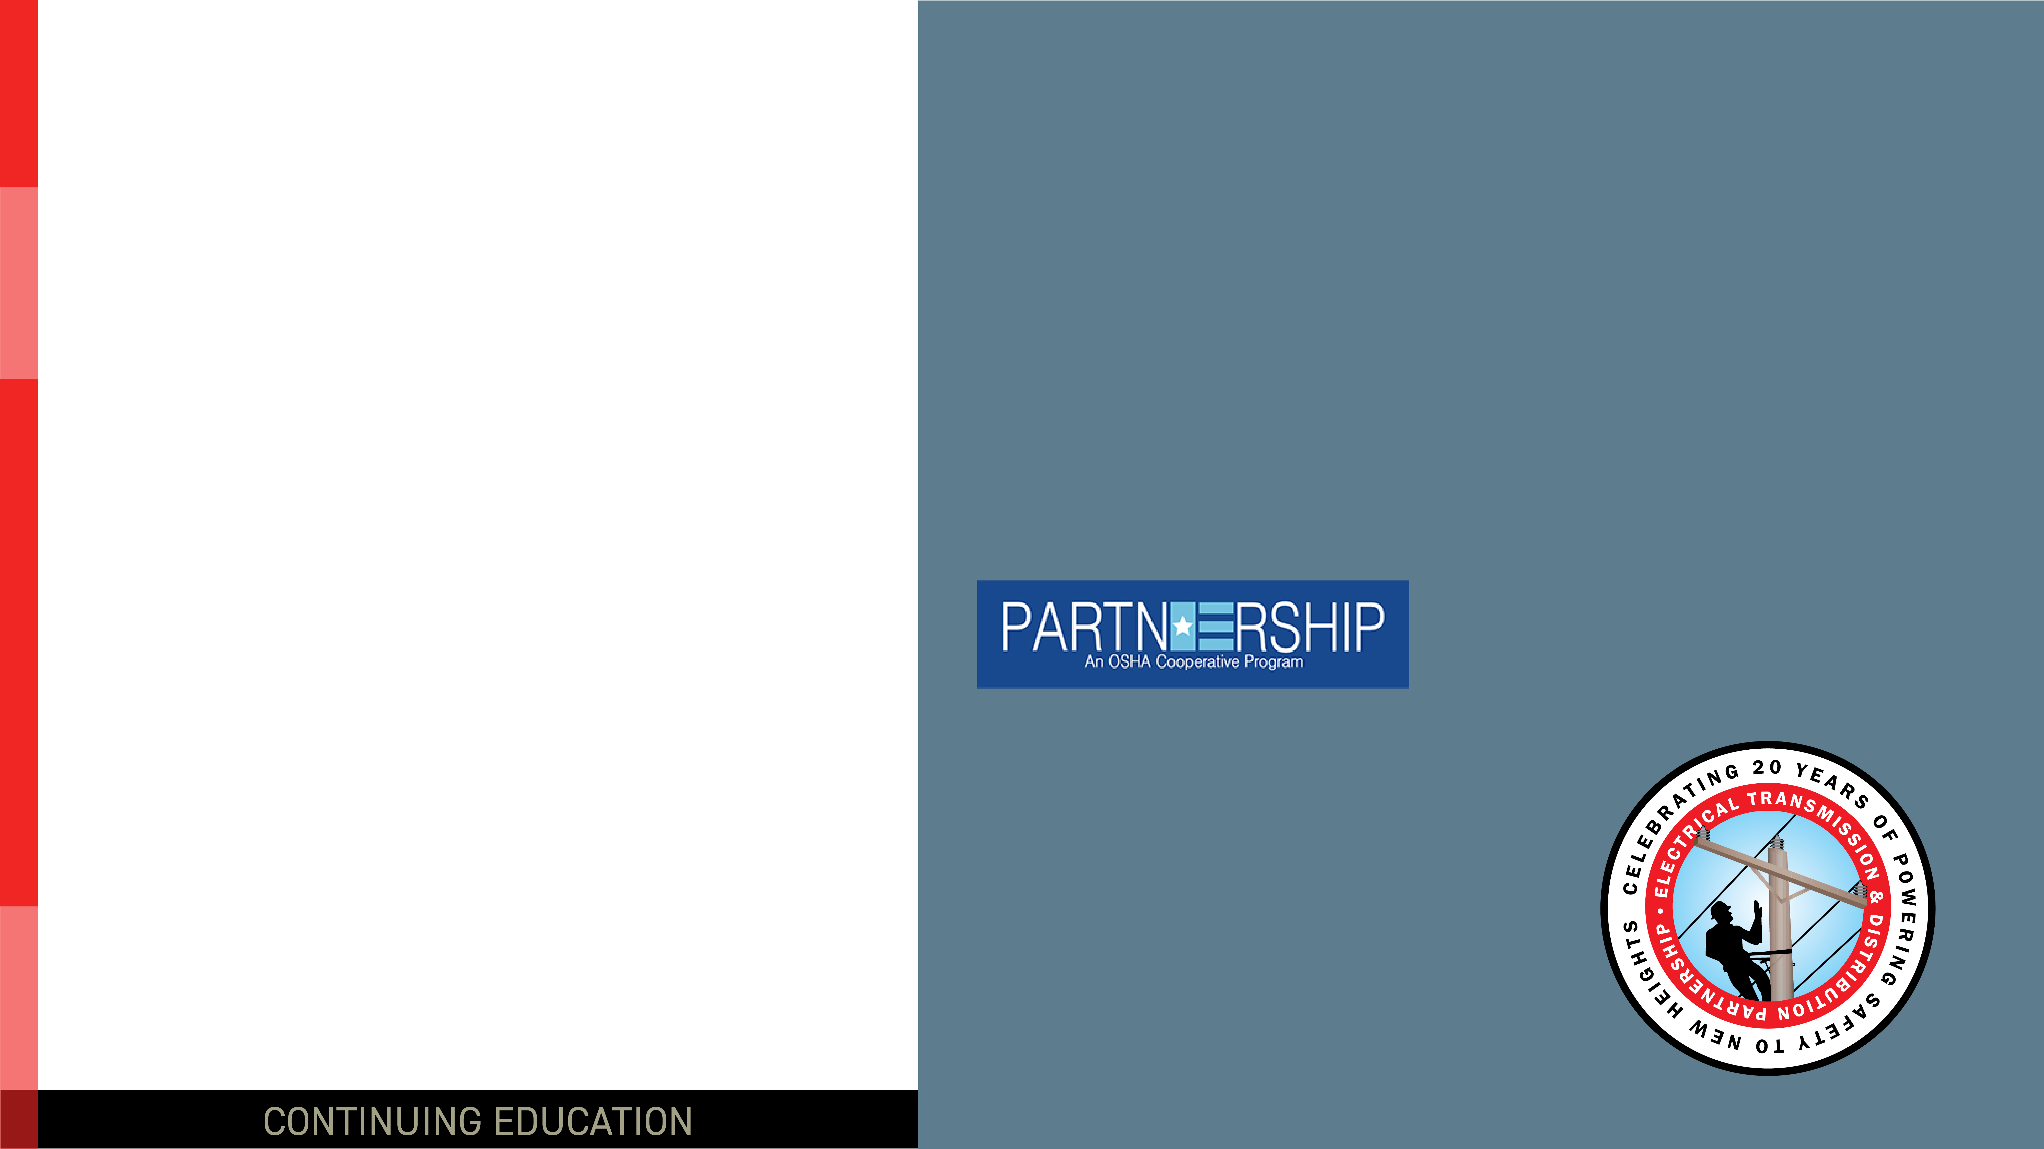
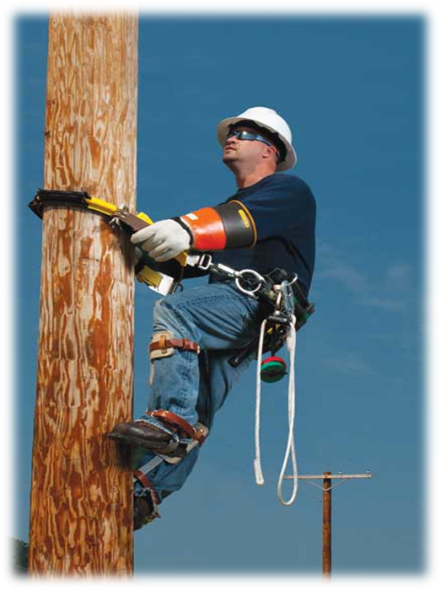
Fall Protection Safety at Heights Best Practice
OSHA ELECTRICAL TRANSMISSION & DISTRIBUTION PARTNERSHIP
1st Quarter 2026
Notes:
Introduce the module. Explain to the group that this module will discuss some general fall protection requirements and requirements for employees engaged in power transmission and distribution work.

Slide 2

Why This Matters?
OSHA Partnership 300 Log Analysis for Calendar Year 2024
Of the 52 total SIF events recorded in 2024, 14 were identified as having an applicable Partnership Best Practices.
13 SIF Events related to Falls From Elevations
25% of all recorded 2024 SIF Events resulted from Falls From Elevations
5 Equipment
3 Bucket Truck Access/Egress
3 Poles
2 Aloft in and Aerial Lift
*Data collected from the OSHA Partnership 300 Log Analysis for Calendar Year 2024*
Q1-2026 – Fall Protection – Safety at Heights
OSHA ELECTRICAL TRANSMISSION & DISTRIBUTION PARTNERSHIP
Notes:
Explain to the group the “WHY” behind the importance of this topic. Each year the Electrical Transmission and Distribution Partnership collects injury data from the partner companies. This data is then tabulated to determine how injuries are occurring within the partner companies. Of the 52 reported Serious Injury and Fatality (SIFs) events, 14 were identified as having an applicable Partnership Best Practice associated with that task. 13 SIF events were related to Falls from Elevations. That’s 25% of all recorded 2024 SIF’s events resulted from Falls from Elevations. Over the next few slides, we will review the OSHA ET&D Safety at Heights Best Practice.

Slide 3

Course Objectives
Understand the Safety At Heights Best Practice
Understand that protection from falls in an employer requirement
List the inspection requirements for Fall Protection Equipment (FPE) & Work Positioning Equipment (WPE)
Identify training requirements related to fall protection
Identify inspection requirements for Wood and Steel Structures
Describe the elements required in a Rescue Plan
Q1 - 2026 – Fall Protection – Safety at Heights
OSHA ELECTRICAL TRANSMISSION & DISTRIBUTION PARTNERSHIP
Notes:
The objectives of this course is to gain an understanding of the following topics:
Understand the Safety at Heights Best Practice
Understand that protection from fall is an employer requirement
List the inspection requirements for Fall Protection Equipment (FPE) and Work Positioning Equipment (WPE)
Identify training requirements related to fall protection
Identify inspection requirements for Wood and Steel Structures
Describe the elements required in a Resue Plan

Slide 4
Elements of OSHA’s Fall Protection Duty Requirements
Ensure the use of fall protection systems as follows:
Each employee working from an aerial lift shall use a fall restraint system or a personal fall arrest system.
Each employee more than 4 feet above the ground on poles, towers, or similar structures shall use a personal fall arrest system, work-positioning equipment, or fall restraint system
Determine if the surfaces on which its employees are to work have the strength and structural integrity to support employees safely
Ensure employees are trained in the use, care and inspection of equipment/systems
Q1 – 2026 - Fall Protection – Safety at Heights
OSHA ELECTRICAL TRANSMISSION & DISTRIBUTION PARTNERSHIP
Notes:
OSHA requires employers to protect workers working at heights from falls. This include working from an aerial lift, 4 feet above the ground on poles, towers or similar structures. Employers are also required to determine the structural integrity of the walking/working surfaces, as well as provide training to employees who are working at heights.

Slide 5
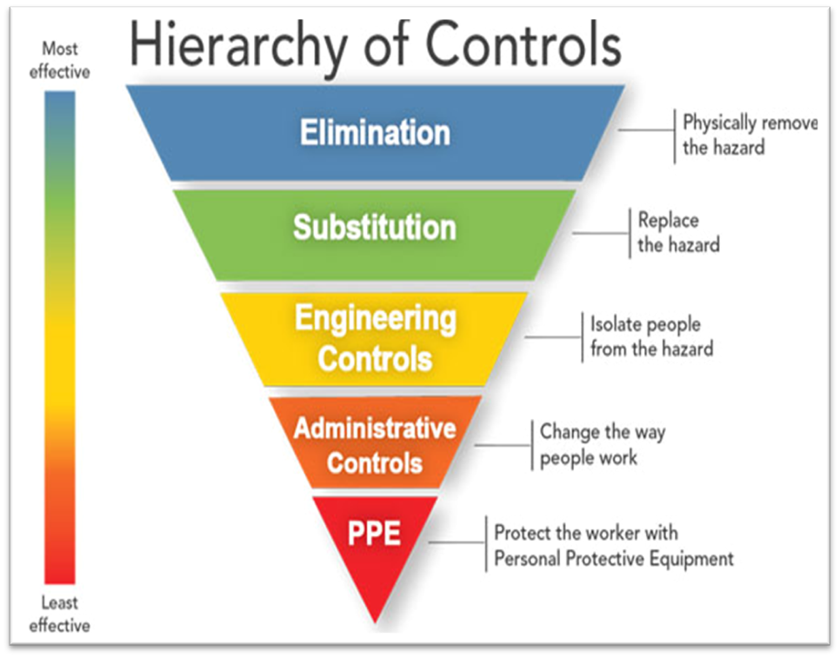
ET&D Safety at Heights Best Practice
The Partnership is committed to the practice of Safety at Heights wherever the potential exists for personnel falling from heights.
This Best Practice:
Addresses fall hazards associated with but not limited to aerial tasks performed on wood/steel poles and metal lattice structures.
Uses the Hierarchy of Controls to eliminate or control fall hazards.
Q1 – 2026 - Fall Protection – Safety at Heights
OSHA ELECTRICAL TRANSMISSION & DISTRIBUTION PARTNERSHIP
Notes:
The Electrical Transmission and Distribution Partnership developed the Safety at Heights Best Practice. This Best Practice was developed as a guide for Employer’s and Employee’s to follow to mitigate/eliminate the hazards associated with working at heights in the industry. This Best Practice addresses the fall hazards associated with but not limited to aerial tasks performed on wood/steel poles and metal lattice structures. Employer’s and Employees should aways utilize the Hierarchy of Controls when controlling all hazards.

Slide 6
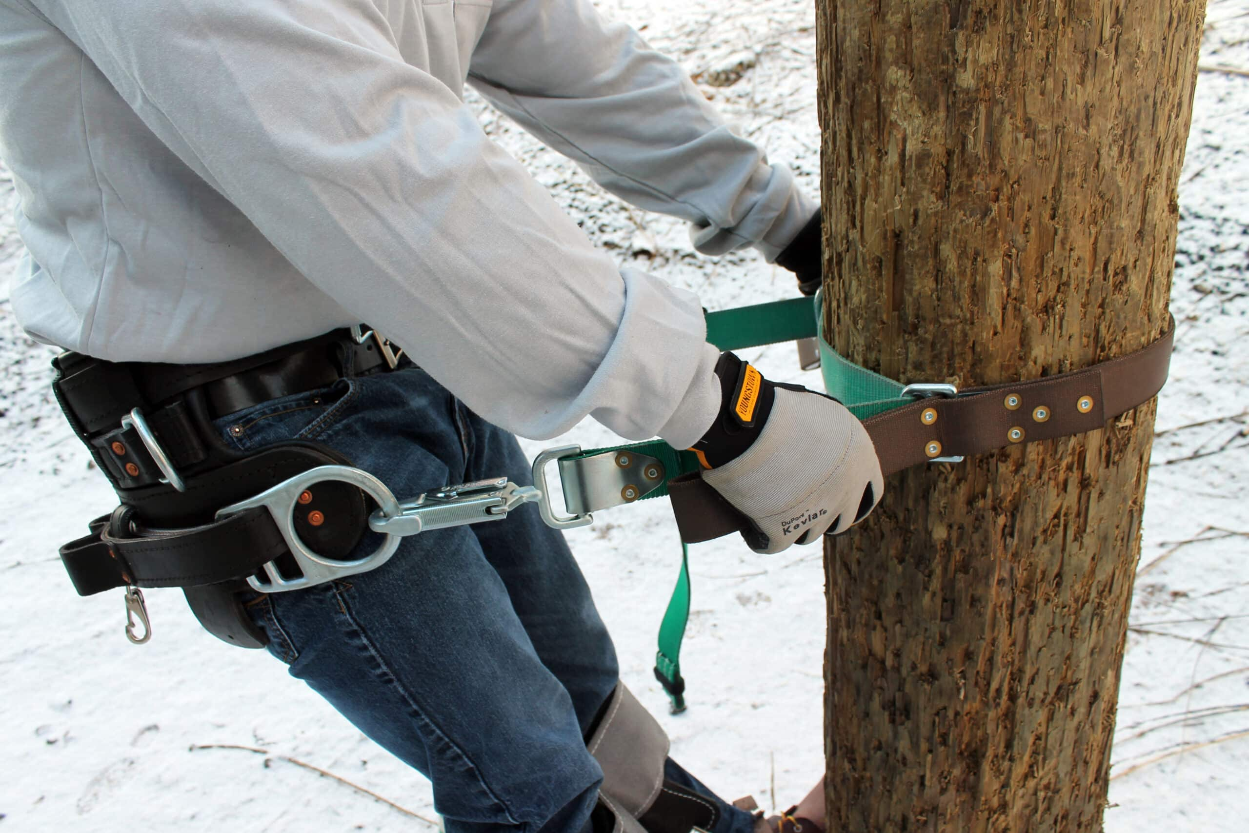
Safety at Heights – Best Practice
Practice Statement:
Fall Protection Equipment (FPE) shall be used above 4 feet on poles, towers, or similar structures when:
Ascending
While in the working position
When changing positions
Descending
And/or Performing Rescue Operations
Q1 – 2026 – Fall Protection – Safety at Heights
OSHA ELECTRICAL TRANSMISSION & DISTRIBUTION PARTNERSHIP
Notes:
The Practice Statement of the Safety at Heights Best Practice states that: Fall protection equipment (FPE) shall be used above 4 feet on poles, towers, or similar structures when:
Ascending – going up the pole or structure
While in the working position
When changing positions on the pole or structure
Descending – coming down the pole or structure
And/or performing rescue operations

Slide 7
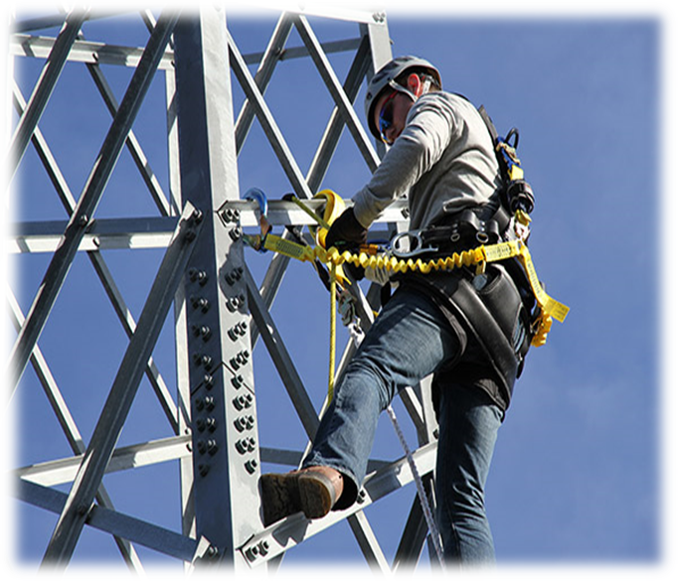
Safety at Heights – Best Practice
Practice Description
Fall hazards associated with aerial work shall be assessed and
fall hazard mitigation plans developed. Fall Protection Devices shall be “engaged” ground-to-ground
Q1 – 2026 – Fall Protection – Safety at Heights
OSHA ELECTRICAL TRANSMISSION & DISTRIBUTION PARTNERSHIP
Notes:
Explain that prior to ascending the pole or structure, the fall hazards associated with aerial work shall be assessed and fall hazard mitigation plans developed. Fall Protection Devices shall be “engaged” ground-to-ground.

Slide 8
Safety at Heights – Best Practice
Fall Protection Plan – Job Briefing
Identify tasks to be performed while working aloft.
Client/Owner Fall Protection policies, procedures and hazard analysis documentation as applicable.
Identify suitable anchorage points that are going to be used for the task to be performed.
Employers shall address rescue considerations and develop appropriate procedures that will allow successful performance of a given rescue technique for varied field conditions.
Determine/Identify necessary Fall Protection Equipment (FPE) and/or Work Positioning Equipment (WPE).
Determine climber qualification in the use of FPE and/or WPE.
Q1 – 2026 – Fall Protection – Safety at Heights
OSHA ELECTRICAL TRANSMISSION & DISTRIBUTION PARTNERSHIP
Notes:
The Best Practice requires that a Fall Protection Plan be developed prior to starting the work. The fall plan must address the following:
Identify the tasks to be performed while working aloft.
Client/Owner Fall Protection policies, procedures and hazard analysis documentation as applicable.
Identify suitable anchorage points that are going to be used for the task to be performed.
Employers shall address rescue considerations and develop appropriate procedures that will allow successful performance of a given rescue technique for varied field conditions.
Determine/identify necessary Fall Protection Equipment (FPE) and/or Working Positioning Equipment (WPE).
Determine climber qualification in the use of FPE and/or WPE

Slide 9
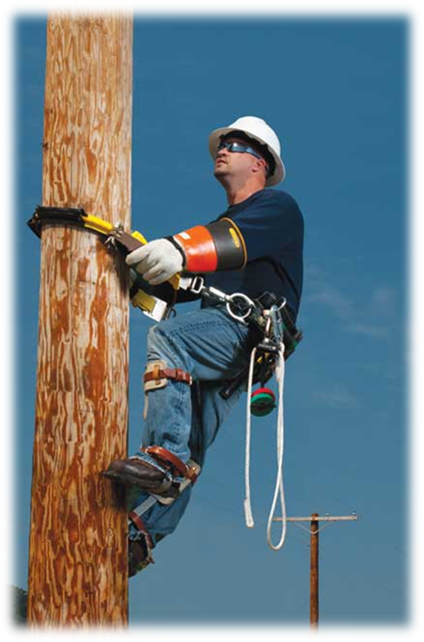
Safety at Heights – Best Practice
Qualified Climber
Until the employer ensures that employees are proficient in climbing and the use of fall protection the employees are not considered qualified employees
Q1 – 2026 – Fall Protection – Safety at Heights
OSHA ELECTRICAL TRANSMISSION & DISTRIBUTION PARTNERSHIP
Notes:
Explain that Employers are required to ensure that employees engaged in aerial work are qualified in the application of all necessary fall protection methods used for the fall hazard mitigation of the task that will be performed. These individuals also need to show proficiency in rescue operations.

Slide 10

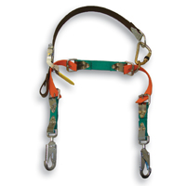
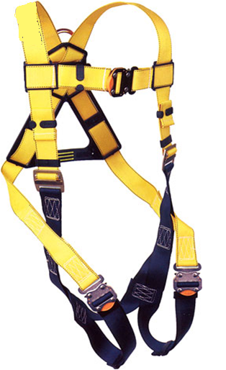
Safety at Heights – Best Practice
Inspection of Equipment
FPE/WPE shall be inspected before each use and used in accordance with the manufacturer’s instructions and guidelines.
Q1 – 2026 – Fall Protection – Safety at Heights
OSHA ELECTRICAL TRANSMISSION & DISTRIBUTION PARTNERSHIP
10
Notes:
Explain that all protective equipment must be inspected prior to use.
1926.954(b)(3): Care and use of personal fall protection equipment.
1926.954(b)(3)(i): Work‐positioning equipment shall be inspected before use each day to determine that the equipment is in safe working condition. Work‐positioning equipment that is not in safe working condition may not be used.
Visual Inspections shall be performed prior to, and during climbing, to ensure that the structure is in an acceptable condition for the safe execution of the tasks to be performed.
The following specific items of the worker’s body belt shall be inspected to determine that: hardware has no cracks, distortion or corrosion; no loose or worn rivets are present; waist strap has no loose grommets; no worn materials that could affect the safety of the user are present; d-rings are compatible with the snap hooks which they are used; and no non-approved modifications have been made to carry tools or materials. Not all d-rings are compatible with all snap hooks. This is why it is important that equipment from the same manufacturer is used. The incompatibility may cause roll-out or unintentional disengagement of the snap hook from the d-ring.

Slide 11
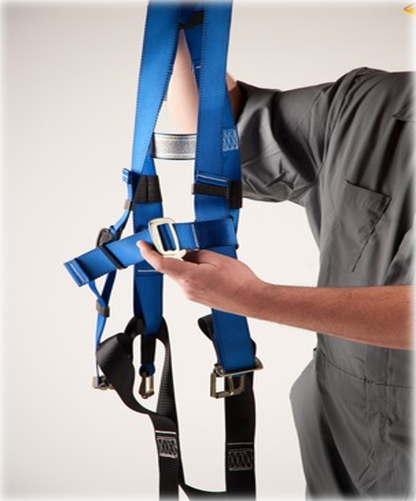
Safety at Heights – Best Practice
Inspecting FPE
Manufacturer’s markings
Missing pieces
Defects or damage
Alteration
UV exposure
Chemical exposure
Frayed webbing
Q1 – 2026 – Fall Protection – Safety at Heights
OSHA ELECTRICAL TRANSMISSION & DISTRIBUTION PARTNERSHIP
11
Notes:
The following specific items of the harness shall be inspected to determine:
Absence or illegibility of manufacturer’s markings
Absence of any elements affecting the equipment
Form, fit or function;
Evidence of defects or damage to hardware elements including:
cracks,
sharp edges,
deformation,
corrosion,
chemical attack,
excessive heating,
alteration and excessive wear.
Evidence of defects or damage to straps or ropes including:
fraying,
misplacing,
inlaying,
kinking,
knotting,
broken or pulled stitches,
excessive elongation,
chemical attack,
excessive soiling,
abrasion,
alteration,
needed or excessive lubrication,
excessive aging and excessive wear;
alteration, or absence of parts,
evidence of defects in, damage to or improper function of mechanical devices and connectors.

Slide 12
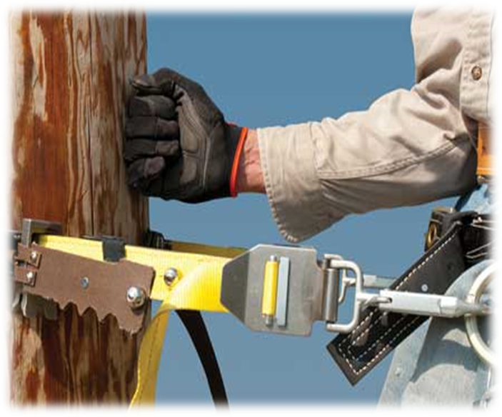
Safety at Heights – Best Practice
Inspecting WPE
The hardware has no cracks, nicks, distortion, or corrosion
No loose or worn rivets are present
The waist strap has no loose grommets
D-rings are compatible with the snap hooks.
No worn materials that could affect the safety of the user are present
Ensure proper adjustment to limit free-fall two (2) feet
Q1 – 2026 – Fall Protection – Safety at Heights
OSHA ELECTRICAL TRANSMISSION & DISTRIBUTION PARTNERSHIP
12
Notes:
The following specific items of the worker’s body belt shall be inspected to determine that: hardware has no cracks, distortion or corrosion; no loose or worn rivets are present; waist strap has no loose grommets; no worn materials that could affect the safety of the user are present; d-rings are compatible with the snap hooks which they are used; and no non-approved modifications have been made to carry tools or materials. Not all d-rings are compatible with all snap hooks. This is why it is important that equipment from the same manufacturer is used. The incompatibility may cause roll-out or unintentional disengagement of the snap hook from the d-ring. Employers and employees also need to ensure fitment and adjustment of WPE. WPE shall be adjusted to limit free fall to two (2) feet. If the WPE in improperly adjusted employees may fall more than two (2) feet causing additional injuries to the employees.

Slide 13

Safety at Heights – Best Practices
Training Requirements
Who is Trained?
On What?
By Whom?
Each employee who will be exposed to fall hazards
Qualified Trainers
Care, Use and Inspection of FPE / WPE
Selection and Safe use of the Equipment/System
Rescue procedures
Q1 – 2026 – Fall Protection – Safety at Heights
OSHA ELECTRICAL TRANSMISSION & DISTRIBUTION PARTNERSHIP
Notes:
Explain that the Employer is responsible for conducting the following training requirements:
Who is Trained?
Each employee who will be exposed to fall hazards
On What
Care, Use and Inspection of FPE / WPE
Selection and Safe Use of the Equipment/System
Rescue Procedures
By Whom
Qualified Trainers (Trainers who have the experience and knowledge of the subject matter)

Slide 14
Safety at Heights – Best Practice
Retraining
Changes in:
Workplace
Types of fall protection or equipment
Inadequacies in employee’s
Knowledge
And/or Use of FPE / WPE
Q1 – 2026 – Fall Protection – Safety at Heights
OSHA ELECTRICAL TRANSMISSION & DISTRIBUTION PARTNERSHIP
14
Notes:
Explain that retraining of employees is required when there are changes in the workplace and in types of fall protection equipment. Retraining is also required when there are inadequacies in employee’s knowledge of Fall Protection Requirement or a miss-use or failure to utilize Fall Protective Equipment.

Slide 15
Safety at Heights – Best Practice
Lattice Tower Structure Inspection
At a minimum, a visual inspection shall be performed prior to, and during climbing, to ensure that the structure is in an acceptable condition for the safe execution of the task to be performed.
Q1 – 2026 – Fall Protection – Safety at Heights
OSHA ELECTRICAL TRANSMISSION & DISTRIBUTION PARTNERSHIP
15
Notes:
Explain that at a minimum, a visual inspection shall be performed prior to, and during climbing, to ensure that the structure is in an acceptable condition for the safe execution of the task to be performed.

Slide 16
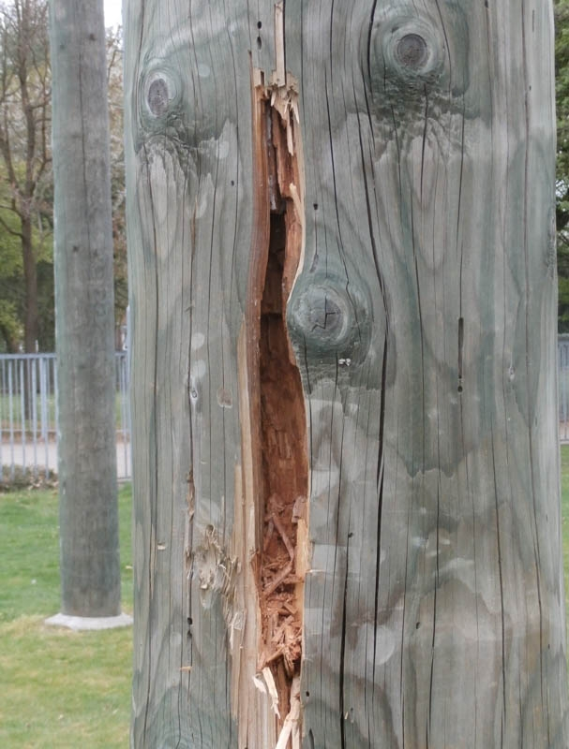
Safety at Heights – Best Practice
Wood Pole Inspection
What to inspect:
Working Pole: Pole being worked on
Adjacent Pole(s): Pole connecting working pole with wires, cables, phone, fiber optic, etc.….
Load Change: Any task that will alter the weight or strain on a pole
Q1 – 2026 – Fall Protection – Safety at Heights
OSHA ELECTRICAL TRANSMISSION & DISTRIBUTION PARTNERSHIP
16
Notes:
Explain that prior to climbing wood poles the Employer shall ensure that employees inspect the wood pole prior to climbing. Employees should not only inspect the pole they are going to climb, but they should also inspect the adjacent pole(s) connected by wires, cables, phone, fiber optic etc.… for integrity. It is important to consider changing loads on poles i.e., removing or installing conductor. These types of load changes can have an impact on multiple poles or structures.

Slide 17
Safety at Heights – Best Practice
Wood Pole Inspection
What to inspect for:
General condition of the pole
Cracks – Horizontal / Vertical
Holes
Shell rot and decay
Knots
Depth of setting
Soil conditions
Burn Marks
Q1 – 2026 – Fall Protection – Safety at Heights
OSHA ELECTRICAL TRANSMISSION & DISTRIBUTION PARTNERSHIP
17
Notes:
When visually inspection wood poles look for:
General condition of the pole
Cracks – Horizontal / Vertical
Holes
Shell rot and decay
Knots
Depth of setting
Soil conditions
Burn Marks

Slide 18
Safety at Heights – Best Practice
Wood Pole Inspection
How to Inspect
Sounding with a hammer
Strike the pole with a 3lb hammer every 2-3 ft upward to a height of 6ft.
A sturdy pole should give a solid sound, and the hammer should rebound sharply
Probe/Prod Test
Probe the pole downward at a 45° angle from the groundline to 6” below grade using a pole prod or a screwdriver with a 5” blade.
If the probing tool penetrates with little pressure, there may be decay below the ground.
If there is any doubt about the condition of pole or a Probe/Prod Test cannot be completed, dig approximately 12” down and probe the pole
Q1 – 2026 – Fall Protection – Safety at Heights
OSHA ELECTRICAL TRANSMISSION & DISTRIBUTION PARTNERSHIP
18
Notes:
Other industry preferred methods of testing wood poles in the Hammer Test and Probe/Prode Test. These tests should be completed prior to climbing any wood pole.
Sounding with a Hammer
Hit the pole sharply with a 3-pound hammer, starting near the ground line and continuing upwards circumferentially around the pole to a height of approximately 6 feet. The hammer will produce a clear sound and rebound sharply when striking sound wood. Decay pockets will be indicated by a dull sound or a less pronounced hammer rebound
Probe/Prod Test
For determining the integrity of the pole below ground, probe the pole using screwdriver with at least a 5” blade. Probe the pole downward at a 45-degree angle from the ground line along multiple sides of the pole. If the screwdriver or similar tool penetrates the pole with little pressure, there may be decay.
If there is any doubt about the condition of pole or a Probe/Prod Test cannot be completed, dig approximately 12” down and probe the pole.

Slide 19
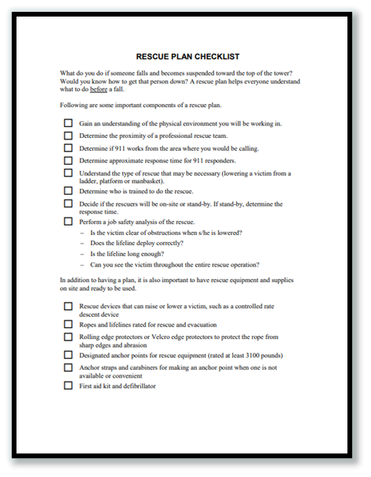

Safety at Heights – Best Practice
Rescue Plan Requirements
Rescue Plan shall be discussed by all crew members, and be specific to the work location
Self Rescue
Assisted Rescue
Q1 – 2026 – Fall Protection – Safety at Heights
OSHA ELECTRICAL TRANSMISSION & DISTRIBUTION PARTNERSHIP
19
Notes:
Explain the Requirement of having a rescue plan.
Self-Rescue
Sometimes when an employee takes a fall, he/she can rescue him/herself. Depending on how far he/she fell, it might be as simple as pulling him/herself back onto the platform or equipment. Employees who use SRL’s are typically able to rescue themselves. Self-retracting lifelines, or SRL’s, are supposed to stop a fall within a maximum of 3.5 feet. But because SRL’s can be extended up to 50 feet or more, employees need to account for swing radius. If an employee has an SRL extended out to 20 feet, he/she could end up falling much further than 3.5 feet.
Assisted Rescue
When an employee is unable to pull him/herself to safety, others working nearby must jump to action. They just must be trained. Depending on the severity of the situation, you might want to call 911 anyway. But don’t wait for them to arrive -- remember, you need to get the employee down as quickly as possible.

Slide 20
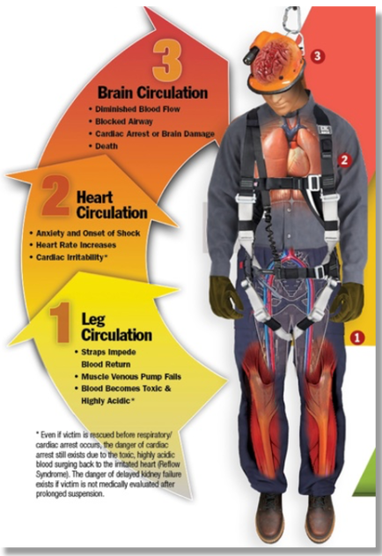
Safety at Heights – Best Practice
Suspension Trauma
Perform rescue and treatment as quickly as possible
Recognize signs and symptoms of suspension trauma
Minimize suspension time
Q1 – 2026 – Fall Protection – Safety at Heights
OSHA ELECTRICAL TRANSMISSION & DISTRIBUTION PARTNERSHIP
20
Notes:
Suspension trauma is a deadly condition brought on by an extended period of orthostatic intolerance. Orthostatic intolerance happens when a person remains in a sedentary position for a prolonged period. Blood accumulates in the veins and interferes with proper blood flow.
When blood cannot circulate throughout the body, vital organs do not get enough oxygen. Without an adequate supply of oxygen to the brain, fainting will occur. Kidney failure can also happen, as the kidneys require oxygen-rich blood to function properly
If not addressed quickly, these conditions could be fatal.
Prolonged suspension from fall arrest systems could cause orthostatic intolerance. The suspension trauma that employees can experience will result in unconsciousness first, potentially followed by death. This can all occur within 20-30 minutes.

Slide 21
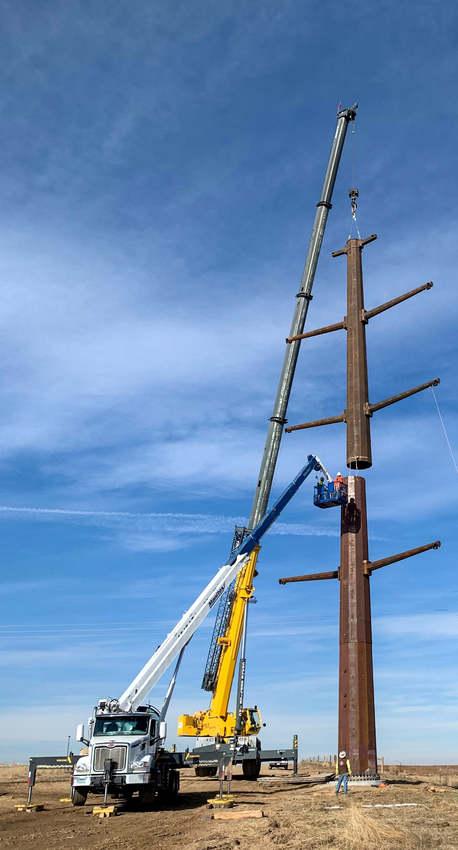
Safety at Heights – Best Practice
Alternative Work Methods
“Company policies shall apply when the conditions of this Best Practice cannot be met. Alternative work methods ensuring climber safety shall be identified, communicated to all affected climbers, implemented, and documented as a part of the Job Briefing process”.
Q1 – 2026 – Fall Protection – Safety at Heights
OSHA ELECTRICAL TRANSMISSION & DISTRIBUTION PARTNERSHIP
21
Notes:
Explain that the Electrical Transmission and Distribution Partnership developed the Safety at Heights Best Practice. This Best Practice was developed as a guide for Employer’s and Employee’s to follow to mitigate/eliminate the hazards associated with working at heights in the industry. This Best Practice addresses the fall hazards associated with but not limited to aerial tasks performed on wood/steel poles and metal lattice structures. There may be work situations where the requirements of this Best Practice cannot be met. In those situations, refer to additional company policies or reach out to Fall Protection Specialist for guidance.

Slide 22

Thank You!

