Slide 1

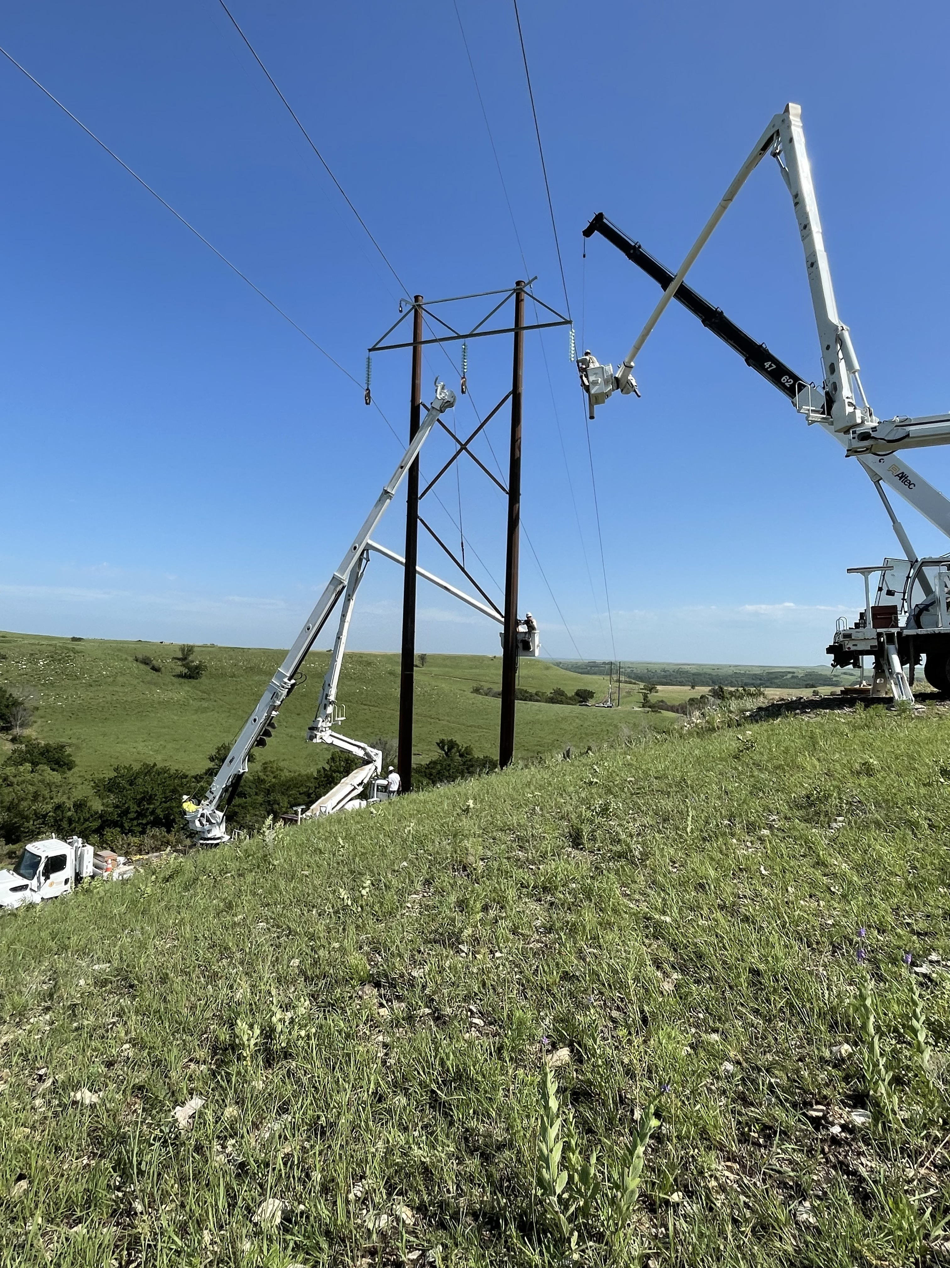
Safety Accountability
DEFINE & PLAN
OSHA ELECTRICAL TRANSMISSION & DISTRIBUTION PARTNERSHIP
4th QUARTER 2025

Slide 2

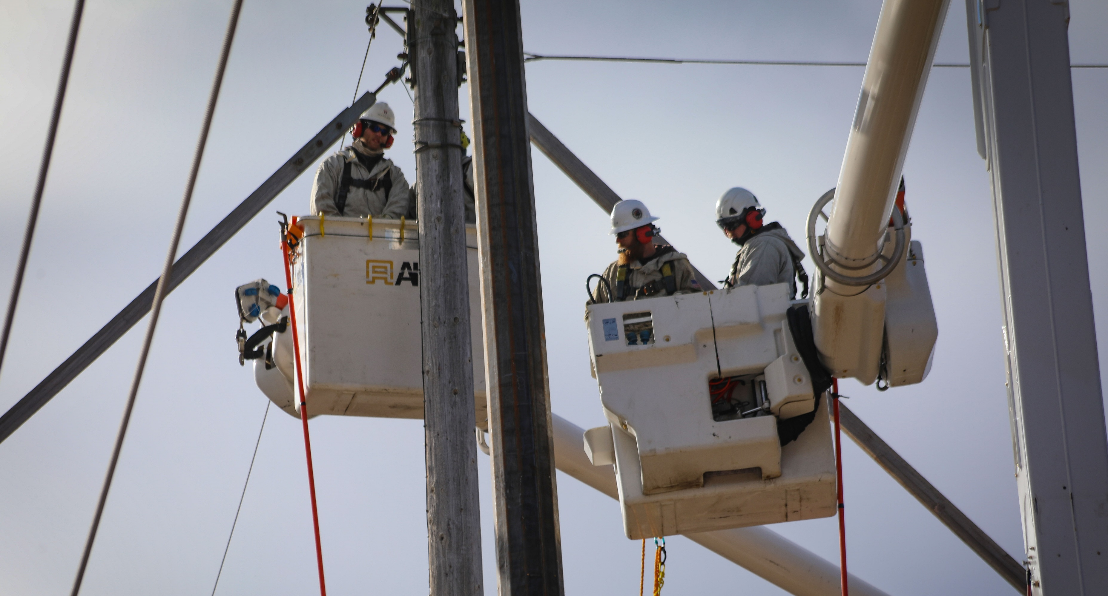

Introduction
Leadership is defined as ANY INDIVIDUAL who takes personal responsibility for his or her performance as well as the company’s or crew’s performance and attempts to influence the improvement of the organization that supports that performance
Q4 2025 – Define & Plan
OSHA ELECTRICAL TRANSMISSION & DISTRIBUTION PARTNERSHIP
Notes:
ANY INDIVIDUAL, this is the entire crew make-up from the Groundman to the General Foreman and Supervision.
Provide examples of your own to facilitate discussion.

Slide 3

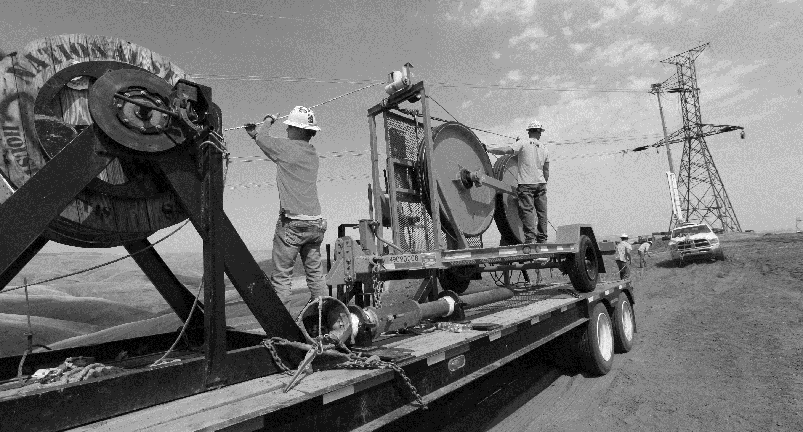
Purpose
The purpose of this presentation is to inform leaders how Defining and Planning can aid in establishing Safety Accountability within their work groups.
Q4 2025 – Define & Plan
OSHA ELECTRICAL TRANSMISSION & DISTRIBUTION PARTNERSHIP
Notes:
Define and Plan is the first step in establishing Safety Accountability, followed by Equip, Measure and lastly Recognize and Coach. This module will focus on explaining the “Why”, “When” and “How” of Define and Plan.

Slide 4

OBJECTIVES
Define Accountability
Discuss the benefits of establishing Accountability
Define the “Why” & “When” of establishing Accountability
Discuss the “How” to establish Accountability
Discuss the common barriers of establishing Accountability
Q4 2025 – Define & Plan
OSHA ELECTRICAL TRANSMISSION & DISTRIBUTION PARTNERSHIP
4
Notes:
During this module we will cover the following topics:
Define Accountability
Discuss the benefits of establishing Accountability
Define the “Why” & “When” of establishing Accountability
Discuss the “How” to establish Accountability
Discuss the common barriers of establishing Accountability

Slide 5
Safety Accountability
Define & Plan
Q4 2025 – Define & Plan
OSHA ELECTRICAL TRANSMISSION & DISTRIBUTION PARTNERSHIP
5

Slide 6

What is Accountability
Accountability can be divided into two areas:
Personal Accountability
  Holding oneself to the standards set by self, team, and organization
Team/Organizational Accountability
  Ensuring people do what the team and/or organization expects and needs
Q4 2025 – Define & Plan
OSHA ELECTRICAL TRANSMISSION & DISTRIBUTION PARTNERSHIP
Notes:
Before we discuss how to establish Accountability, we must first define what Accountability “is”. Accountability is the act holding oneself to a set of standards set by either self, a team or an organization. This Module divides Accountability into two areas: Personal and Team/Organizational. Leaders should strive to establish Personal Accountability by “Walking the Talk” , as well as develop skills in fostering Team/Organizational Accountability. This section will focus on the first step to establishing Safety Accountability for the Team/Organization by discussing Define & Plan.

Slide 7
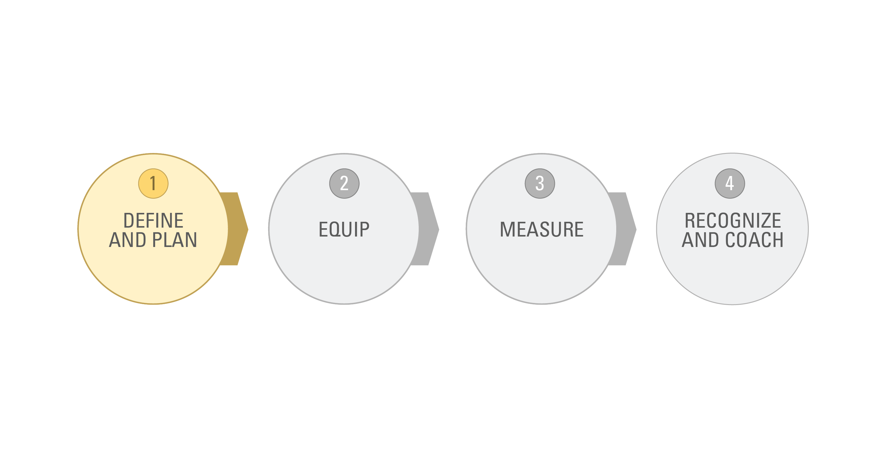
Four Steps to Establishing Accountability
Q4 2025 – Define & Plan
OSHA ELECTRICAL TRANSMISSION & DISTRIBUTION PARTNERSHIP
Notes:
As discussed earlier, Define and Plan is the 1st step in establishing Safety Accountability

Slide 8
“WHY” & “WHEN” TO ESTABLISH EXPECTATIONS
Define & Plan
Q4 2025 – Define & Plan
OSHA ELECTRICAL TRANSMISSION & DISTRIBUTION PARTNERSHIP
8

Slide 9
Reason Workers Don’t Do What’s Expected
They didn’t know you wanted them to do it
They didn’t have the right materials or equipment
They didn’t get any feedback after doing it
They didn’t know how to do it
They didn’t want to do it in the first place
The feedback they received was meaningless or confusing
Q4 2025 – Define & Plan
OSHA ELECTRICAL TRANSMISSION & DISTRIBUTION PARTNERSHIP
9
Notes:
Review the items within each box on the slide.
A strong system of Safety Accountability addresses all the issues listed here.
Have you ever noticed any of these issues in your past or current role?

Slide 10
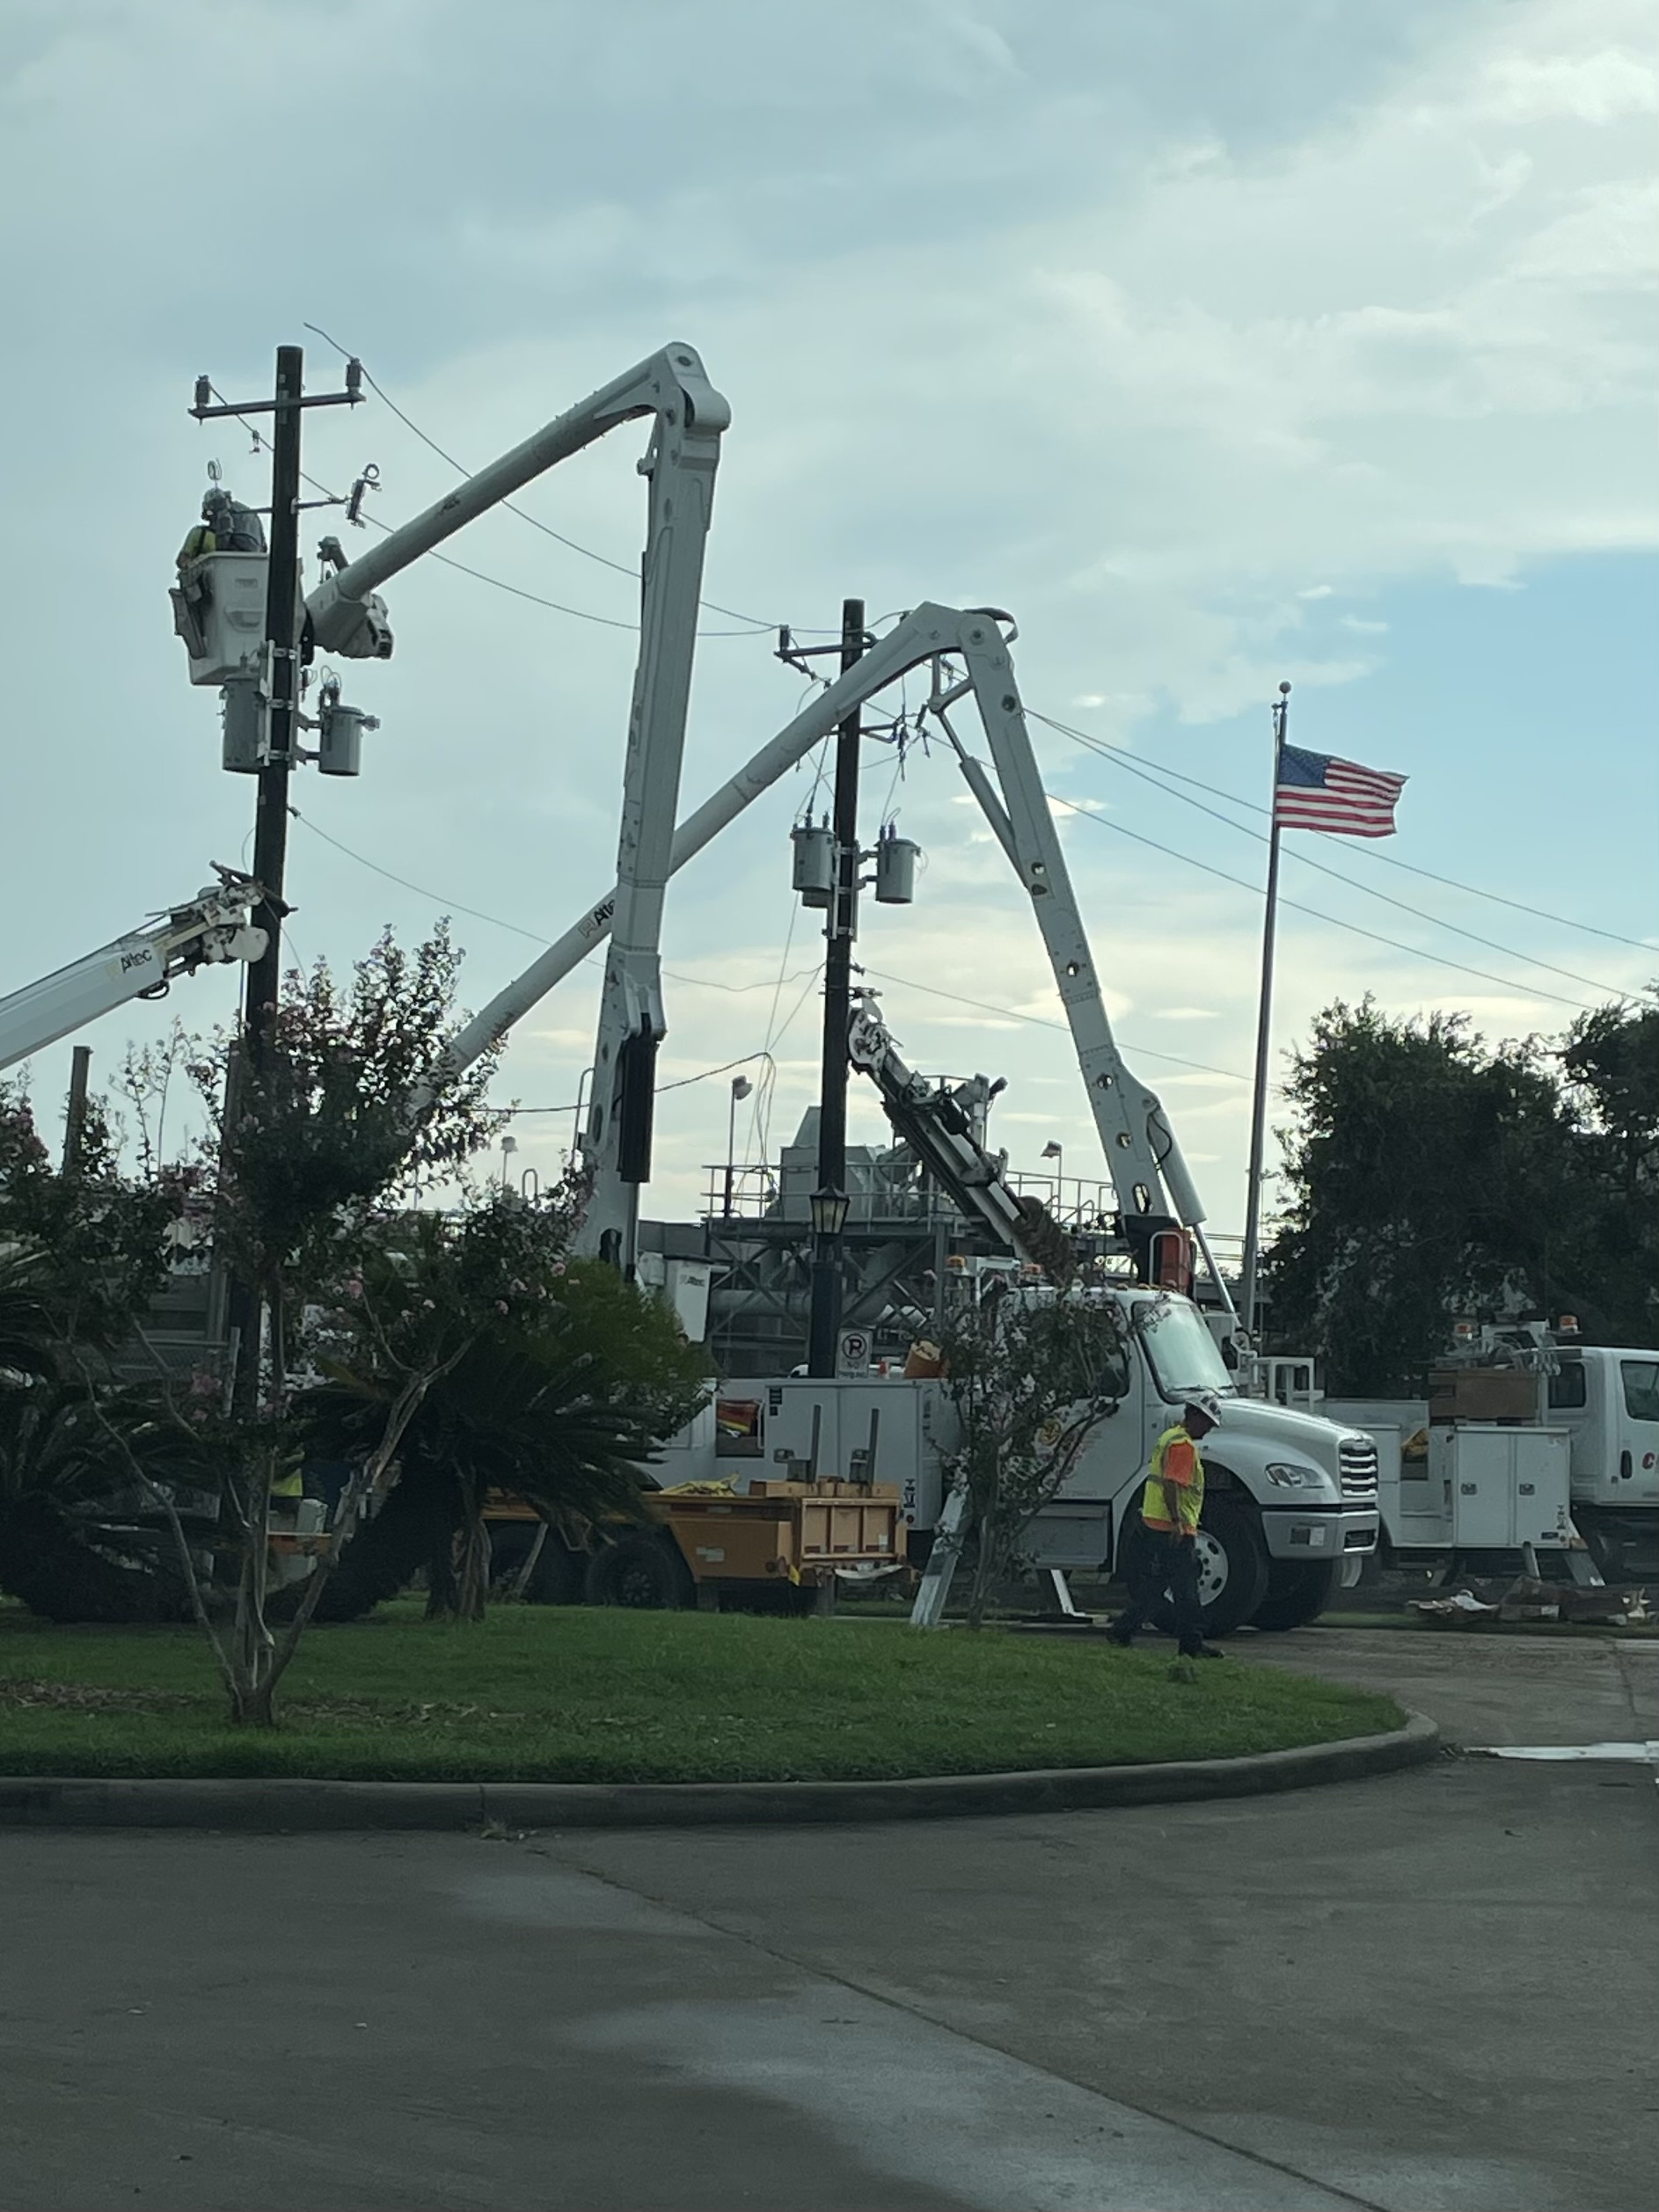
“Why” Set Expectations
Workers understand expectations of doing the task
No one can say they didn’t know
Safety, Quality, and Production improve
Gives workers clear boundaries and expectations to follow
People try to do what they think their boss expects
Improvement is sustained for the individual and the organization
Q4 2025 – Define & Plan
OSHA ELECTRICAL TRANSMISSION & DISTRIBUTION PARTNERSHIP

Slide 11
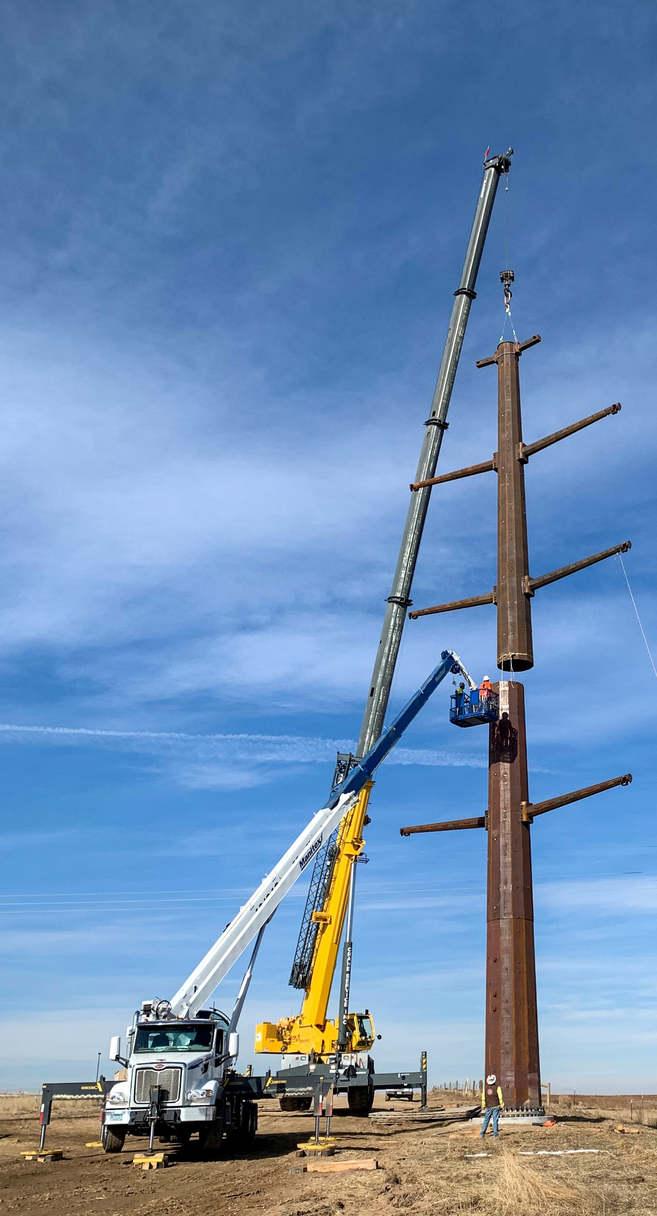
“WHEN” to Set Expectations
At the beginning
  During the onboarding process
  When new expectations or changes occur
Every day as we interact with our employees
Periodic Summary Discussions
Q4 2025 – Define & Plan
OSHA ELECTRICAL TRANSMISSION & DISTRIBUTION PARTNERSHIP
11
Notes:
Safety Expectations should be set early and revisited often to ensure compliance.
This module breaks the process into three areas:
At the beginning – During the onboarding process e.g., New Hire Orientation , when a new crew member joins the crew, and anytime new expectations or changes in process or policy.
Every day we interact with our employees – Leaders should routinely revisit the Safety Expectations
Periodic Summary Discussion – Provides an opportunity for Leaders to give constructive feedback to initiate change.

Slide 12
“WHEN” At the Beginning
During the onboarding process or when new expectations or changes occur
Share your intent
Communicate to create accountability
  Job role expectations
  Training and resources needed
  How performance will be measured
  How feedback will be given
Agree on how to communicate the difficult messages
Q4 2025 – Define & Plan
OSHA ELECTRICAL TRANSMISSION & DISTRIBUTION PARTNERSHIP
12
Notes:
Share your intent as the leader of the team.
Communicate to create accountability
Clearly explain the job expectations and confirm understanding
Explain what resources are available and decide if additional training will be required
Describe how job performance will be measured – Show them what “Right Looks Like”
Explain how feedback will be given
Agree on how to communicate the difficult messages

Slide 13
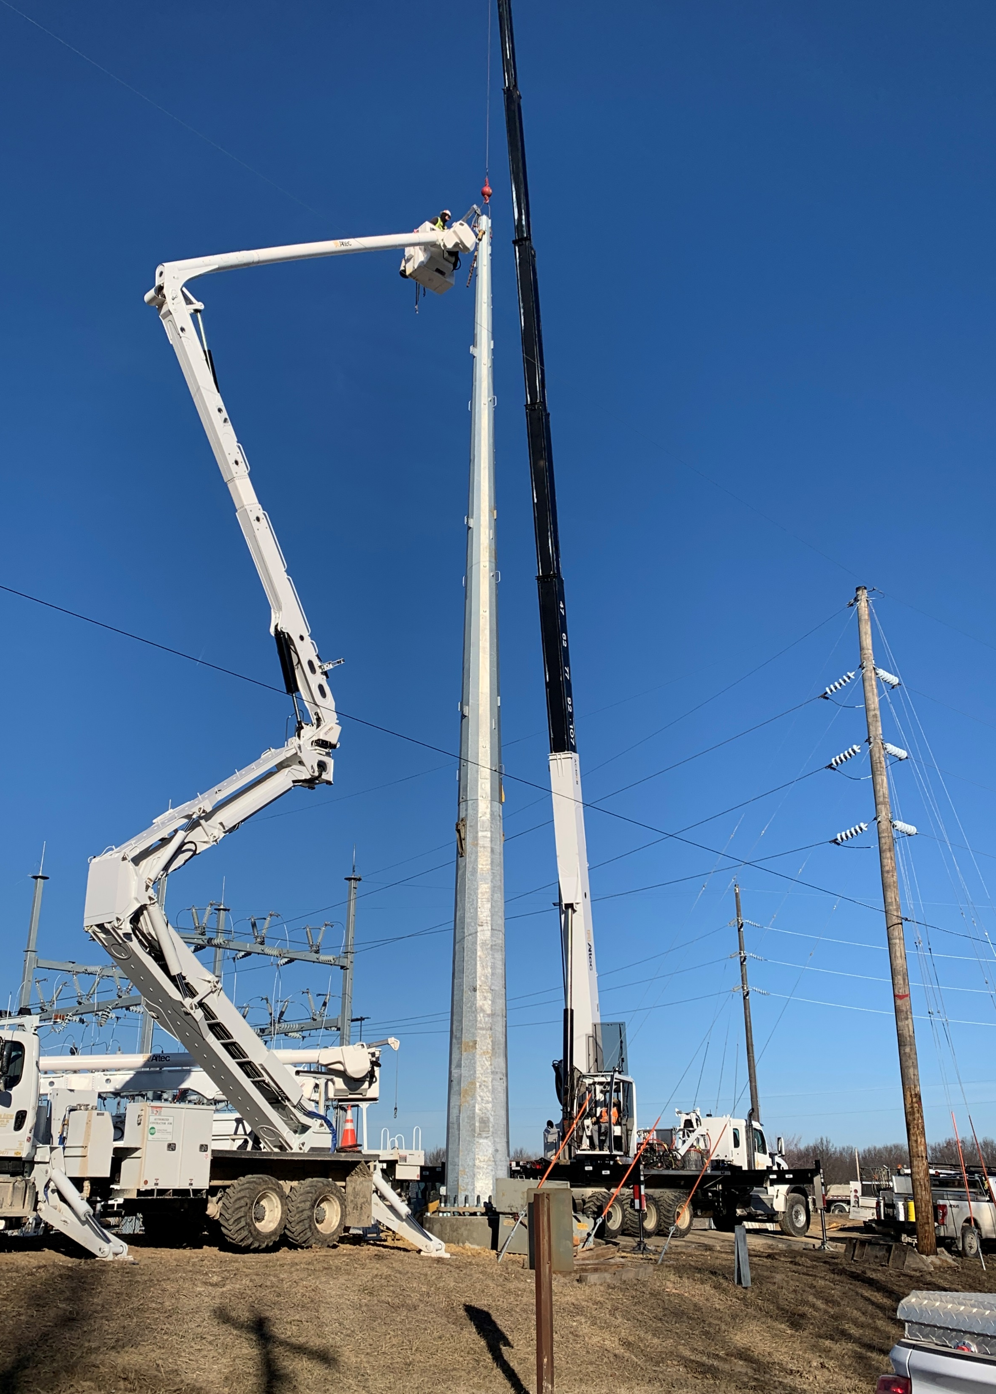

“WHEN” Every Day
As you interact with each other
Pay attention to what people are doing
Recognize what’s right!
Coach to improve what’s wrong
Reinforce standards and expectations at every opportunity
Q4 2025 – Define & Plan
OSHA ELECTRICAL TRANSMISSION & DISTRIBUTION PARTNERSHIP
13
Notes:
Once you’ve observed their performance, you then have a responsibility to provide feedback based on what you observe. If you notice them working safely and accurately, you should provide them with positive recognition. Positive recognition is the single-most powerful thing you can do to steer them toward safe work and reinforce what you expect them to do. It’s easy, positive, and should be well received

Slide 14
Periodic Summary “WHEN”
Employees
Leaders
Once per quarter
Prepare them for what will be discussed
Current status
Future goals and development needs
Employee does most of the talking
Once per month
Structured according to what’s important
Subordinate does most of the talking
Discuss SMART goals that have established
Q4 2025 – Define & Plan
OSHA ELECTRICAL TRANSMISSION & DISTRIBUTION PARTNERSHIP
14
Notes:
To aid in establishing Accountability among work groups, Leaders should conduct Periodic Summary discussions of the established Safety Expectations. For field level employees, it is recommended that this discussion takes place on a quarterly basis. For individuals in Leadership roles, it is recommended that these discussions take place monthly. These discussions should be sincere and focused on providing constructive feedback.

Slide 15
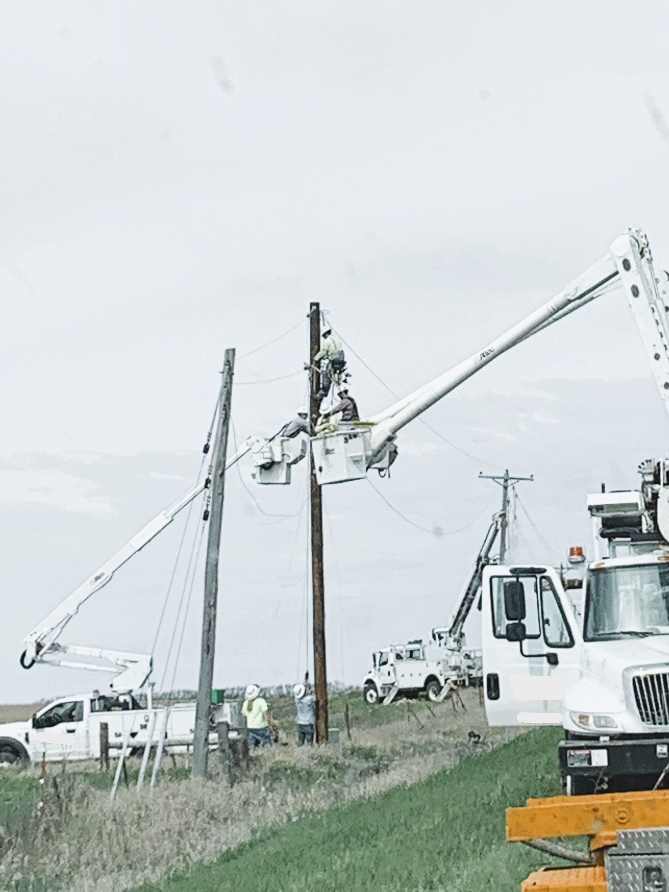
S.M.A.R.T GOALS
S – Specific
M – Measurable
A – Actionable, Attainable
R – Realistic, Relevant
T – Time-Bound
Q4 2025 – Define & Plan
OSHA ELECTRICAL TRANSMISSION & DISTRIBUTION PARTNERSHIP
Notes:
SMART goal setting provides a process for making sure goals are clearly written for the best chance of accomplishment.
The goals should be:
Specific – Make your goals specific and narrow for more effective planning.
Measurable – Define what evidence will prove you’re making progress and reevaluate when necessary.
Actionable/Attainable – Make sure you can reasonably accomplish your goal within a certain timeframe.
Realistic/Relevant – Your goals should align with your values and long-term objectives.
Time-Bound – Set a realistic ambitious end-date for task prioritization and motivation.
By rule of thumb, the more clearly a goal is stated, the more likely it is to be achieved. The SMART goal-setting process helps you accomplish this.

Slide 16
SECTION SUMMARY
Definition of Leadership
Accountability
Why and When to establish expectations
SMART Goals
Q4 2025 – Define & Plan
OSHA ELECTRICAL TRANSMISSION & DISTRIBUTION PARTNERSHIP
Notes:
Review of the Section Key Points:
Definition of Leadership
What does it mean to each person
Accountability
Both personal and team
Why and When to establish expectations
Beginning, Each Day, Periodic Summaries
SMART Goals

Slide 17
“HOW” TO ESTABLISH EXPECTATIONS
Define & Plan
Q4 2025 – Define & Plan
OSHA ELECTRICAL TRANSMISSION & DISTRIBUTION PARTNERSHIP
17

Slide 18
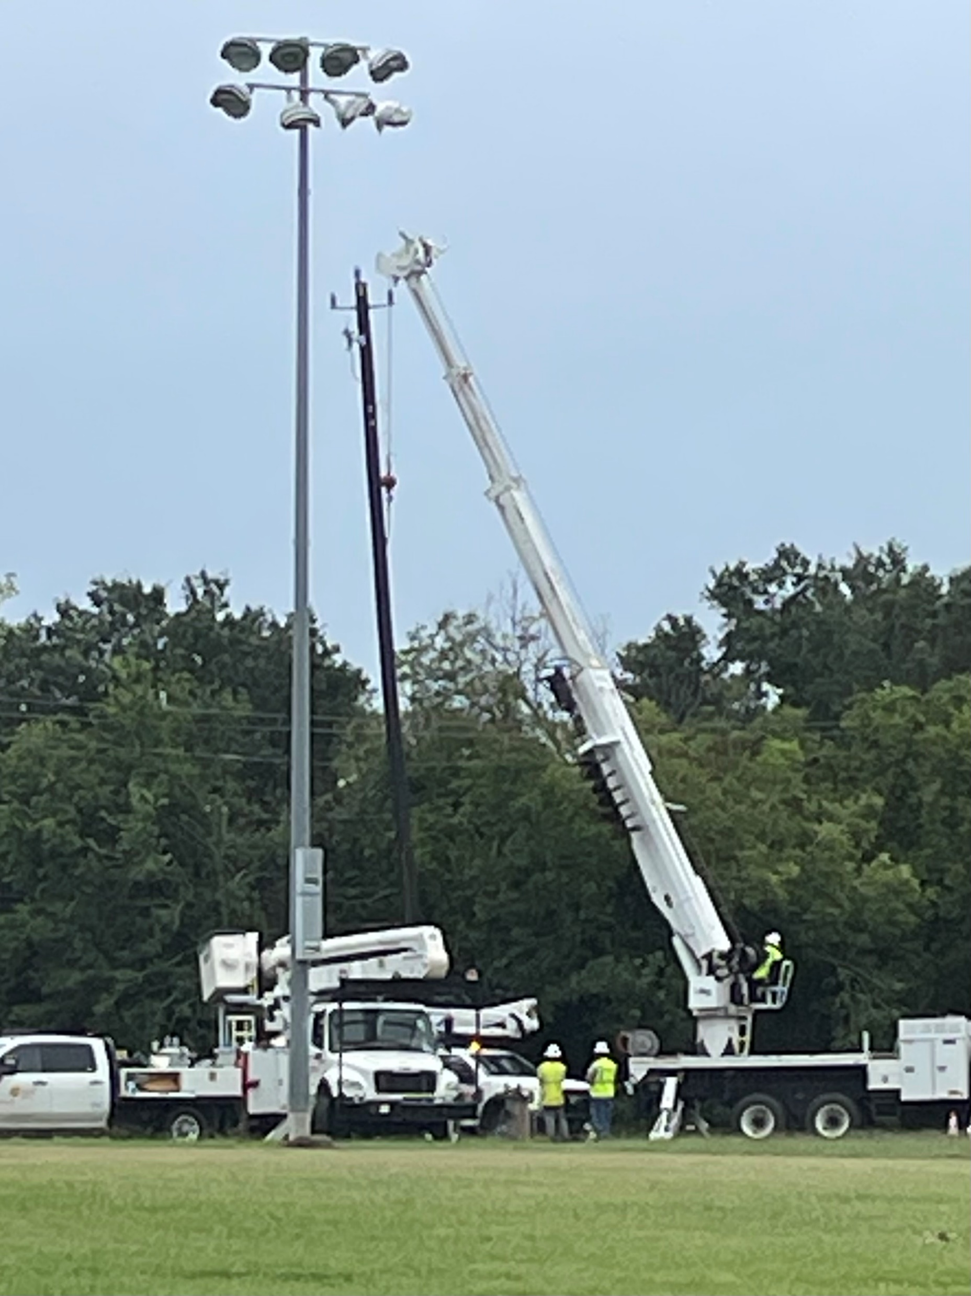
“HOW” to Set Expectations
Clearly and Specially
Firmly
Positively
Do not emphasize competing priorities such as speed
Q4 2025 – Define & Plan
OSHA ELECTRICAL TRANSMISSION & DISTRIBUTION PARTNERSHIP
Notes:
To deter from fuzzy or unclear expectations Leaders should utilize these 4 tools when setting Expectations:
Be clear and specific about what your expectations are. Allow for questions and explain the “Why”.
Be firm with your message, this will ensure that employees understand the importance and will be more engaged in the message.
Recognize what is being done right. Reward/Praise employees for expectable behaviors.
Do not emphasize competing priorities, such as speed. This could send the wrong message that production is more important than quality or safety.

Slide 19
COMMON BARRIERS
Define & Plan
Q4 2025 – Define & Plan
OSHA ELECTRICAL TRANSMISSION & DISTRIBUTION PARTNERSHIP
19

Slide 20
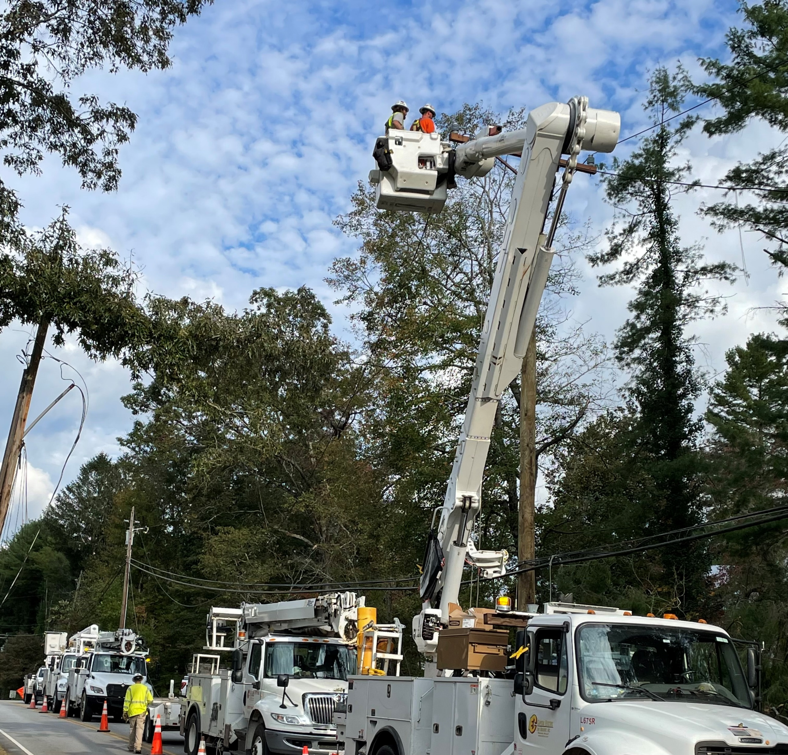
Common Barriers
Time Pressure
Failing to view it as a value vs a priority
Not sure what the expectations are or should be
“My boss never asks me about it”
  "My boss never asks me if I've completed the job briefing for the day."
“My boss doesn’t set expectations with me"
Q4 2025 – Define & Plan
OSHA ELECTRICAL TRANSMISSION & DISTRIBUTION PARTNERSHIP
20
Notes:
Some of the Common Barriers associated with Communicating and Setting Expectations are listed on the slide. Our goal as Leaders should be to break down these barriers by clearly communicating our Safety Expectations of all team members.

Slide 21
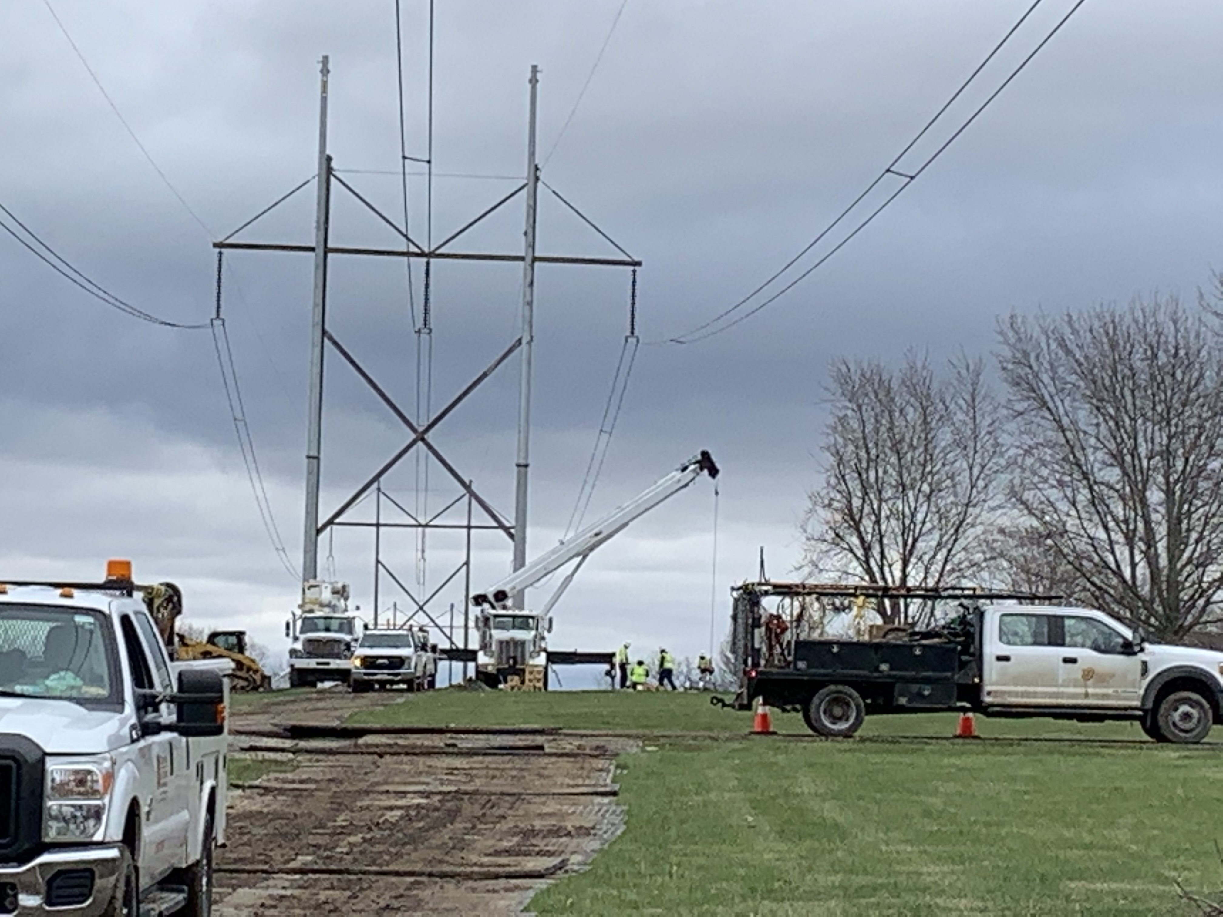
Common Barriers Cont.
“Didn’t know it was my job”
Pressure to get the job done from management or customer
Not understanding accountability
Lack of upper management support
Lack of SMART expectations
Q4 2025 – Define & Plan
OSHA ELECTRICAL TRANSMISSION & DISTRIBUTION PARTNERSHIP

Slide 22
Questions for Review
In this module Accountability was divided into two areas, what were they?
Name some of the reasons workers Don’t Do What’s Expected?
When should Expectations be set?
What are the 4 key points in “How” to set Expectations?
What does the acronym S.M.A.R.T. stand for when setting goals?
Q4 2025 – Define & Plan
OSHA ELECTRICAL TRANSMISSION & DISTRIBUTION PARTNERSHIP
Notes:
In this module Accountability was divided into two areas, what were they?
Personal
Team/Operational
Name some of the reasons workers Don’t Do What’s Expected?
They didn’t know you wanted them to do it
They didn’t have the right materials or equipment
They didn’t get any feedback after doing it
They didn’t know how to do it
They didn’t want to do it in the first place
The feedback they received was meaningless or confusing
When should Expectations be set?
At the beginning
Everyday
Periodically
What are the 4 key points in “How” to set Expectations?
Clearly and Specifically
Firmly
Positively
Do not compare competing resources
What does the acronym S.M.A.R.T. stand for when setting goals
Specific
Measurable
Achievable
Realistic
Time-Bound

Slide 23

Thank You!

