Slide 1
Cuts and Punctures
Continuing Education
Third Quarter 2019
Notes:
Introduce the module. Introduce the module. Explain that the intent of this presentation is as a continuing education training topic related to certain aspects from the ET&D 10-Hour OSHA training class, the OSHA Partnership Best Practices, and/or incident trending analysis. This training focuses on cuts and puncture hazards and how to prevent and protect against them.

Slide 2
Objectives
Upon Completion of this module you should be able to:
Describe the effects of cut and puncture injuries
Explain employer responsibilities regarding worker protection
Explain injury prevention
Explain workplace hazards that require protection
Select appropriate protection based on exposure
Notes:
Explain the module objectives and explain why this topic is important. Say that lacerations can occur anywhere and with any number of pieces of equipment. When it comes to protecting different parts of the body from lacerations, hands are the most important. This is because just over 40 percent of hand injuries are lacerations. That's huge. Imagine the difference removing those injuries would make. But how can we prevent these injuries? By targeting the two main casual factors: machinery and hand tools. More than 26% of machinery injuries are lacerations. When it comes to hand tools, more than 55% of injuries are lacerations. In both cases gloves can help, but innovative cutting tools designed for safety, and proper training and oversite may drastically reduce injuries. The Takeaway: It's unlikely that large specialized machinery has a big enough market to encourage the development of safer alternatives, so PPE is a company’s best friend here. Safer versions of cutting hand tools reduce injuries to one of the most delicate, complex and crucial parts of a worker's body.

Slide 3
Cuts and Punctures
Continuing Education
Third Quarter 2019
Session One

Slide 4
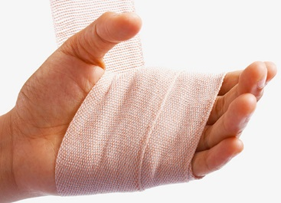
Facts
OSHA Statistics
In 2015 143,000 hand injuries
Employers are providing hand protection
Many injured workers were not wearing the protection
70% of injured workers were not wearing gloves
Notes:
Say that in 2015, there were 143,000 reported workplace hand injuries. The fact is that employers are providing hand protection like gloves available for employees. However, a quick look at OSHA’s hand injury stats reveals that workers were not wearing hand protection when injured. Actually over 70% of hand injuries in the United States occur to people are not wearing gloves. Another interesting fact is that although overall injuries go down on the weekends, laceration injuries account for a higher proportion of weekend injuries. We can speculate that workers are less likely to wear safety gloves on the weekend, but this is really just speculation.

Slide 5


Facts
Overall injuries go down on the weekends
However, laceration injuries account for a higher proportion of weekend injuries
Notes:
Say that in 2015, there were 143,000 reported workplace hand injuries. The fact is that employers are providing hand protection like gloves available for employees. However, a quick look at OSHA’s hand injury stats reveals that workers were not hand protection when injured. Actually over 70% of hand injuries in the United States occur to people are not wearing gloves. Another interesting fact is that although overall injuries go down on the weekends, laceration injuries account for a higher proportion of weekend injuries. We can speculate that workers are less likely to wear safety gloves on the weekend, but this is really just speculation.

Slide 6
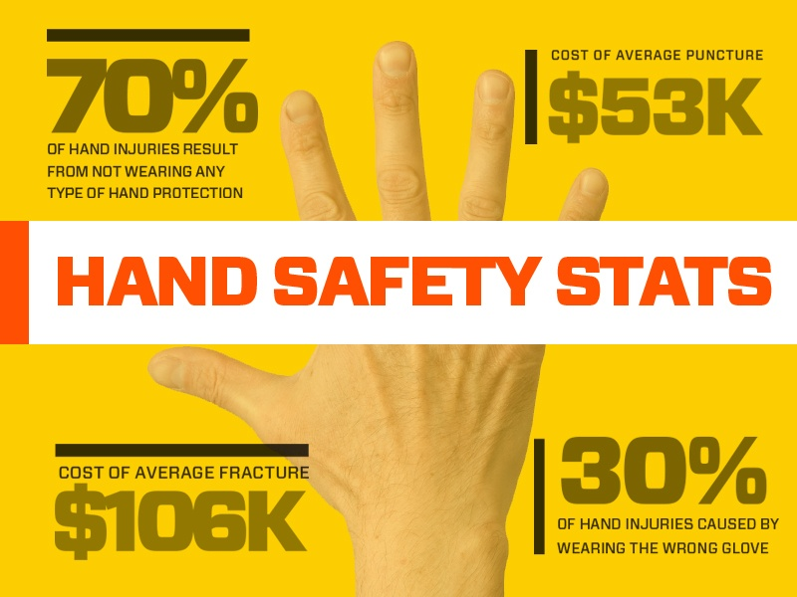

Notes:
Say that hand injury statistics reveal how costly and painful on-the-job injuries can be. These injuries don’t just hurt workers; companies suffer costs due to injuries, compounded by the loss of productivity. The question becomes: what is the true cost of an injury? Whether you’re searching for safety information to present to your company, or if you’re looking to learn more about hand injury statistics, check out our selection of surprising safety statistics that reveal the true cost of an injury. Clearly, the associated costs are tied to injury type. Next, let's break down incidents by injury type using data from The Bureau Of Labor Statistics.
There were 186,830 nonfatal occupational injuries to hands and wrists that involved days away from work
Wrist injuries led to 15 median days away from work and hand injuries led to 5 median days away from work
Number of injuries to hands and wrists by nature of injury are broken down as follows:
30,400 sprains, strains, and tears
17,000 fractures
12,300 pain and soreness
6,790 bruises and contusions
Information courtesy of Ringer Gloves. https://blog.ringersgloves.com/hand-injury-statistics

Slide 7

Results
Average five lost work days
Modified duty
Income loss
Possible loss of lively hood
Hard to do with an injured hand
Notes:
Say that in moderate to serious cases, hand injuries mean modified work duties and, in many situations, a loss in income because of the time off work. In more sever cases the worker could possible lose their lively hood.

Slide 8

Statistics
Hand injuries may not be deadly
They can make your daily life harder
Injuries to the hand are difficult to heal
Because of the way the hand moves
Hard to do with an injured hand
Notes:
Explain that while hand injuries may not be the deadliest, they can certainly make your day-to-day work much harder. Injuries to the hand can also be more difficult to heal because of the way the hand moves. Hand movement can cause a wound to reopen.

Slide 9

Young Workers
Twice as likely to be hurt
2016 13% of the total workforce is less that 24 years old
Effective training can benefit in injury reduction
In 2014, emergency room treatment for workers 15 to 19, was over 2 times greater than for workers 25 and older
Notes:
State that according to the Center for Disease Control (CDC) young workers have high rates of job-related injury. These injuries are often the result of the many hazards present in the places they typically work, such as sharp knives and slippery floors. Limited or no prior work experience and a lack of safety training also contribute to high injury rates. Middle and high school workers may be at increased risk for injury since they may not have the strength or cognitive ability needed to perform certain job duties.
Fast Stats:
In 2016, there were about 19.3 million workers under the age of 24. These workers represented 13% of the total workforce.
In 2015, 403 workers under the age of 24 died from work-related injuries.
In 2015, there were 24 deaths to workers under 18 years of age.
In 2014, the rate of work-related injuries treated in emergency departments for workers, ages 15–19, was 2.18 times greater than the rate for workers 25 years of age and older. In the same year, the rate of work-related injuries treated in emergency departments for workers, ages 20–24, was 1.76 times greater than the rate for workers 25 years of age and older.

Slide 10
Defensive Efforts
Less More
Effort
Safety More
Hazard elimination efforts and worker safety are directly proportional
Effectiveness
Less More
Notes:
Explain that the greater the effort toward hazard elimination, the greater the benefit to the worker, the company, the public, and their families. Undoubtedly, more effort takes more time, more planning, and more expense. The bottom line is it takes more effort to work safely. However the gains far outweigh the costs.

Slide 11
Key Points-Session One
In 2015, 70% of workers suffering a hand injury were not wearing gloves.
  True
  False
30% of hand injuries are a result of not wearing the proper glove.
  True
  False
On average, hand injuries result in 5 lost-time work days.
  True
  False
On average, young workers (< 25 years old) twice as likely to be injured as more experienced workers (25 and older).
  True
  False
Notes:
SIn 2015, 70% of workers suffering a hand injury were not wearing gloves.
True
False
30% of hand injuries are a result of not wearing the proper glove.
True
False
On average, hand injuries result in 5 lost-time work days.
True
False
On average, young workers (< 25 years old) are twice as likely to be injured as more experienced workers (25 and older).
True
False

Slide 12
Cuts and Punctures
Continuing Education
Third Quarter 2019
Session Two

Slide 13

Responsibility
Employers must implement safety processes
Training
Hazard identification
Hazard controls
Monitor job tasks
Provide resources
Notes:
State that to help minimize cuts and lacerations, employers should establish safe work processes to identify the hazards. Once identified, the employer must train the worker on the hazards and on the expected behavior. Then the employer develops controls and provides the tools, equipment, and support to enable the worker to accomplish the desired outcome.

Slide 14

Injuries
Possible causes
  Improper training
  No established procedures
  Rushing
  Shortcuts
  Improper protection
  Not using PPE
  Guards missing or misadjusted
Notes:
Explain that there are many typical hazards and possible causes of cuts and lacerations in the workplace which may include:
Improper training
Lack of established safety procedures
Employees rushing or taking shortcuts
Failure to wear proper hand protection
Missing or improperly adjusted guarding equipment
When looking for high risk exposures it is easy to overlook some of the more common injuries and mistakenly categorize them as minor in nature. Hand injuries (cuts, lacerations) are often ignored because they are so common. Under certain circumstances they can be severe and pose a serious concern.

Slide 15

Levels of Defense
Consider the “two-level” approach
  Primary defense (Plan A)
    Eliminate the hazard
  Secondary defenses (Plan B)
    Substitute
    Engineering controls
    Administrative controls
    Personal Protective Equipment
Notes:
Explain that primary levels of defense include proper planning for each job task, checking material/equipment being handled for rough or sharp edges before handling, and making sure moving parts are guarded. In essence, how can the hazard be eliminated? Explain that secondary defenses may be used when elimination is not possible, or in conjunction with primary defenses. Examples of secondary levels of defense are proper use of hand protection and understanding the limitations of the equipment. When using secondary levels of defense the hazard still exists but is being controlled. The worker is protected from the hazard but the hazard still is present. The worker is still at risk, just at a reduced level.

Slide 16

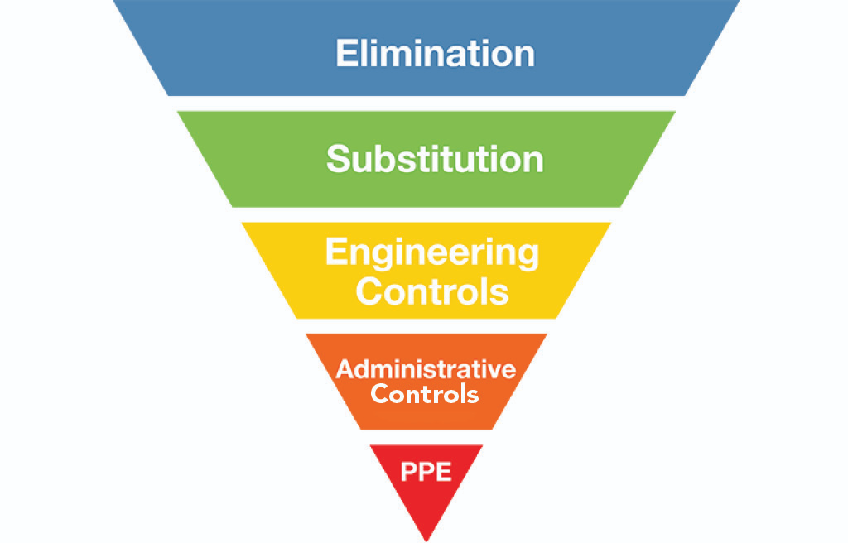
Primary Defense-Plan A
Once identified
Take steps to eliminate the Hazard(s)
Elimination of the Hazard should always be the First Consideration
Notes:
5
5
5
5
5
Explain that there are conditions in the workplace that can cause a hand injury. The longer we work are exposed to a hazard and suffer no negative consequences the less we respect a hazard’s ability to harm us. The best way to avoid hand injury events to eliminate the hazards that cause these incidents whenever possible. By totally eliminating the hazards there is no chance that you or anyone else in the work area can be injured by that hazard.

Slide 17

Levels of Defense
Primary defenses are always the most effective
Not always an option
Hazard elimination may not always be practical or feasible
Notes:
State that it is obvious that the elimination of any identified hazard is the best option. However, because we must go out into the world to perform our jobs and simply to live our everyday lives, we must accept the fact that we are going to be exposed to certain hazards. It is a thought process where we identify the hazard then ask ourselves if the hazards exposure can be avoided. If the answer is “No” then we employ secondary levels of defense.

Slide 18
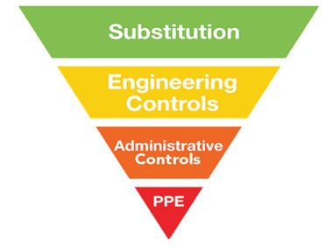

Secondary Defenses-Plan B
If the hazards cannot be eliminated
Effectiveness
Notes:
5
5
5
5
5
State that if it is not possible to remove the hazards, we must mitigate them. Explain the hierarchy of controls. State that elimination is the most effective. For example, use proper personal protective equipment to avoid exposure. Explain that PPE is the last line of defense. Do not rely just on your PPE to avoid injury. Think about the conditions that can cause hand injuries and how to mitigate them. State that some great topics to be identified and discussed during the pre-task meeting are:
Pinch points
Sharp objects
Extremes in temperature
Punctures
Where is my body located in relation to the hazard? What is the worst-case scenario of my task? How can I protect myself from the hazard? When elimination is not possible, engineering controls are the next best choice in protecting yourself from line of fire incidents. Some engineering controls that could protect you from line of fire incidents include physical barriers, guarding around moving parts, and toe boards on elevated work platforms to prevent objects from falling to the area below. There are many other possible engineering controls that could be used depending on the specific hazard. Total elimination of hazards is not always possible and engineering controls may not be feasible or they can fail.

Slide 19
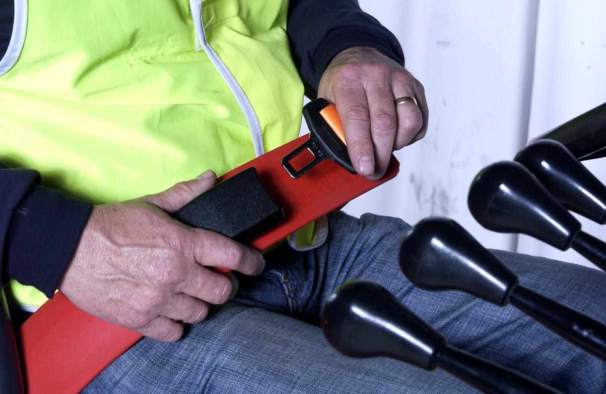
Combination Defenses
Primary defense
No collision
No roll-over
Secondary defense
Seatbelt
Safe operation
Primary defenses are Plan “A”
Secondary defenses are in place if Plan “A” is not an option or Plan “A” fails!
Notes:
State that it is obvious that the elimination of any identified hazard is the best option. However, because we must go out into the world to perform our jobs and simply to live our everyday lives, we must accept the fact that we are going to be exposed to certain hazards. It is a thought process where we identify the hazard then ask ourselves if the hazards exposure can be avoided. If the answer is “No” then we employ secondary levels of defense.

Slide 20
Remember Mr. Murphy and his Law
Notes:
5
5
5
5
5
State than when looking at any job task, plan the task then spend ample time asking “What can go wrong?” Remember Murphy's Quantum Law states that Anything that can, could have, or will go wrong, is going wrong, all at once. If there are two or more ways to do something, and one of those ways can result in a catastrophe then it will!

Slide 21
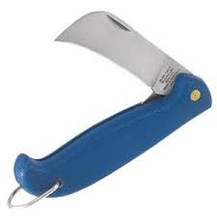
Knifes
If using a knife or blade during work tasks
  Wear proper PPE
  Use the proper tool
  Keep the work area clear
  Use a sharp blade
  Replace dull blades
  Never leave an exposed blade unattended
Notes:
Discuss some common safety tips for preventing cuts:
• Use the right knife for the job and make sure it’s sharp. A dull knife requires more pressure to cut, so you are more likely to cut yourself
• Handle knives and other sharp utensils with care. Dry your hands before using a knife
• Use a cutting board or flat surface. Put a damp cloth under cutting boards to prevent it from sliding
• Wear cut-resistant gloves where possible
• Curl your fingers and cut away from your body when trimming or deboning
• If you are interrupted when using a knife, place the knife down, do not continue cutting while distracted
• Don’t use knives for other purposes like to open bags, boxes, and/or cans
• When carrying a knife, keep it to your side with the point down and cutting edge away from you
• When passing a knife to someone, put the knife down on a clean work surface and let them pick it up
• Don’t try to catch a knife if it falls
• Don’t leave knives near the edges of tables
• Store knives securely, blade down, in designated areas
In regards to knife safety at home:
Do not drop knives into dishwater in the sink
Hand wash knives immediately after use, or place in a container labeled “knives only” near the sink to ensure that another person washing dishes does not accidentally get cut
Do not run knives through the dishwasher – it can ruin the blade, loosen rivets, and cause cracks in the handles

Slide 22
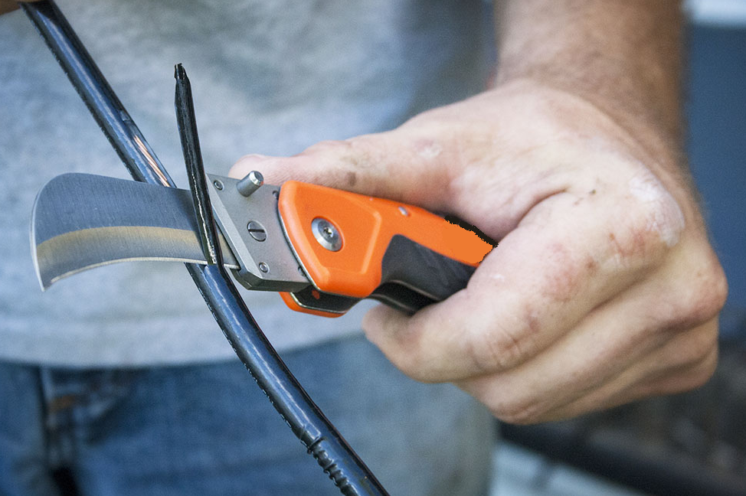
Hazard(s)?
Possible Solution(s)?
2-11
Notes:
Use this picture as a involvement activity. Explain that the key question to ask in regards to this picture is “Is a knife the correct tool for this job?” The desired responses here are that there may be a stripper for the job, the worker should be wearing PPE regardless of the tool type being used, and if the only alternative is a knife, then proper use of the knife and ensuring the knife is in good condition is paramount. For almost all applications of this type there are manufactured wire stripping tools designed for the job task. Wire strippers are a tool that anyone can use to remove the insulation covering wires in order to plug them into terminals or splice loose wires together. The most important part is to take precaution by wearing protective gear when working with wires connected to an electrical source. Then, all you need to do is fit the strippers snugly around the wire. By removing the casing, you’ll have a wire you can use to plug into a terminal to operate an electronic device or splice a damaged wire into a new one.

Slide 23
Use a second insulator to handle the broken part
Wear cut resistant gloves
Keep hands away from sharp edges
Handle with a tool
Wrap in a Kevlar cloth
2-12
Notes:
Use this slide as an involvement activity. State that this picture obviously shows a different type of insulator that the previous slide, but the potential of a cut remains the same. Ask the group if the defenses listed are primary or secondary defenses (controls). Wearing cut resistant gloves is a “PPE” control, keep hands away from sharp edges is an “administrative control”, and use a tool is a “substitution control”. All are secondary controls. A primary defense or control would be to not handle the broken insulator.

Slide 24
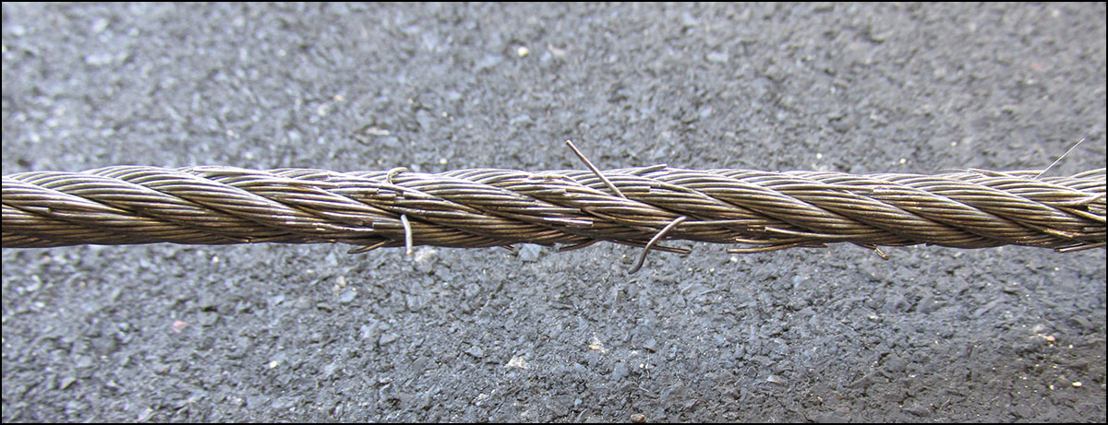
Wire Rope Hazards
Hazard(s)?
Possible Solution(s)?
2-13
Notes:
Use this slide as an involvement activity. Discuss the fact that wire rope can have broken wires which create a cut and puncture hazard. State the need to always use appropriate protective gloves when handling wire rope. Primary defense is number one. Ask the group if this wire rope sling meets the “out of service” criteria listed in the OSHA requirements? The desired answer is “yes”. The out-of-service criteria states that a wire rope shall be removed from service if there are ten randomly distributed broken wires in one rope lay or five broken wires in one strand in one lay.

Slide 25
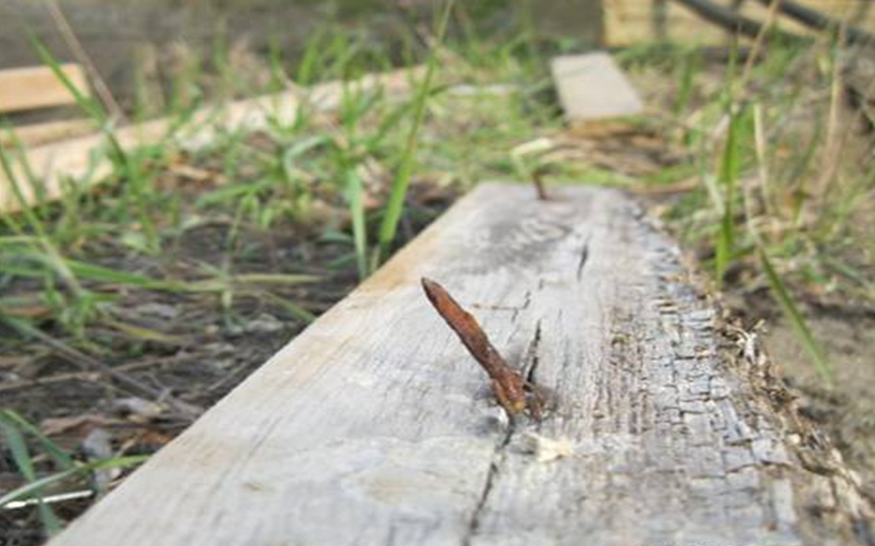
Hazard(s)?
Possible Solution(s)?
2-14
Notes:
Explain that the simplest way to render this a non-hazard is to bend the nail over with a hammer. Eliminate the possibility of a puncture altogether. Ask the group if bending the nail over is a primary or secondary defense? The desired answer is “a primary defense” because the hazard is eliminated. However, remind the group that when striking the nail to bend it over, we must wear safety glasses.

Slide 26
Key Points-Session Two
Employers must implement safety processes that help protect workers from cut and puncture hazards.
  True
  False
Personal Protective Equipment is a Primary Defense.
  True
  False
Cut resistant gloves are not cut and/or puncture proof.
  True
  False
Some possible causes of cuts, punctures, and/or lacerations in the workplace are:
  Improper or no training
  Rushing and/or shortcuts
  Not wearing PPE or improper PPE for the hazard
  All the above
Notes:
Employers must implement safety processes that help protect workers from cut and puncture hazards.
True
False
Personal Protective Equipment is a Primary Defense.
True
False
Cut resistant gloves are not cut and/or puncture proof.
True
False
Possible causes of cuts, punctures, and/or lacerations in the workplace are:
Improper or no training
Rushing and/or shortcuts
Not wearing PPE
All the above

Slide 27
Cuts and Punctures
Continuing Education
Third Quarter 2019
Session Three
Notes:
State that the following section will discuss selecting the appropriate glove for the hazard. Say that the nature of hazards and the operation to be performed will determine the type of glove to be worn. A variety of potential hand injuries may make selecting the appropriate pair of gloves more difficult than choosing other PPE. Take care to choose gloves designed for the specific hazard. Manufacturers can provide more information relating to your specific needs and requirements.

Slide 28
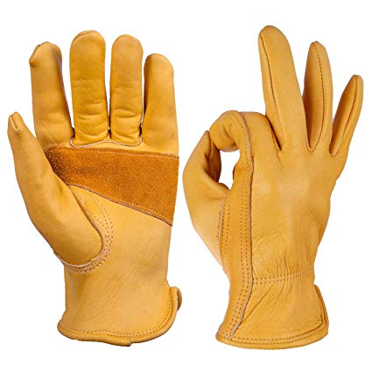
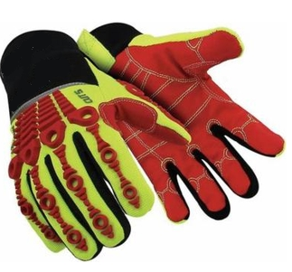
Assessment & Selection
There are many types of gloves available
Protect against a wide variety of hazards
The nature of the hazard and the operation involved will affect the selection of gloves
Notes:
The variety of potential occupational hand injuries makes selecting the right pair of gloves challenging. It is essential that employees use gloves specifically designed for the hazards and tasks found in their workplace because gloves designed for one function may not protect against a different function even though they may appear to be an appropriate protective device.

Slide 29
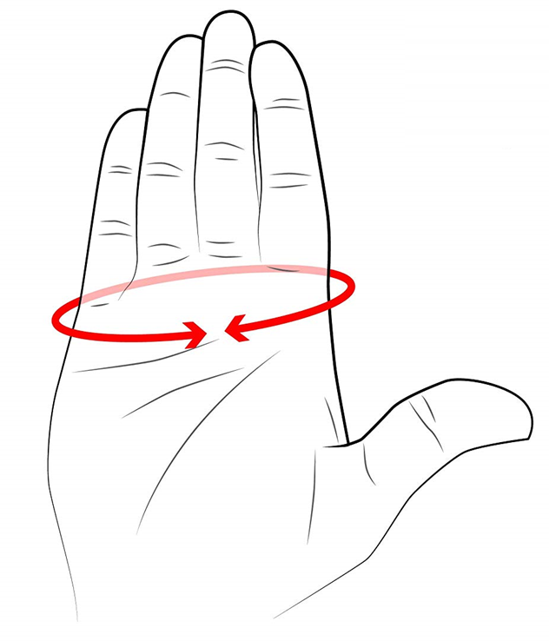
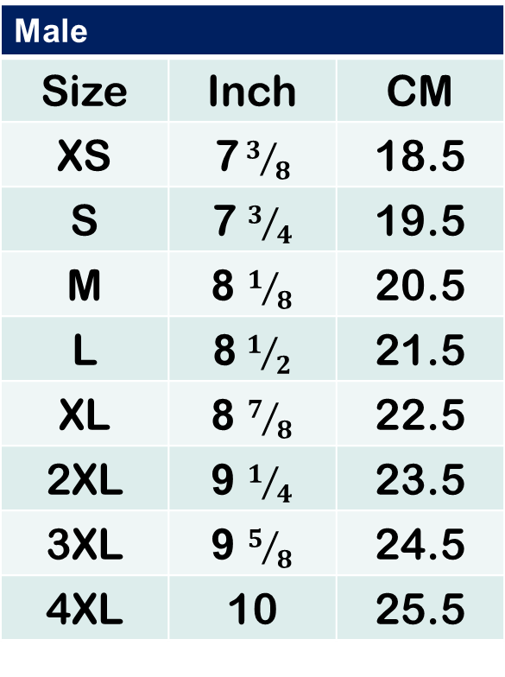
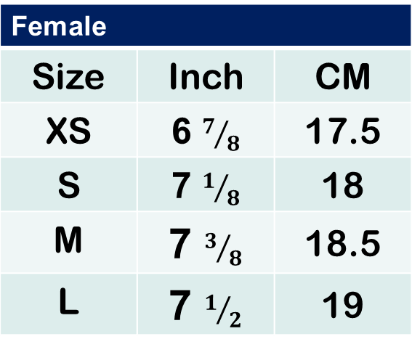
Size
Measure around dominant hand at knuckles with fingers extended
Male
Size | Inch | CM
XS | 7${ 3}/8$ | 18.5
S | 7 $3/4$ | 19.5
M | 8 $1/8$ | 20.5
L | 8 $1/2$ | 21.5
XL | 8 $7/8$ | 22.5
2XL | 9 $1/4$ | 23.5
3XL | 9 $5/8$ | 24.5
4XL | 10 | 25.5
Female
Size | Inch | CM
XS | 6 $7/8$ | 17.5
S | 7 $1/8$ | 18
M | 7 $3/8$ | 18.5
L | 7 $1/2$ | 19
For general use. Check with your glove provider.
Notes:
Explain that it is important that gloves fit properly. Gloves that are too large will slide around on the hands and won't provide protection where it is needed. Gloves that are too snug can decrease a worker's dexterity and may become so uncomfortable that workers will remove them. Keep in mind that men and women have different requirements relative to glove sizes and shapes.

Slide 30

Myth
Cut-Proof gloves are like unicorns
They do not exist
Cut-Resistant gloves help protect against
  Cuts
  Abrasions
  Heat
  Cold
Notes:
Ask the group: “Where are the cut-proof gloves?” The true and correct answer is that cut proof gloves are the unicorns of the safety world. No, we don't mean that cut-proof gloves are the national animal of Scotland (look it up), we mean they are entirely mythical. There are now 9 levels of cut resistant gloves. In the United States and Canada we generally follow the ANSI 105 standard.

Slide 31
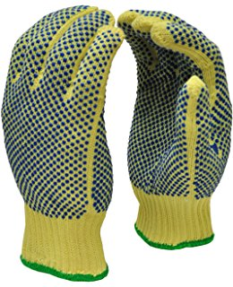
Cut Resistant Gloves
Prevent or reduce cuts from knives or sharp edges
Cut RESISTANT, not Cut PROOF!
Offer little protection from pinch points or punctures
Available in cut levels 1-9
Level 9 offers best protection
Notes:
Explain that cut resistant gloves help prevent or reduce cuts from knives or sharp edges. The key point here is that these gloves are cut RESISTANT, not cut PROOF! Additionally, these gloves offer little to no protection from pinch points or punctures. These gloves are available in cut levels 1 through 9 with level 9 offering the best protection.

Slide 32
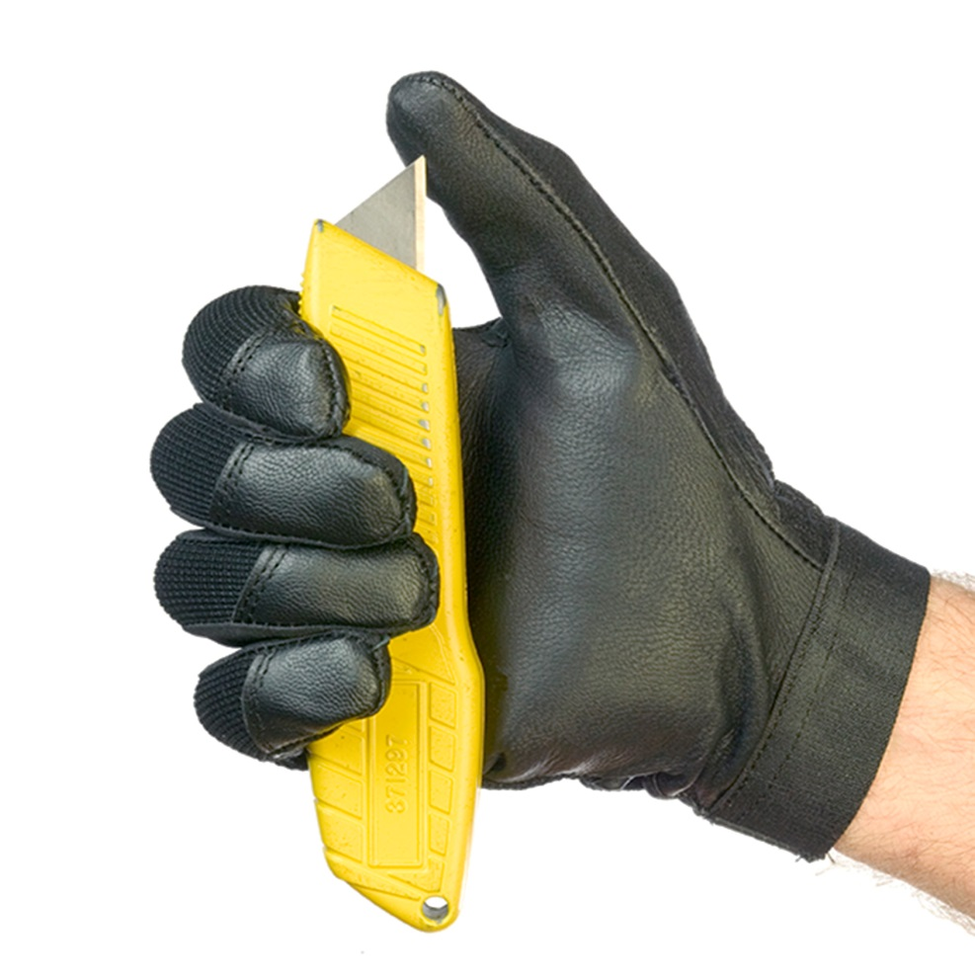
Puncture Resistant
Many gloves are designed to protect from slashes
Few provide high levels of puncture resistance
Results depend on the nature of puncture
Performance based on point sharpness and force
Notes:
Explain that “Puncture Resistance” denotes the relative ability of a material or object to inhibit the intrusion of a foreign object. This is defined by a test method, regulation, or a technical specification. The puncture resistance will depend on the nature of puncture attempt, with the two most important features being point sharpness and force. Puncture resistance in fabrics can be obtained through very tight woven fabrics, small ceramic plates in fabric coating or tight woven fabrics with a coating of hard crystals. All described methods significantly reduce the softness and flexibility of the fabric. A fine sharp point such as a hypodermic needle will require a high ability to absorb and distribute the force to avoid penetration, but the total forces applied are still limited. Explain that many gloves are designed to protect from slashes caused by sharp objects, but few provide high levels of puncture resistance from objects such as the ragged edges of a piece of metal or glass.

Slide 33
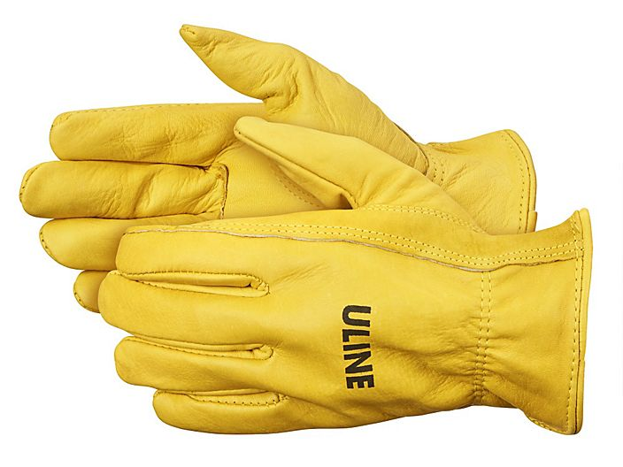
Leather Gloves
Provides protection from rough surfaces
Many styles
May be thermally insulated for cold conditions
Very cost effective
Good for most abrasion hazards
May not provide adequate cut protection
Notes:
Explain that leather gloves offer some protection from rough and abrasive surfaces. They are comfortable and usually easy to put on and take off. There are many styles to pick from that have varying gauntlet lengths. They are generally available insulated styles for cold conditions and can be very cost effective and affordable. These gloves are good for most hand hazards but offer little to no cut protection.

Slide 34
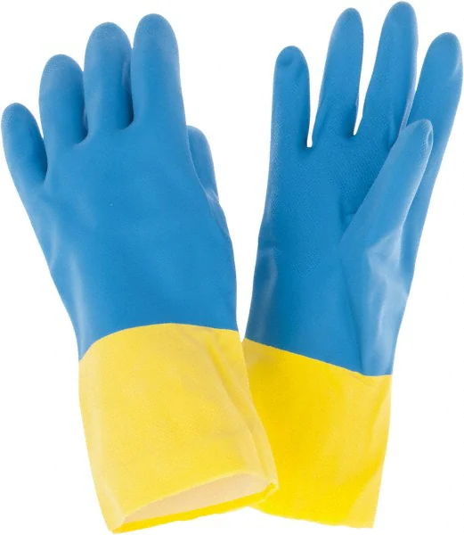
Chemical Resistant
Prevent direct contact
No glove will protect from all chemicals
Will break down over time
The thicker the glove, the more resistant
Notes:
Explain that chemical resistant gloves help to prevent direct contact with chemicals. It is critical to mention that no glove will protect from ALL chemicals and all chemicals will break down the glove material over time. It is important to mention that the thicker the glove, the more resistant it is to chemicals. Workers must reference the SDS sheet to determine what glove is appropriate for a given chemical.

Slide 35

Anti-Vibration Gloves
Reduce the effects of excessive vibration
Have padding in palms and fingers
Help absorb the vibration
Reduces but does not eliminate
Bulky
Notes:
Explain that anti-vibration gloves will reduce the effects of excessive vibration from hand tools and machinery. These gloves have padding in palms and fingers to help absorb the vibration. These gloves reduce but not eliminate the exposure from vibration. These gloves may be too bulky for regular work.

Slide 36
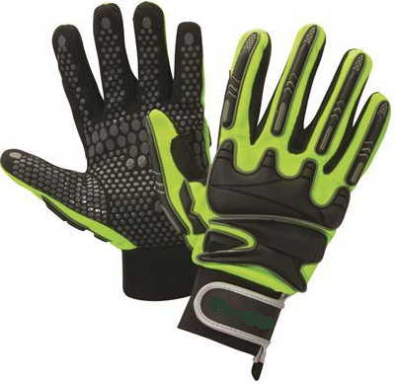
Impact Resistant Gloves
Provide added protection from crushing injuries
Impact absorbing rubber ribs and padding designed into gloves
Usually have a cut resistant rating as well
Provides good dexterity and grip
Best overall option in a glove
Notes:
Explain that impact resistant gloves are impact resistant not impact proof. The key here is to keep your hands out of the line-of-fire. These gloves provide added protection from crushing injuries. They are equipped with impact absorbing rubber ribs and padding designed into gloves. Usually have a cut resistant rating as well. They provides good dexterity and grip. They are generally best overall option in a glove.

Slide 37
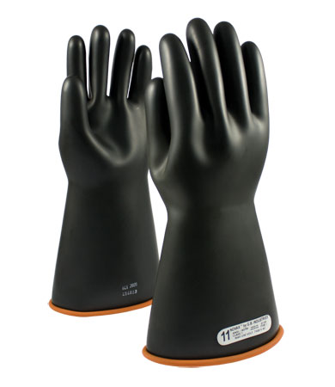
Insulated Rubber Gloves
Voltage rated
Must be electrically tested and stamped
Inspected before use
Used in conjunction with leather protective covers
Notes:
Explain that rubber insulating gloves protect only from the voltages for which they are rated. The voltage rating for rubber gloves range from 00 to class 4. These gloves must be electrically tested regularly according to local standards and date stamped. The maximum test interval allowed by OSHA is 6 months. Prior to use these gloves must be inspected for leaks, holes, tears, cuts, and/or ozone damage. These gloves should be used with leather protective covers to help prevent damage.

Slide 38
Class | AC proof test Voltage | Maximum AC Use Voltage
00 | 2,500 | 500
0 | 5,000 | 1,000
1 | 10,000 | 7,500
2 | 20,000 | 17,000
3 | 30,000 | 26,000
4 | 40,000 | 36,000
Notes:
Explain that according to OSHA, all electrical gloves have a test voltage and safe use voltage requirement. All glove manufacturers incorporate some form of production code or date coding to indicate the date of initial testing. In accordance with OSHA, gloves must be tested before first issue and at least every six months thereafter. Gloves must also be tested upon indication that the insulating value is suspect. Also, if the insulating equipment has been electrically tested but not issued for service, the insulating equipment may not be placed into service unless it has been electrically tested within the previous 12 months. These testing requirements can sometimes be a little confusing to interpret. Here's an example: You're considering using your electrical gloves for the first time on March 1, 2017, and notice the date stamp is February 27, 2016. Would you need to get the gloves retested before use? Yes, because you haven't put the gloves into service within the allowable 12 month window. But, if the date stamp read March 2, 2016, you could use them and wouldn't need to retest them until six months after you put them into service on March 1, 2017.

Slide 39
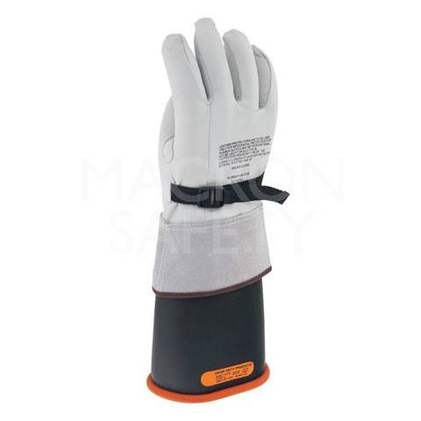
Length
One inch of rubber past the top of protector for each kV class rating
Class | Distance
1 | 1 inch
2 | 2 inches
3 | 3 inches
4 | 4 inches
Notes:
Explain that there is a required amount of rubber cuff that extend past the leather protector. The standard distance is one-inch of rubber for each class rating. For example, class 3 gloves must have 3 inches of rubber extending past the leather protector.

Slide 40

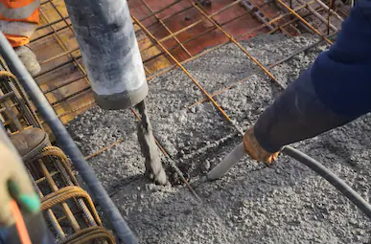
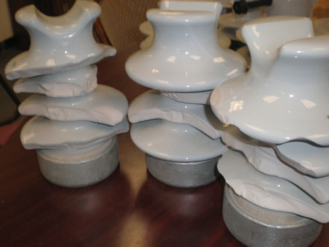
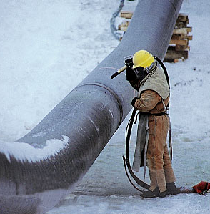
Match Up
Glove Type | Match
Chemical
Leather
Anti-Vibration
Cut Resistant
2
1
2
4
1
3
3
4
Notes:
This is an involvement activity. Begin with picture number 1. Ask the group which glove in the “Glove Type” list would be appropriate for the job task shown in picture 1. The answer is “Anti-Vibration”. Trigger the animation and a number 1 will appear beside the word “Anti-Vibration” in the “Match” column. Progress likewise through the entire series.

Slide 41
Key Points-Session Three
Leather gloves provide good abrasion protection but may not provide good cut/puncture protection.
  True
  False
Puncture resistant glove strength is primarily based on sharpness and force exposure
  True
  False
20 kV rated insulation gloves have a maximum use voltage of 20 kV.
  True
  False
Gloves selection should be based on which of the following:
  Personal preference
  Job task & hazards
  Price
  Environment
Notes:
Leather gloves provide good abrasion protection but may not provide good cut/puncture protection.
True
False
Puncture resistant glove strength is primarily based on sharpness and force
True
False
20 kV rated insulation gloves have a maximum use voltage of 20 kV.
True
False
Gloves selection should be based on which of the following:
Personal preference
Job task & hazards
Price
Environment

Slide 42


Review
Notes:
Ask for questions. Once complete thank the attendees and close the session.

