Slide 1
Line of Fire
Continuing Education
First Quarter 2019
Notes:
Introduce the module. Explain that the intent of this presentation is as a continuing education training topic related to certain aspects from the ET&D 10-Hour OSHA training class, the OSHA Partnership Best Practices, and/or incident trending analysis. OSHA has determined that there are four main safety hazards, excluding transportation incidents, that account for a majority of all construction worker deaths each year on the jobsite. Dubbed the “Fatal Four” by OSHA, they include falls, electrocutions, struck-by, and caught-in or between hazards. In 2016, 63.7% of all fatalities at construction sites were from one of OSHA’s Fatal Four. This training focuses on struck-by and caught-in/between hazards and how to prevent and protect against them. Caught-in/between hazards are caused when a worker is compressed between or gets caught in equipment or objects. It also includes when a worker is killed by getting caught, struck or crushed from materials, equipment or a collapsing structure. According to OSHA, accidents caused by getting caught in or between objects accounted for 72 construction worker deaths in 2016, which is 7.3% of the 991 fatalities that occurred on construction sites.

Slide 2
Objectives
Upon completion of this continuing education module you should be able to:
  Define Line of Fire injury and hazard types
  Describe how to identify hazards associated with Line of Fire
  Describe how to eliminate Line of Fire hazards whenever possible
  Describe how to identify and control Line of Fire hazards
  Describe ways to use effective methods to minimize Line of Fire hazards
Notes:
5
5
5
5
5
Explain that this is the Q1 topic. Explain the objectives of this course and the duration.

Slide 3
Line of Fire
Session One
Notes:
State that the following section will discuss struck-by hazards.

Slide 4



What is the “Line-of-Fire”?
A simple definition
“Being in Harm’s Way”
Line of fire injuries can occur when the path of a moving object intersects with an individual’s body
Notes:
4
4
4
4
4
A simple definition of “line of fire” is being in harm’s way. Line of fire injuries occur when the path of a moving object intersects with an individual’s body. Three major categories of line of fire incidents are caught-in or between incidents, struck-by incidents, and released energy incidents. There are many specific examples of hazards for each of these categories.

Slide 5
Primary Types
Struck-by Hazards
Occurs if a person is struck by an object
Caught-in or Between Hazards
Occurs if a person is caught inside of, or in between different objects
Energy Released Hazards
Occurs if a person is in the path of and suffers the consequences of released energy
Notes:
Explain that it is important to always remember that Line-of-Fire hazards are one of the most deadly hazards found in Construction, second only to Slips, Trips and Falls. A few quick examples for each category:
Caught-in or between- A person is standing between a wall and an excavator. When the excavator spins around the counter weight pins the worker against the wall. Another example would be a worker placing his hand too close to a rotating gear and gets it pulled into the gear.
Struck-by- A pedestrian struck-by a moving vehicle. An object falling from a higher level striking a person at a lower level.
Released energy- A pipe releasing hot steam from a valve that is being removed, metal banding snapping back at a worker after being cut, current flow through the body are examples of released energy.

Slide 6
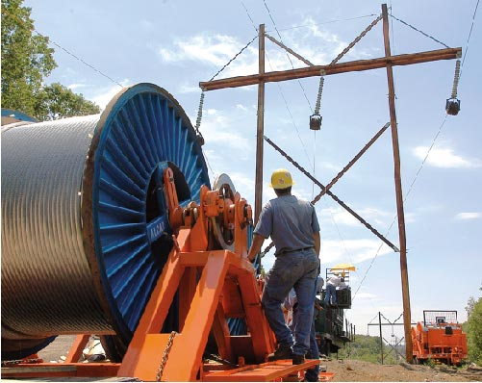
Before Starting Work
Look for Line of Fire Hazards
Line-of-Fire is the path of a moving object or,
Path of an object that could move and,
An injury may occur as a result of that movement
Notes:
Explain that at its most basic level, the Line-of-Fire is the path of a moving object that could potentially injure you, or the potential path of an object that may move. Explain how important job planning and a thorough job brief is when identifying Line of Fire hazards. Explain and discuss ways to identify Line of Fire hazards on the job before work begins. Ask the group to discuss the first time they may have performed an unfamiliar activity. Ask them if while learning the steps to perform safely that activity, they allowed themselves the time to make sure the task was performed safely.

Slide 7

Questioning Attitude
Teamwork
Is what
makes the
Dream Work
Steps
What are we going to do?
Hazards
What is the worst thing that can happen?
Safe Guards
If it all goes South, are we protected?
Self Check
&
Peer Check
?
?
Notes:
Ask the group if they have ever seen the “Steps”, “Hazards”, “Safeguards” model before? The desired answer is “yes”. These are the three basic steps to a job hazard analysis. Explain that a questioning attitude helps to prevent “group think” by encouraging diversity of thought and intellectual curiosity. It challenges the entire group to get clarification when something comes up that doesn't seem right. Check yourself and have someone else check your conclusions. Remember, two heads are always better than one. Teamwork makes the Dream work!

Slide 8
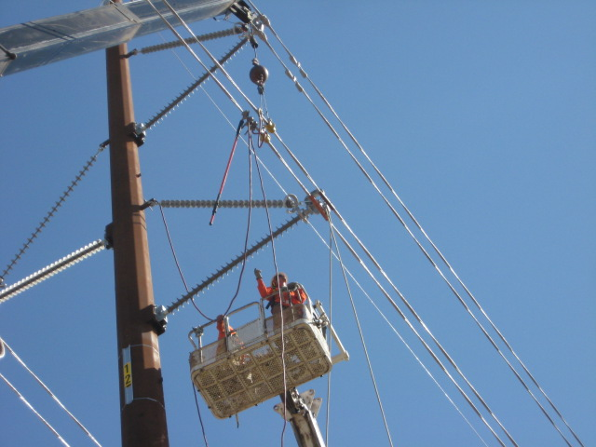

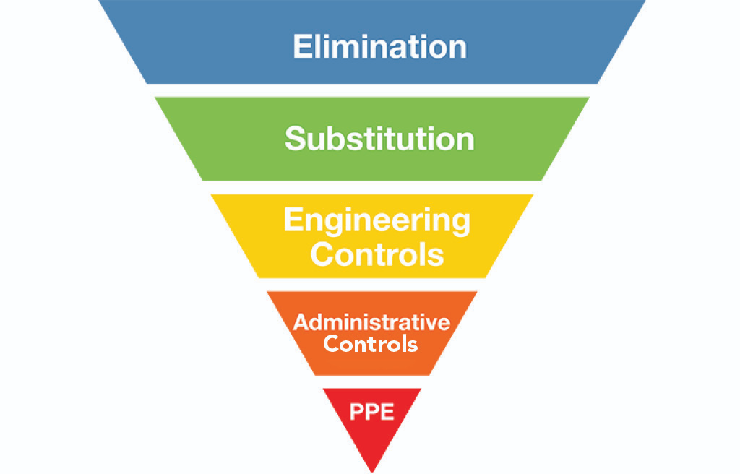
Eliminate the Hazard
Once identified
Take steps to eliminate the Hazard(s)
Elimination of the Hazard should always be the First Consideration
Notes:
5
5
5
5
5
Explain that there are many Line of Fire hazards out there that are easy to identify. The longer we work around a hazard (or in this case the more we place ourselves in the Line-of-Fire) and suffer no negative consequences the less we respect a hazard’s ability to harm us. The best way to avoid line of fire incidents is to eliminate the hazards that cause these incidents whenever possible. By totally eliminating the hazards there is no chance that you or anyone else in the work area can be injured by that hazard.

Slide 9
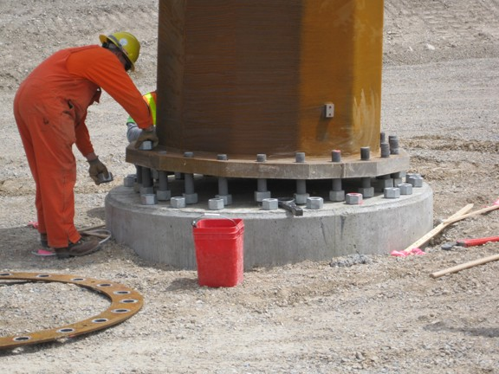
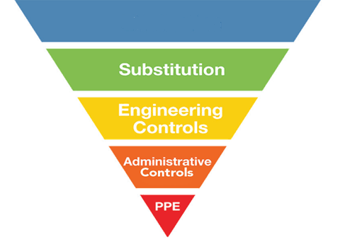
Control
If the hazards cannot be eliminated
Effectiveness
Notes:
5
5
5
5
5
State that if it is not possible to remove the hazards, we must mitigate them. Explain the hierarchy of controls. State that elimination is the most effective. For example, use proper personal protective equipment to avoid exposure. Explain that PPE is the last line of defense. Do not rely just on your PPE to avoid injury. Think about the L.O.F. hazard and how to mitigate. State that some great questions to ask are: Where is my body located in relation to the hazard? What is the worst-case scenario of my task? How can I protect myself from the hazard? When elimination is not possible, engineering controls are the next best choice in protecting yourself from line of fire incidents. Some engineering controls that could protect you from line of fire incidents include physical barriers, guarding around moving parts, and toe boards on elevated work platforms to prevent objects from falling to the area below. There are many other possible engineering controls that could be used depending on the specific hazard. Total elimination of hazards is not always possible and engineering controls may not be feasible or they can fail.

Slide 10
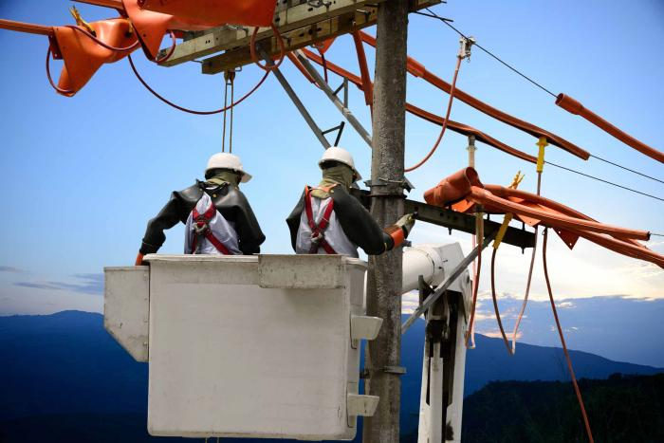
Minimize Line of Fire Hazards
Be aware of the hazards
We must understand
  The Steps
  The Hazards
  The Safe Guards
Take time to think about the consequences
Notes:
5
5
5
5
5
Ask the question: “Can all hazards be eliminated?” Most of the group will answer “No”. Explain that almost all hazards can be eliminated if we choose to do absolutely nothing. Then state that if we choose to live and function in this world we must accept the fact that we will be exposed to hazards. Because of this reality, it is important to decrease your chance of being a victim of line of fire injuries by not putting yourself in harm’s way in the first place. Understand the work tasks that are going on around you and the associated hazards. Ask yourself what is the worst that can happen or what will happen if a certain safeguard fails. Recognize line of fire hazards and act accordingly. Explain the importance of body position when line of fire hazards exist. Explain that organizing the jobsite and providing unobstructed and easy access to equipment can prevent Line of Fire hazards.

Slide 11
Struck-By Hazards
Notes:
Explain that the following section will review “Struck-by Hazards”

Slide 12
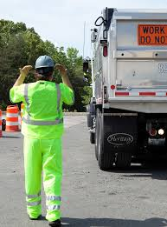
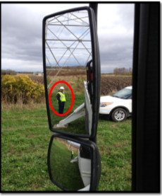
Equipment Hazards
If no Spotter
360° walk-around before first move
If using a Spotter
They can be seen
Never directly behind equipment
Loose site of each other, STOP!
Notes:
Explain that anyone around moving vehicles has the potential of becoming struck-by. Be sure spotters stay off to the side of trucks and never put themselves directly behind a reversing vehicle. If you do not have a spotter, the driver must perform a 360 walk-around prior to first move from park. Anytime a blind spot appears during moving a vehicle, the driver must stop and walk around or ask for assistance.

Slide 13
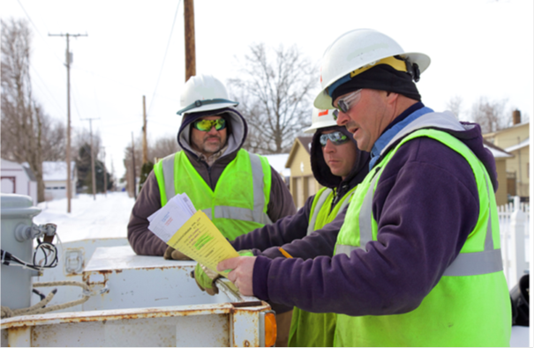
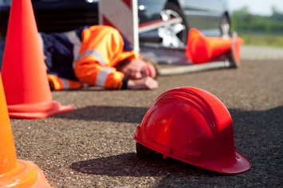
Work Practices
During the job planning phase, ask the “What If” questions
Am I or will I be in harm’s way?
Will someone else be in harm’s way?
Avoid This!
Notes:
STOP, THINK, ACT, REVIEW (STAR Principle): Ensure that you and others do the right thing BEFORE taking action. Consider “what can happen”. Place yourself in a safe working position when conducting your task. Always ask yourself, "Am I or is someone else in harms way"? Have a questioning attitude: consider the “what if’s” prior to taking any action or making any decision. During job briefing, discuss proper distances and identify all pinch points and line of fire. Understand and know when to use Stop Work Authority.

Slide 14
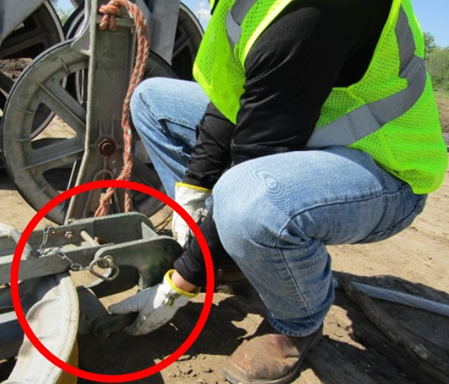
Hand Position
Be cognizant of hand placement
Look for pinch points
What if it moves
Unexpected release of energy
Notes:
State the necessity of being aware of hand placement, especially the non-dominant hand. Identify possible pinch points and other “Line of Fire” hazards. Ask yourself, what will happen when or if this moves? Will I be in the path of movement.
Think about the consequences of where you place all or part of your body at all times.
• Fingers/Hands in Pinch Points
• Under suspended loads
• Struck by hand tools
• Electrical contact

Slide 15
Key Points-Session One
Body position is a key component when identifying struck–by type line of fire hazards.
  True
  False
A good example of when to use Stop Work Authority (SWA) is if you loose sight of your spotter when backing a vehicle or piece of equipment.
  True
  False
If a spotter is not available, it is OK to back up as long as you sound the horn first.
  True
  False
A person that is in a position that allows them to be struck and injured if there is a movement of an object is exposed to a ___________ injury.
  Struck-By
  Caught Between
Notes:
Body position is a key component when identifying struck–by type line of fire hazards.
True
False
A good example of when to use Stop Work Authority is if you lose sight of your spotter when backing a vehicle or piece of equipment.
True
False
If a spotter is not available, it is OK to back up as long as you sound the horn first.
True
False
A person that is in a position that allows them to be struck and injured if there is a movement of an object is exposed to a ___________ injury.
Struck-By
Caught Between

