Slide 1
Caught-In or Between Hazards
Session Two
Notes:
Explain that the following section will Explain “Caught Between Injuries”

Slide 2
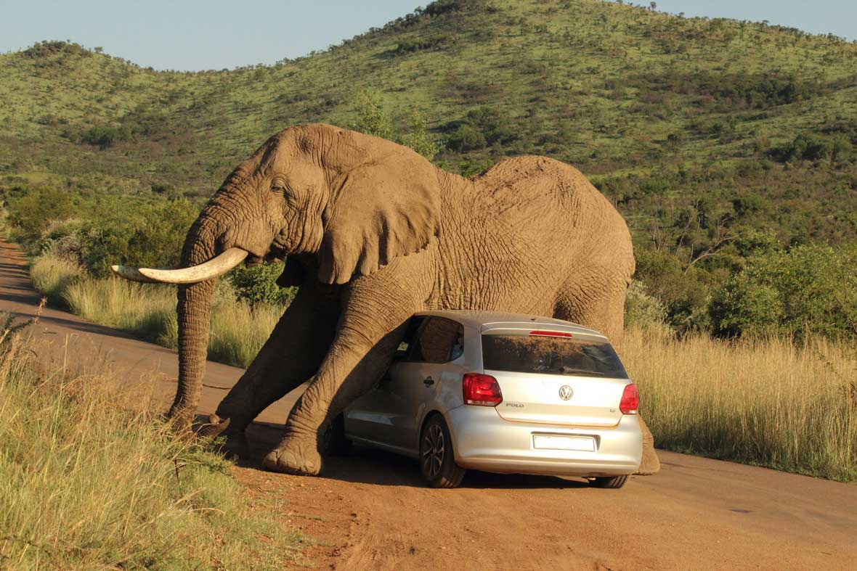
Definition
An crushing injury
Occurs as a result of being caught between objects
Notes:
The key factor in making a determination between a Caught-in or between event and a Struck-by event is whether the impact of the object alone caused the injury. When the impact alone creates the injury, the event should be considered a Struck-by event. When the injury is created more as a result of crushing injuries between objects, the event should be considered as a Caught-in or between event.

Slide 3
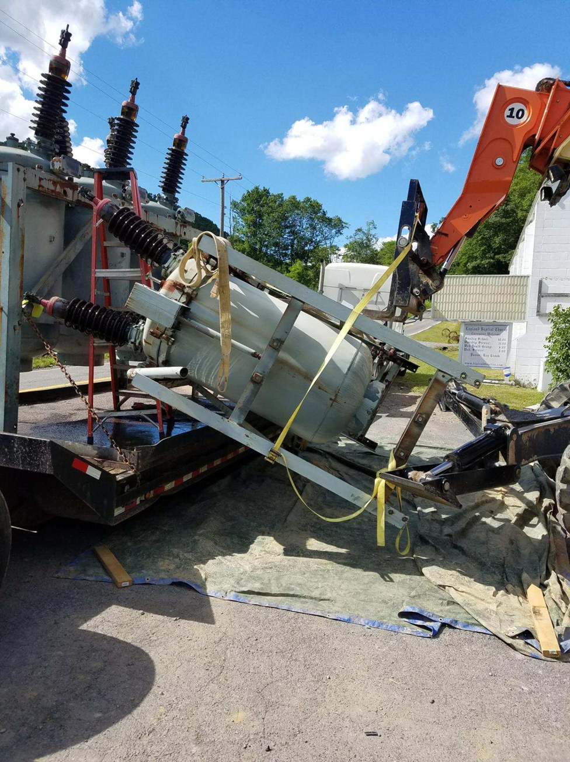
2017 Partnership Injuries
Caught-in or Between injuries
Accounted for 11% of all ET&D Partner Company OSHA Recordable injuries
  69 of 644
  Does not include non-recordable injuries
Notes:
Explain that of the 644 ET&D Partner OSHA recordable injuries in 2017, 69 were reported as caught-in or between incidents.

Slide 4
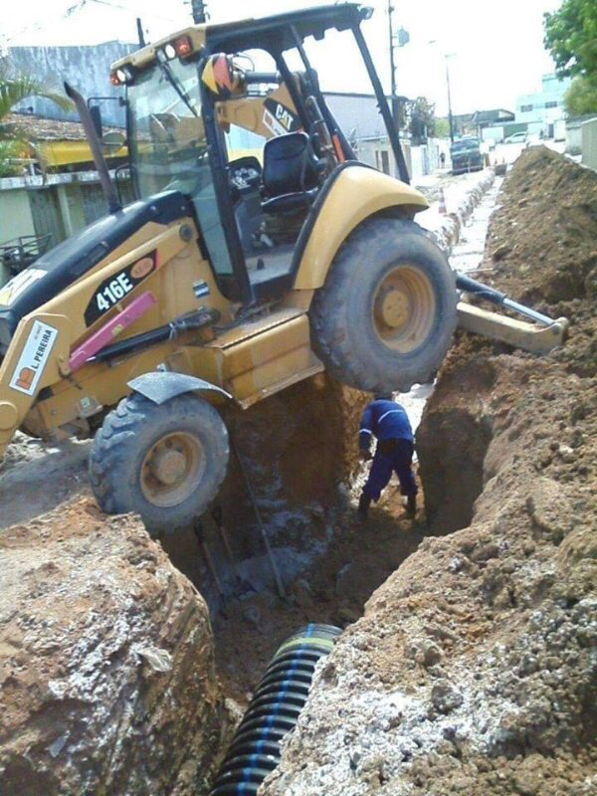
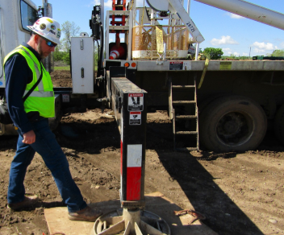
Crushing Injury
Stand clear when outriggers are being deployed
Communication
Do not take unnecessary risks
Notes:
Explain that communication is key to prevent struck by injuries when deploying outriggers. Assign spotter to ensure outrigger area is clear. Use outrigger pads. That way a person is more aware that they may be placing their foot in the danger zone. Explain that the second picture illustrates a totally unnecessary risk.

Slide 5
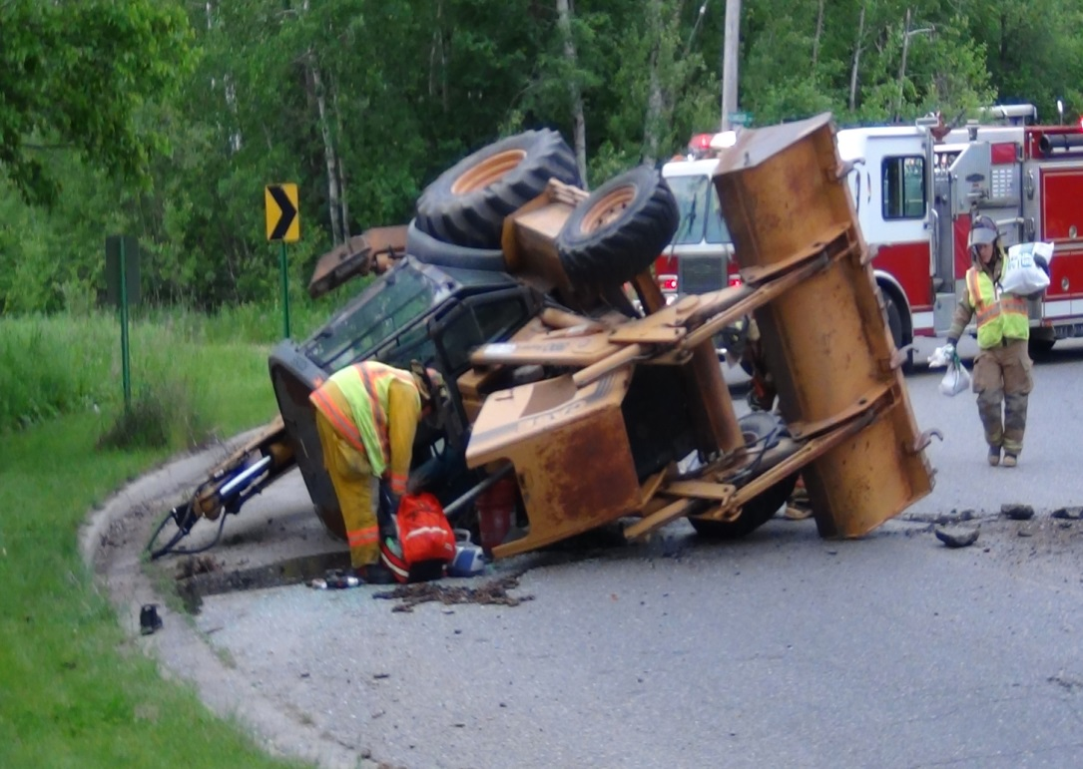
Crushing Injury
Equipment with Rollover Protection Systems or ROPS
Wear seatbelts
Mandatory requirement
Notes:
Seatbelts must be worn by operators using equipment that has rollover protection. A National Institute for Occupational Safety and Health (NIOSH) review of the Bureau of Labor Statistics (BLS) Census of Fatal Occupational Injuries (CFOI) data identified 346 deaths associated with excavators or backhoe loaders during 1992-2000 [NIOSH 2002]. Review of these data and of NIOSH Fatality Assessment and Control Evaluation (FACE) cases [NIOSH 2000, 2001] suggests two common causes of injury: (1) being struck by the moving machine, swinging booms, or other machine components; or (2) being struck by quick-disconnect excavator buckets that unexpectedly detach from the excavator stick. Other leading causes of fatalities are rollovers, electrocutions, and slides into trenches after cave-ins.

Slide 6
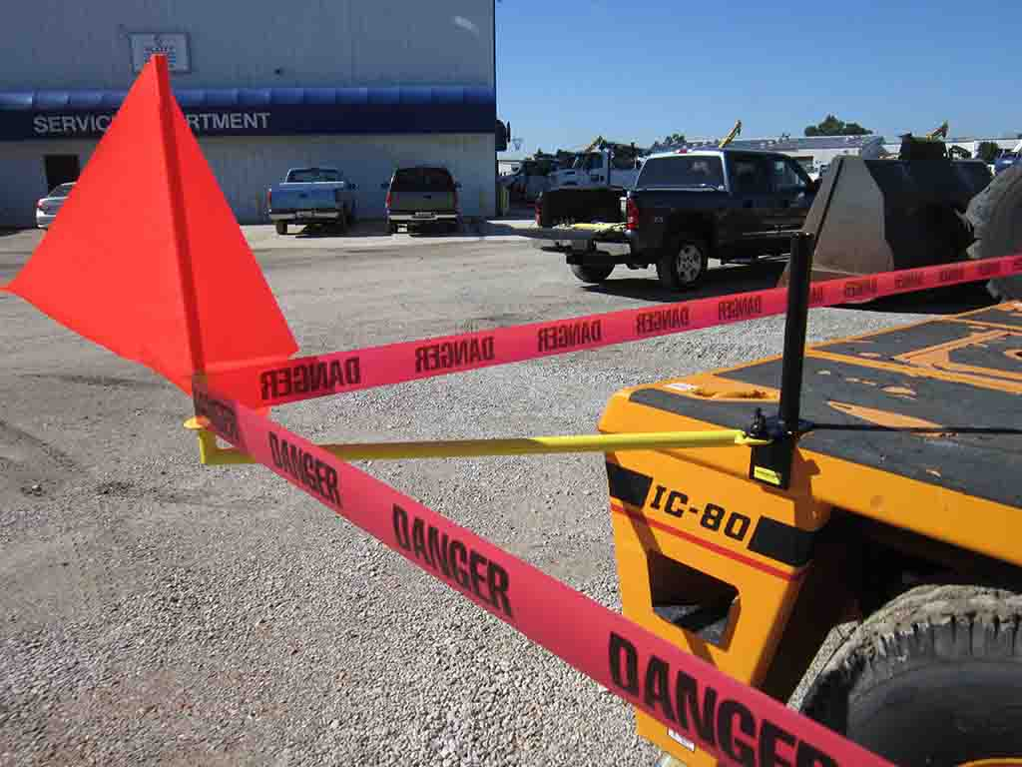
Rotating Equipment
Accessible areas within the swing radius of the rotating superstructure
Barricaded
Training is required
Inform the operator before entry
Prevents crushing injuries
Notes:
According to the OSHA crane standard 1926.1424 where there are accessible areas in which the equipment's rotating superstructure (whether permanently or temporarily mounted) poses a reasonably foreseeable risk of striking and injuring an employee or, pinching/crushing an employee against another part of the equipment or another object, to prevent employees from entering these hazard areas, the employer must train each employee assigned to work on or near the equipment ("authorized personnel") in how to recognize struck-by and pinch/crush hazard areas posed by the rotating superstructure. The employer must also erect and maintain control lines, warning lines, railings or similar barriers to mark the boundaries of the hazard areas. Exception: When the employer can demonstrate that it is neither feasible to erect such barriers on the ground nor on the equipment, the hazard areas must be clearly marked by a combination of warning signs (such as "Danger--Swing/Crush Zone") and high visibility markings on the equipment that identify the hazard areas. In addition, the employer must train each employee to understand what these markings signify. In addition, before an employee goes to a location in the hazard area that is out of view of the operator, the employee (or someone instructed by the employee) must ensure that the operator is informed that he/she is going to that location. Where the operator knows that an employee went to a location the operator must not rotate the superstructure until the operator is informed in accordance with a pre-arranged system of communication that the employee is in a safe position. Where any part of a crane/derrick is within the working radius of another crane/derrick, the controlling entity must institute a system to coordinate operations. If there is no controlling entity, the employer (if there is only one employer operating the multiple pieces of equipment), or employers, must institute such a system.

Slide 7
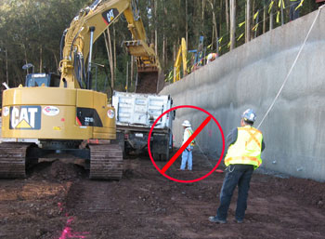
Moving Equipment
Caught between moving equipment/vehicle and another object
Spotters
Unaware co-workers
During maintenance
Failure to secure vehicle in place
Notes:
Explain that anyone around moving or improperly secured equipment and vehicles has the potential of becoming caught between it and a stationary object. Stop operation if spotter cannot be seen or anyone walks into hazardous area. Explain that thie picture shows the potential for an injury. The one worker may not be in plain view of the operator.

Slide 8
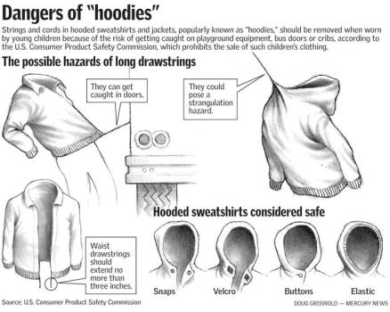
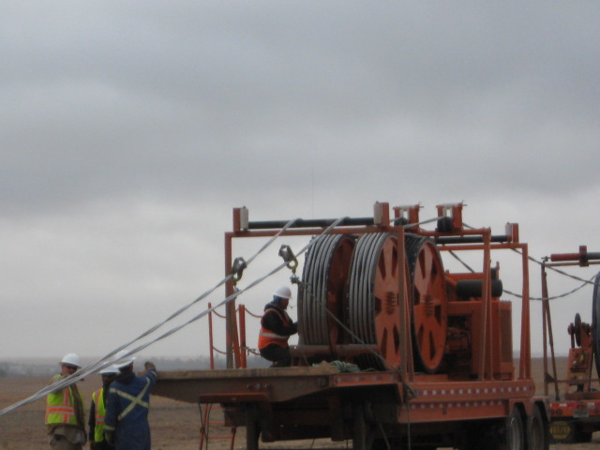
Snags
Being pulled into or caught in machinery and equipment
  Strangulation
  Amputations
  Fractures
  Death
  It is not just a “work” safety issue
Notes:
State that almost all sites use machinery that has moving or rotating parts. All of that equipment, at some time requires maintenance or repair. If machinery is not properly guarded or de-energized during maintenance or repair, injuries from caught-in or between hazards may result. These injuries rang from amputations and fractures to death. When machines or power tools are not properly guarded, workers can get their clothing or parts of their body caught in the machines. If machines are not de-energized (locked-out) when they are being repaired, they may cycle or otherwise start up and catch a worker’s body part or clothing and cause injury or death. State that we should never wear loose clothing around moving machinery. A simple thing like the hood string on a sweatshirt or coat could cause a sever and even fatal injury. Cable pullers offer multiple opportunities for crushing injuries, often resulting in amputations due to the extent of the damage caused to bone and tissue. State that safety is not just an “at work” issue. Safety at home is as critical as safety at work. Think about your children as well.

Slide 9
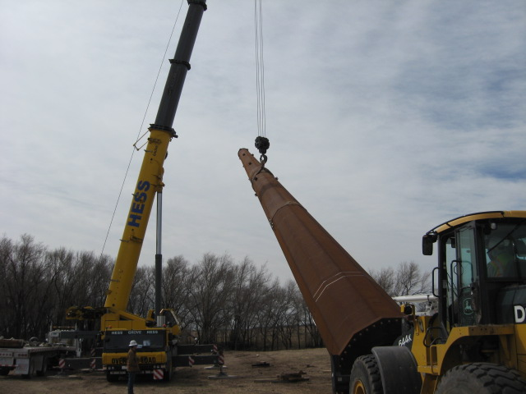
Material Handling
Moving loads may create hazards
Shifting poles can cause an injury
Workers may be struck by objects falling from the structure
Rigging failure
Caught-between the pole and a machine
Notes:
State that everyone must maintain proper distance during pole handling tasks. Always chock/block downhill side of staged poles. Be aware of the Line of Fire hazards. Discuss the policies and procedures your company has in place to prevent the various types of crushing injuries mentioned. Make sure that your crew has received the appropriate training in order to identify these hazards and correctly implement site and task specific protective measures to eliminate them. Areas of concern here are the possible loss of the load, possible crushing injury from being caught-between the pole and the crane or other equipment, and possible struck-by injuries resulting from objects falling from the pole. This could include tools that were left behind, lose hardware, and/or dirt clods falling from the elevated structure.

Slide 10
Key Points-Session Two
In 2017 , over 10% of OSHA recordable injuries experience by ETD partnership company employees was a result of caught-in or between injuries.
  True
  False
A caught-in or between injury is a crushing injury?
  True
  False
The best time to identify struck-by and/or caught-between hazards and develop a control is during the job planning phase.
  True
  False
If you could be hit by a moving object or an object that has the potential to move, you are in the line-of-fire.
  True
  False
Notes:
In 2017 , over 10% of OSHA recordable injuries experience by ETD partnership company employees was a result of caught-in or between injuries.
True
False
A caught-in or between injury is a crushing injury?
True
False
Personal Protective Equipment should always be the first consideration for worker protection.
True
False
If you could be hit by a moving object or an object that has the potential to move, you are in the line-of-fire.
True
False

