Slide 1
Lock-to-Lock and Underground Cable Work
Notes:
Introduce the module. Explain to the group that this module will address how the use of the Lock-to-Lock best practice on underground cables and equipment.

Slide 2
Purpose
Underground cable work continues to be an area of growth for members of ET&D Partnership.
The utility industry has seen significant incidents resulting from cable work and repair.
This review will discuss hazards associated with the work and control options to protect workers from the dangers of electrical shock and arc flash when working on or near underground cables and equipment.
Notes:
Explain that this is the Q3 ET&D Continuous Education Module topic. Explain that Underground Cable work continues to be a growing area within the Outside Electrical Industry and the industry has experienced an increase in underground cable related events.

Slide 3
Learning Objectives
Define ET&D Partnership Best Practices
  Lock-to-Lock
Discuss Underground Cable Work Protection Options
  Insulate
  Isolate
Discuss Tooling and Equipment Uses
  Cable Inspection
  Cable and Fault Identification Equipment
  Grounding Cable
  Spiking Cable
  Cutting Cable
Notes:
Explain the learning objectives for this module.

Slide 4
Overview
Steps must be taken to prevent employee injury when identifying, de-energizing, grounding, and working on underground cables.
Before any underground cable work begins:
  Ensure OSHA ET&D Partnership lock-to-lock insulating rubber gloves and sleeves rules are reviewed and followed.
  Confirm circuit/equipment information, including arc flash rating for personal protective equipment including the use of face/head protection (balaclava/arc flash face shield).
Notes:
Explain the overview of this course.

Slide 5
Definitions
Insulating Personal Protective Equipment (IPPE): Rubber Gloves and Sleeves.
Insulating Protective Equipment (IPE): Rubber blankets, rubber line hose, rubber hoods, plastic covers, etc.
Notes:
Ensure that participants are aware of the definitions for Insulating Personal Protective Equipment (IPPE) and Insulating Protective Equipment (IPE).

Slide 6

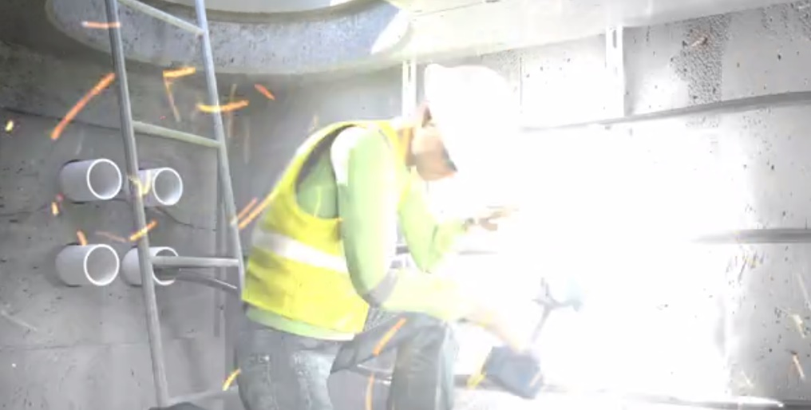

NECA Underground Incident Recreation Video
Click to Play Video
Notes:
Have the participants watch the attached video.

Slide 7
Lock-to-Lock Definition
Lock-to-Lock is used to describe the utilization of rubber gloves and sleeves, when required, prior to the time the pad mounted equipment is unlocked until work is complete, and the pad mounted equipment is relocked.
Extended Reach is used to describe being within five feet of energized conductors and/or equipment or having a conductive object within five feet of energized conductors and/or equipment.
Notes:
Define the ET&D Best Practice of Lock-to-Lock and the importance of understanding the requirements of extended reach.

Slide 8
Lock-to-Lock Use of IPPE
When employees are working on energized circuits or equipment, rubber protective-insulating gloves and sleeves rated for the exposure of the highest nominal voltage shall be worn “lock-to-lock” when employees are working on underground electrical equipment.
  This includes when the employee manipulates the enclosure’s door.
Notes:
Ensure participants understand that when employees are working on energized circuits or equipment rubber protective-insulating gloves and sleeves rated for the exposure of the highest nominal voltage shall be worn “lock-to-lock” when employees are working on underground electrical equipment. This includes when the employee manipulates the enclosure’s door.

Slide 9
Lock-to-Lock Use of IPPE
A complete, thorough inspection and hazard assessment must be conducted prior to any action involving manipulation of locking mechanism being performed.
  This hazard assessment could include the following based on geographical location: Visible damage, hinge condition, foundation (stability and general condition), rust, site conditions (landscaping), noise in the enclosure, oil present in and around enclosure, wildlife concerns (bees, snakes, etc.)
Notes:
Describe that a complete, thorough inspection and hazard assessment must be conducted prior to any action involving manipulation of locking mechanism being performed. This hazard assessment could include the following based on geographical location:
Visible damage
Hinge condition
Foundation (stability and general condition),
Rust,
Site conditions (landscaping),
Noise in the enclosure,
Oil present in and around enclosure,
Wildlife concerns (bees, snakes, etc.)

Slide 10
Lock-to-Lock Use of IPPE
If no physical, sensory, or environmental condition is present during the hazard assessment that would necessitate the use of gloves and sleeves to unlock the lock, gloves and sleeves may be omitted for unlocking. Gloves and sleeves are required for lock removal without exception.
Rubber gloves and sleeves shall be worn when working on or within the extended reach of the conductor or piece of equipment.
Electrical class rating of the insulating rubber sleeves shall meet or exceed the electrical class rating of the insulating rubber gloves.
Notes:
Explain that if no physical, sensory, or environmental condition is present during the hazard assessment that would necessitate or cause a greater hazard the use of gloves and sleeves to unlock the lock, gloves and sleeves may be omitted for unlocking. Gloves and sleeves are required for lock removal without exception.
Rubber gloves and sleeves shall be worn when working on or within the extended reach of the conductor or piece of equipment.
Electrical class rating of the insulating rubber sleeves shall meet or exceed the electrical class rating of the insulating rubber gloves.

Slide 11

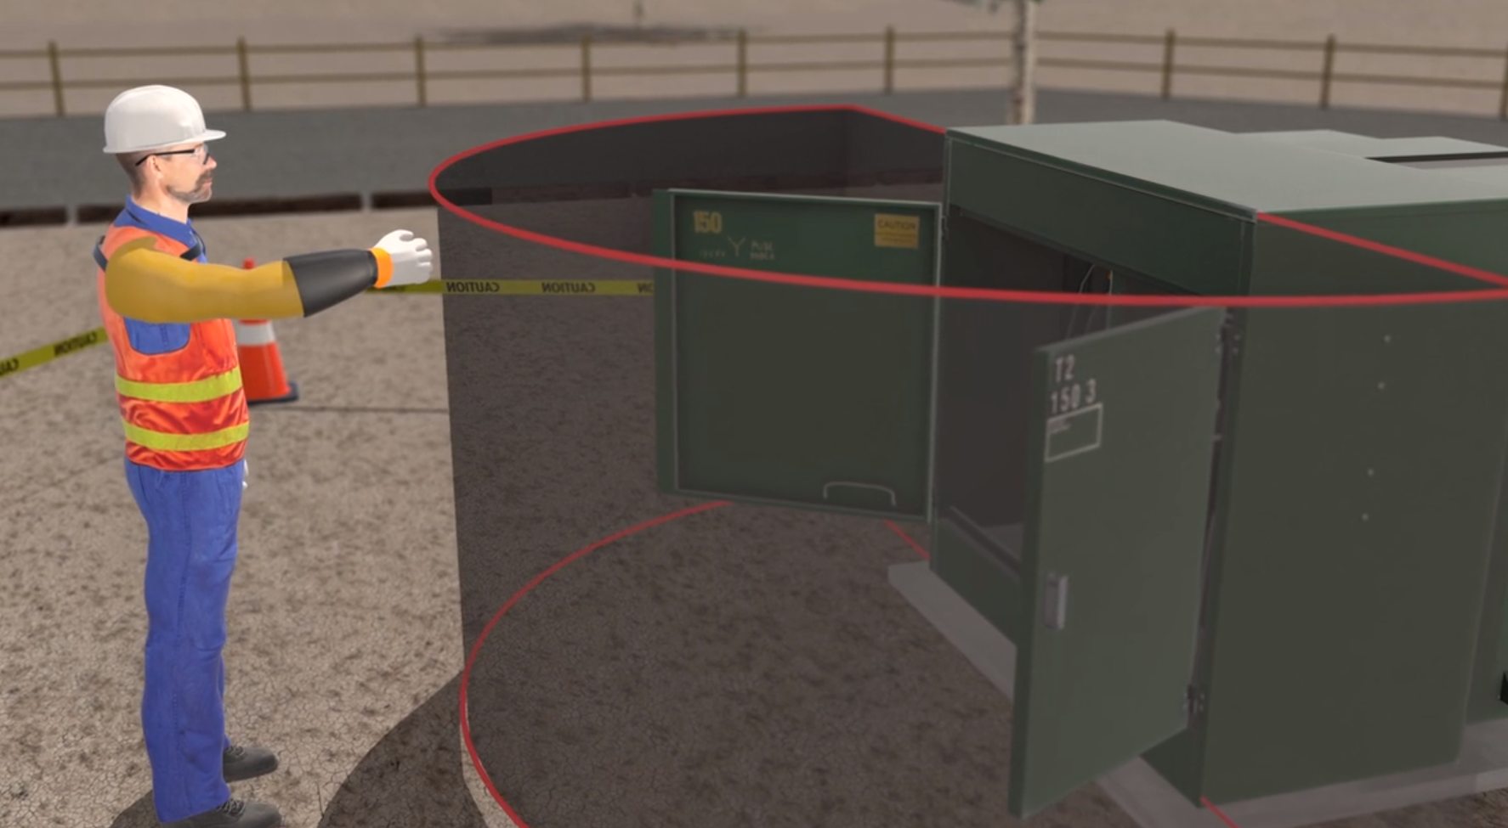
Partnership Lock-to-Lock Video
Best Practice: Lock-To-Lock on Vimeo
Scan to Watch Video
Notes:
Have the participants watch the Best Practices Video describing in detail Lock-to-Lock.

Slide 12
True or False?
Lock to Lock includes when the employee manipulates the enclosure’s door?
TRUE
Notes:
Ask the participants True or False, if Lock-to-Lock includes when the employee manipulates the enclosures door? They should all respond with TRUE.

Slide 13
Cable Inspection
Always inspect exposed sections of cable for abnormalities, signs of fault, physical damage, and dielectric concerns.
If abnormalities are identified, employees must be protected from the possible effects of cable faults.
  Electrical contact
  Arc flash
  Etc.
Notes:
1926.965(g)Moving cables. Except when paragraph (h)(2) of this section permits employees to perform work that could cause a fault in an energized cable in a manhole or vault, the employer shall ensure that employees inspect energized cables to be moved for abnormalities.
1926.965(h)(1)Cables with abnormalities. Where a cable in a manhole or vault has one or more abnormalities that could lead to a fault or be an indication of an impending fault, the employer shall deenergize the cable with the abnormality before any employee may work in the manhole or vault, except when service-load conditions and a lack of feasible alternatives require that the cable remain energized. In that case, employees may enter the manhole or vault provided the employer protects them from the possible effects of a failure using shields or other devices that are capable of containing the adverse effects of a fault. The employer shall treat the following abnormalities as indications of impending faults unless the employer can demonstrate that the conditions could not lead to a fault: Oil or compound leaking from cable or joints, broken cable sheaths or joint sleeves, hot localized surface temperatures of cables or joints, or joints swollen beyond normal tolerance.
1926.965(h)(2)Work-related faults. If the work employees will perform in a manhole or vault could cause a fault in a cable, the employer shall deenergize that cable before any employee works in the manhole or vault, except when service-load conditions and a lack of feasible alternatives require that the cable remain energized. In that case, employees may enter the manhole or vault provided the employer protects them from the possible effects of a failure using shields or other devices that are capable of containing the adverse effects of a fault.

Slide 14
Cable Identification
Identification of direct buried primary cable is essential before cutting or grounding the cable.
  Never touch or cut cables that have not been positively identified, tested, de-energized, and grounded.
After the cable has been visually verified, isolated, tested, and grounded.
A de-energized cable detector can identify the cable to be worked.
Notes:
1926.965(f)Multiple cables. When multiple cables are present in a work area, the employer shall identify the cable to be worked by electrical means, unless its identity is obvious by reason of distinctive appearance or location or by other readily apparent means of identification. The employer shall protect cables other than the one being worked from damage.

Slide 15
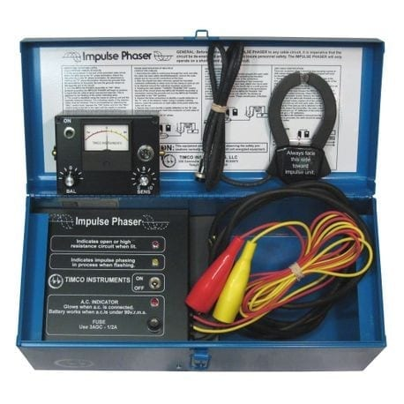
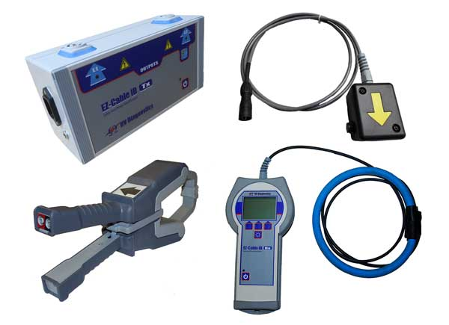
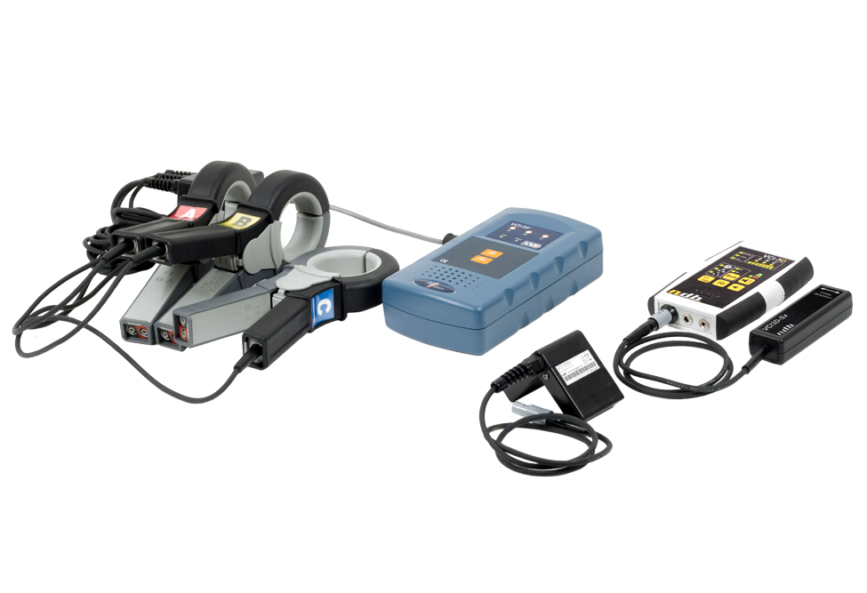
Cable Identification & Phasing Tools
Common Cable ID and Phasing Tools Include:
TIMCO - Impulse Phaser
NDB - VCi-3
HV Diagnostics – EZ-Cable ID
Hi-Potronics
Notes:
There are many different types of cable identification & phasing tools on the market.
These tools generally work by discharging a directional current pulse into a shorted loop of cable.
This current pulse is detected by using an orientation-sensitive current transducer (often clamp-on type) as the input to the detector unit.
The current pulse travels down the cable and returns on the other cables.
Due to the orientation and direction of the signal, the signal will not be present on any other cables.

Slide 16
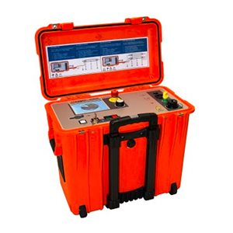
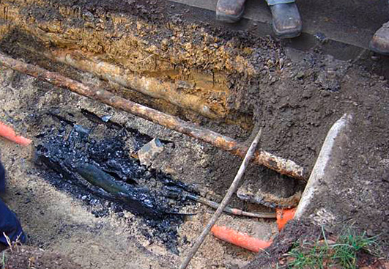
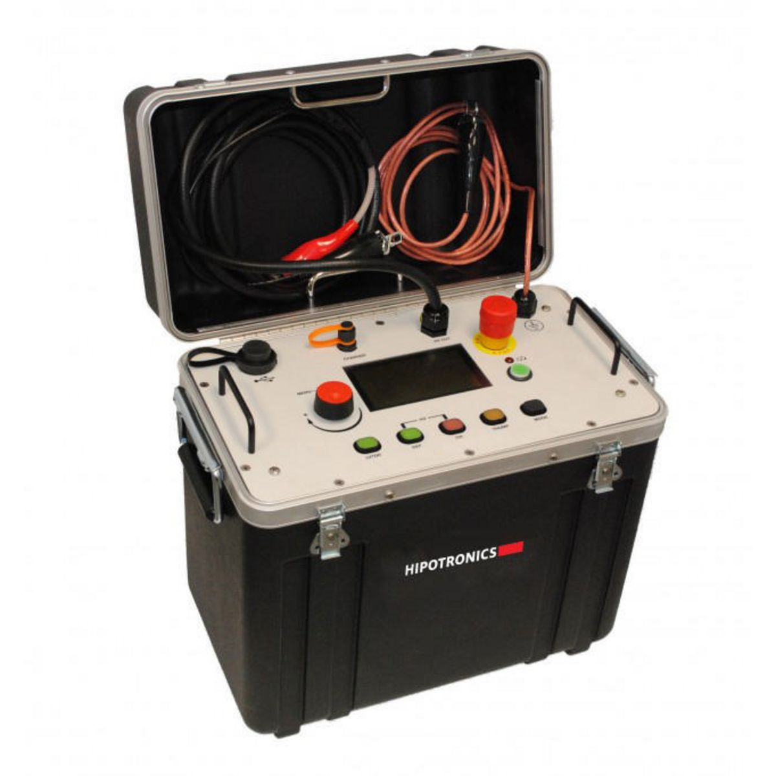
Fault Locating Equipment
Notes:
Various types of cable fault-locating equipment are available. When correctly used, ground fault locator and cable fault locator equipment can accurately identify the location and depth of underground cable, even when it is inside conduit, and can pinpoint breaks or faults in underground cable.
The amount of current flow on an energized faulted cable will vary at the point of the insulation breakdown. The resistance can be low, high, or somewhere in between. The amount of fault current will depend (in part) on the resistance between the conductor and the earth at the fault location.
High Resistance Faults
A high resistance fault usually means the conductor does not have an excellent connection to the earth. The resistance of a fault can be measured in ohms by use of a megger or ohm meter. However, high resistance faults do not generate significant current flow from the cable into the ground, making it challenging to locate such a fault with standard cable/fault locating equipment.
High-resistance cable faults often do not affect the normal flow of electricity in an electrical circuit and remain unnoticed in dry or sandy soil. However, these faults become noticeable after the cable goes through stages of oxidization, heating, and contamination. The result is that the conductor turns into a high-resistance powder and will not allow current to flow to the customer or the earth.
Low Resistance Faults
Low-resistance faults have little opposition to the current flowing into the ground. Low resistance faults generally create a high enough fault current to cause overcurrent protection to trip or blow open. Operators become
aware of faults when customers complain about the loss of power.
Low resistance faults are generally easy to find using low-cost, fault locating apparatus.

Slide 17
URD Cable Work – Insulate
The insulation option utilizes Insulating Personal Protective Equipment (gloves, sleeves, overshoes, etc.) and Insulating Protective Equipment (insulating blankets, platforms, tools, equipment, etc.).
Insulation can be used conjunction with other methods as secondary protection to cover cables (secondary or primary) that are not being directly worked on.
Notes:
Insulate
The insulation work method is challenging for URD due to the limited space and difficulty covering exposed energized conductors and paths to ground. This is not practical for underground work.

Slide 18
URD Cable Work – Isolate
Isolate the cable and ground it
Isolate Defined
  Physically separated, electrically and mechanically from all sources of electrical energy Such separation may not eliminate the effects of electrical induction!
Extreme caution is needed if you open the system neutral.
Notes:
Isolate
The isolation work method can be challenging due to the potential for energization and the need to open a system neutral. This method requires completely disconnecting the cables (including any concentric neutral, shield, and ground)
Use caution when opening a system neutral, a capacitive charge may still exist on the cable and the cable can be energized due to electrostatic or electromagnetic induction.
Explain that according to the IEEE isolated means: (A) physically separated, electrically and mechanically, from all sources of electrical energy. Such separation may not eliminate the effects of electrical induction.

Slide 19
Live Line Tool Inspection
Daily Inspection
  Each live-line tool shall be wiped clean and visually inspected for defects before use each day.
Defects
  If any defect or contamination that could adversely affect the insulating qualities or mechanical integrity of the live-line tool is present after wiping, the tool shall be removed from service and examined and tested before being returned to service.
Biennial Inspection and Testing
  Live-line tools used for primary employee protection shall be removed from service every 2 years, and defects are identified.
Notes:
1926.957(b)Condition of tools.
1926.957(b)(1)Daily inspection. Each live-line tool shall be wiped clean and visually inspected for defects before use each day.
1926.957(b)(2)Defects. If any defect or contamination that could adversely affect the insulating qualities or mechanical integrity of the live-line tool is present after wiping, the tool shall be removed from service and examined and tested according to paragraph (b)(3) of this section before being returned to service.
1926.957(b)(3)Biennial inspection and testing. Live-line tools used for primary employee protection shall be removed from service every 2 years, and whenever required under paragraph (b)(2) of this section, for examination, cleaning, repair, and testing as follows:
1926.957(b)(3)(i)Each tool shall be thoroughly examined for defects.
1926.957(b)(3)(ii)If a defect or contamination that could adversely affect the insulating qualities or mechanical integrity of the live-line tool is found, the tool shall be repaired and refinished or shall be permanently removed from service. If no such defect or contamination is found, the tool shall be cleaned and waxed.
1926.957(b)(3)(iii)The tool shall be tested in accordance with paragraphs (b)(3)(iv) and (b)(3)(v) of this section under the following conditions:
1926.957(b)(3)(iii)(A)After the tool has been repaired or refinished; and
1926.957(b)(3)(iii)(B)After the examination if repair or refinishing is not performed, unless the tool is made of FRP rod or foam-filled FRP tube and the employer can demonstrate that the tool has no defects that could cause it to fail during use.
1926.957(b)(3)(iv)The test method used shall be designed to verify the tool's integrity along its entire working length and, if the tool is made of fiberglass-reinforced plastic, its integrity under wet conditions.
1926.957(b)(3)(v)The voltage applied during the tests shall be as follows:
1926.957(b)(3)(v)(A)246,100 volts per meter (75,000 volts per foot) of length for 1 minute if the tool is made of fiberglass, or
1926.957(b)(3)(v)(B)164,000 volts per meter (50,000 volts per foot) of length for 1 minute if the tool is made of wood, or
1926.957(b)(3)(v)(C)Other tests that the employer can demonstrate are equivalent.

Slide 20
Cable Grounding
Ampacity
  Protective grounding equipment shall be capable of conducting the maximum fault current that could flow at the point of grounding for the time necessary to clear the fault.
Order of connection
  The employer shall ensure that, when an employee attaches a ground to a line or to equipment, the employee attaches the ground-end connection first and then attaches the other end by means of a live-line tool.
  The employer shall ensure that, when an employee removes a ground, the employee removes the grounding device from the line or equipment using a live-line tool before he or she removes the ground-end connection.
Notes:
1926.962(d)(1)(i)Protective grounding equipment shall be capable of conducting the maximum fault current that could flow at the point of grounding for the time necessary to clear the fault.
1926.962(f)(1)Order of connection.
The employer shall ensure that, when an employee attaches a ground to a line or to equipment, the employee attaches the ground-end connection first and then attaches the other end by means of a live-line tool. For lines or equipment operating at 600 volts or less, the employer may permit the employee to use insulating equipment other than a live-line tool if the employer ensures that the line or equipment is not energized at the time the ground is connected or if the employer can demonstrate that each employee is protected from hazards that may develop if the line or equipment is energized.
1926.962(f)(2)Order of removal.
The employer shall ensure that, when an employee removes a ground, the employee removes the grounding device from the line or equipment using a live-line tool before he or she removes the ground end connection. For lines or equipment operating at 600 volts or less, the employer may permit the employee to use insulating equipment other than a live-line tool if the employer ensures that the line or equipment is not energized at the time the ground is disconnected or if the employer can demonstrate that each employee is protected from hazards that may develop if the line or equipment is energized.

Slide 21
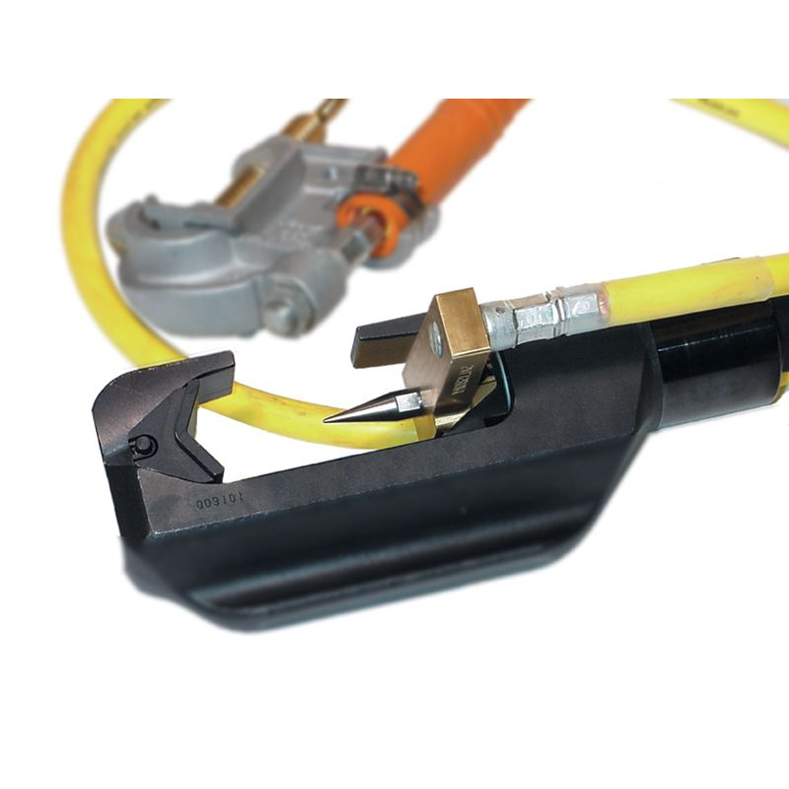
Cable Spiking Tools
A cable spiking tool can help verify that a cable is de-energized before performing maintenance.
Because malfunctions can occur when spiking, cables should still be cut remotely to ensure employee safety.
Cables are often preliminarily spiked to enable the splicing or termination of faulted cables.
Notes:
Note: Remote cable cutters and the cable spiking tool typically have written operating and safety instructions that must be strictly followed when operating these devices.

Slide 22
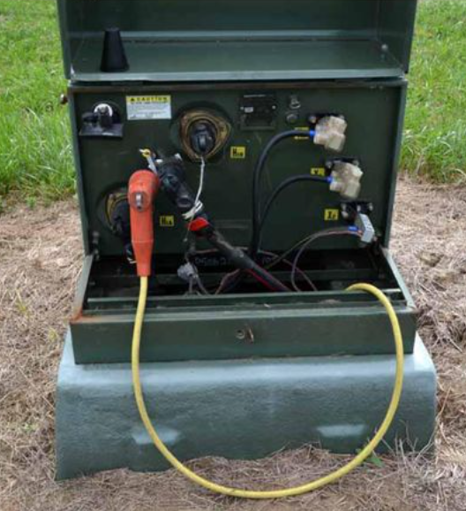
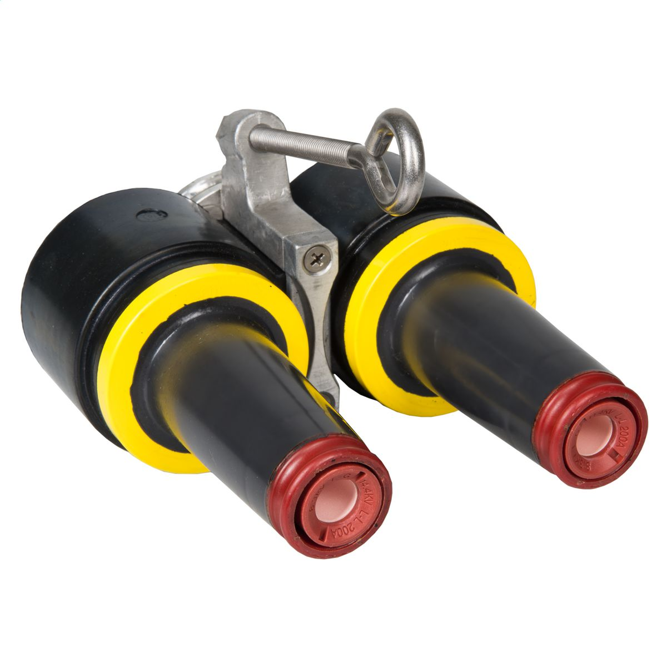
Cutting and Work at Mid-Cable
When working “mid-cable”, steps should be taken to prevent exposure to hazardous differences of potential.
Both ends of the cable need to be completely isolated and grounded
Notes:
When working “mid-cable”, steps should be taken to prevent exposure to hazardous differences of potential. Isolation requires both ends of the cable to be completely isolated.

Slide 23
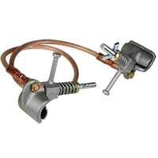
Cutting and Work at Mid-Cable
A temporary bond or jumper can maintain continuity when working on an existing cable.
Concentric Neutral
Jumper Assembly
Notes:
1926.965(h)(2)(i)Sheath continuity.
When employees perform work on buried cable or on cable in a manhole or vault, the employer shall maintain metallic-sheath continuity, or the cable sheath shall be treated as energized.

Slide 24

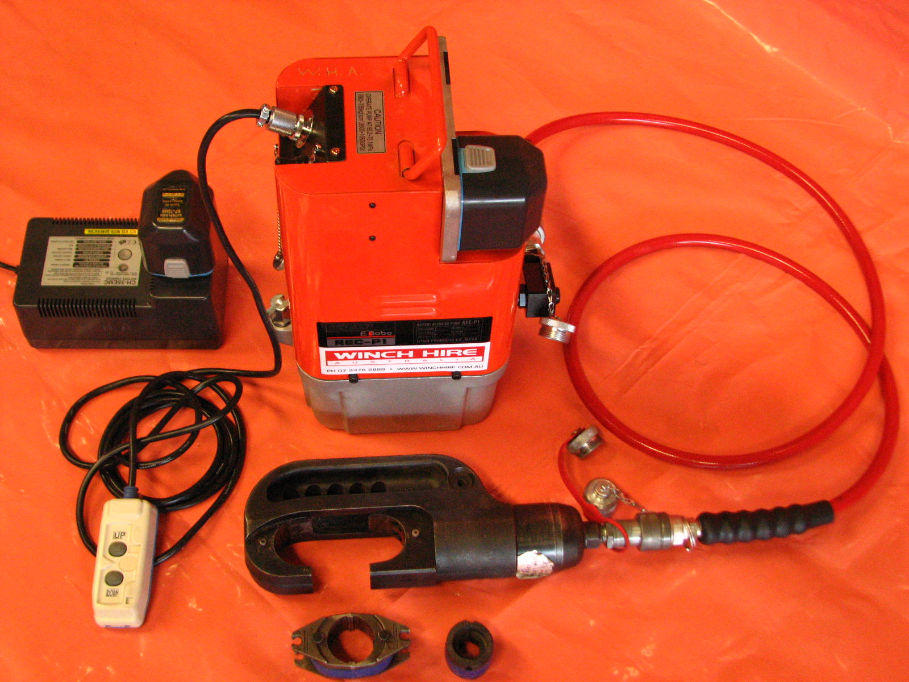
Hydraulic and Wireless Remote Cutters
Hydraulic or wireless remote cutters remove the worker from the exposure area.
In the event the wrong cable has been identified, or an unanticipated hazard occurs, employee exposure to arc flash or hazardous differences of potential will be limited.
Notes:
Caution Note: The operator must wear appropriate personal protective equipment when operating this device to prevent injury from a potential electrical flash. If tooling has been subjected to a fault, it should be discarded.
Add note: Company specific policies for tooling

Slide 25
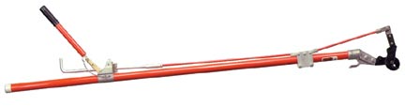
Insulated Remote Cutters
The insulated ratchet cable cutters were developed to allow the operator to be out of the trench when performing the cable-cutting operation.
The slicer style heads cuts through the cable contacting the neutral wires first and then the conductor. Should an energized cable be accidentally cut, creating a fault, it will occur away from the operator.
Notes:
Caution Note: The operator must wear appropriate personal protective equipment when operating this device to prevent injury from a potential electrical flash. If tooling has been subjected to a fault, it should be discarded.
Add note: Company specific policies for tooling.

Slide 26
True or False
When multiple cables are present in a work area, and there is no other means to identify them, we must identify the cable to be worked by electrical means?
TRUE
Notes:
Ask the participants: True or False – When multiple cables are present in a work area, we must identify the cable to be worked by electrical means? Everyone should respond TRUE.
PLEASE SEE NOTES FROM SLIDE 14…1926.965(f)Multiple cables. When multiple cables are present in a work area, the employer shall identify the cable to be worked by electrical means, unless its identity is obvious by reason of distinctive appearance or location or by other readily apparent means of identification. The employer shall protect cables other than the one being worked from damage.

Slide 27
Review
Defined ET&D Partnership Best Practices
  Lock-to-Lock
Discussed Underground Cable Work Protection Options
  Insulate
  Isolate
Discussed Tooling and Equipment Uses
  Cable Inspection
  Cable and Fault Identification Equipment
  Grounding Cable
  Spiking Cable
  Cutting Cable

Slide 28
Questions?

