Slide 1
Fall Protection
Continuing Education
Third Quarter 2016
Notes:
Introduce the module. Explain that this is the next module in the continuing quarterly education series.

Slide 2
Objectives
Upon completion of this module you should be able to:
Explain the difference between fall protection, fall arrest, and positioning systems
Explain the performance requirements of each system
Explain equipment inspection requirements
Explain anchorage requirements
Explain how to determine fall distance
Notes:
Explain that this module is not intended to cover every aspect of fall protection. It is simply a review of some pertinent points. It is designed to cover the more basic aspects for overhead electrical work. Please note that specific company and client rules may be more stringent than those talked about here. Upon completion of this module you should be able to determine when fall protection is needed; what is needed; how to inspect, use and care for this equipment.

Slide 3
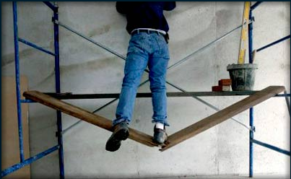
Employer’s Duty
Determine if the surfaces on which its employees are to work have the strength and structural integrity to support employees safely
Notes:
Explain that Fall Protection is governed by OSHA regulations and that the regulations have certain requirements. The regulation that governs fall protection is titled “Subpart M”. Subpart M, sub-section 1926.501(a)(2) states that the employer shall determine if the walking/working surfaces on which its employees are to work have the strength and structural integrity to support employees safely. Employees shall be allowed to work on those surfaces only when the surfaces have the requisite strength and structural integrity. In addition Subpart M requires that the employer must provide fall protection when there is a hazard of falling 6 feet or more to a lower level. This can include wall openings that are less than 39 inches from the floor that have a fall hazard of 6 feet or more to a lower level. An example of this would be a building under construction that has a rough window opening in place. These standards would take precedence over work not covered by the Power Transmission & Distribution standard “Subpart V”.

Slide 4
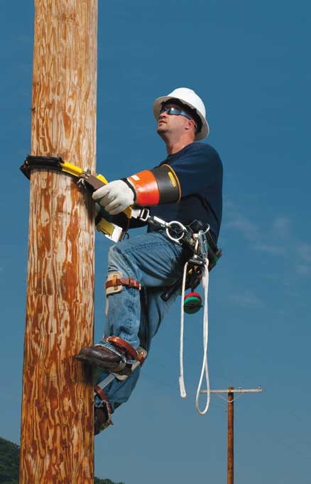
Subpart “V” Change
Fall protection and fall arrest is now required for Power Transmission and Distribution workers
  Wooden & Steel Poles
  Towers
Notes:
OSHA requires that each employee in elevated locations more than 1.2 meters (4 feet) above the ground on poles, towers, or similar structures shall use a personal fall arrest system, work-positioning equipment, or fall restraint system, as appropriate, if the employer has not provided other fall protection meeting Subpart M of this part.
Explain that these regulations apply to structures that support overhead electric power transmission and distribution lines and equipment. They do not apply to portions of buildings, such as loading docks, or to electric equipment, such as transformers and capacitors. Subpart M of this part contains the duty to provide fall protection associated with walking and working surfaces.
Explain that these regulations require that until the employer ensures that employees are proficient in climbing and the use of fall protection the employees are not considered "qualified employees“.

Slide 5
Equipment Inspection
Notes:
Explain that the following slides will briefly discuss pre-use inspection of equipment.

Slide 6
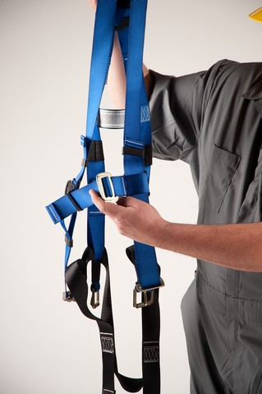
General
Inspection prior to use
Done by a competent person
Defective or damaged equipment removed from service
This includes equipment subjected to fall event
Notes:
Explain that fall protection, fall arrest, and/or work-positioning equipment shall be inspected before use each day to determine that the equipment is in safe working condition. Any equipment that is not in safe working condition may not be used.

Slide 7
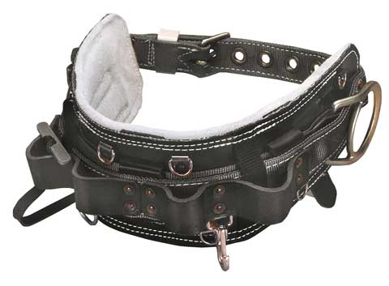
Body Belt
The hardware has no cracks, nicks, distortion, or corrosion
No loose or worn rivets are present
The waist strap has no loose grommets
The fastening straps are not 100-percent leather
No worn materials that could affect the safety of the user are present
Notes:
Explain that the following specific items of the worker’s body belt shall be inspected to determine that:
The hardware has no cracks, distortion, or corrosion
There are no loose or worn rivets
The waist strap has no loose grommets
There are no worn materials that could affect the safety of the user
The d-rings are compatible with the snap hooks which they are used
There are no non-approved modifications have been made to carry tools or materials

Slide 8
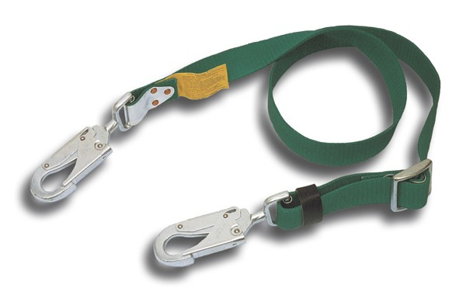
Positioning Strap
Inspect for the following:
  Damage to the snaps
  Locking snap type
  Electrical burns
  Damage rivets
  Elongated holes
  Red warning indicator
  Dry rot
Notes:
These straps and lanyards must be inspected prior to each use. They should be inspected for the following:
Electrical burns, cracks, or deformation of the snap-hooks, buckle, friction adjustor, or carabineer.
Loose rivets or broken stitching on the hardware attachment points, sewn splices or compression fittings, and other primary strength members.
Degraded or torn nylon strength members, as well as other physical, chemical, heat or age related damage.
Dry rotted leather.
Exposed red wear indicator
Elongated holes, or broken stitches

Slide 9
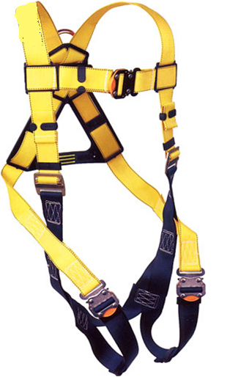
Body Harness
Manufacturer’s markings
Missing pieces
Defects or damage
Alteration
UV exposure
Chemical exposure
Frayed webbing
Notes:
Explain that some of the following specific items of the harness shall be inspected to determine:
The absence or illegibility of manufacturer’s markings;
The absence of any elements affecting the equipment
The form, fit or function;
Any evidence of defects or damage to hardware elements including:
cracks,
sharp edges,
deformation,
corrosion,
chemical attack,
excessive heating,
alteration and excessive wear;
Any evidence of defects or damage to straps or ropes including:
fraying,
misplacing,
inlaying,
kinking,
knotting,
broken or pulled stitches,
excessive elongation,
chemical attack,
excessive soiling,
abrasion,
alteration,
needed or excessive lubrication,
excessive aging and excessive wear;
alteration, or absence of parts,
evidence of defects in, damage to or improper function of mechanical devices and connectors.

Slide 10
Flammability
If a worker is exposed to flames or electric arcs
  The fall protection equipment must be capable of withstanding these hazards
Notes:
Explain that when used by employees weighing no more than 140 kg or 310 pounds fully equipped, body belts and positioning straps that conform to American Society of Testing and Materials Standard Specifications for Personal Climbing Equipment, ASTM F887, are deemed to be in compliance with this requirement. Explain that the severity of arc flash is measured in terms of the heat energy imparted by the electric current. The ASTM F 887 standard specifies exposures of 40 cal/cm². This exposure level is considered to be a very high risk category, typically encountered only by working on energized parts like voltage-testing in switchgear greater than 1000 Volts.

Slide 11
Weight Rating
Standard body harness is rated for 310 pounds
  Weight of the worker and tools
Notes:
Explain that when used by employees weighing no more than 140 kg or 310 pounds fully equipped, body belts and positioning straps that conform to American Society of Testing and Materials Standard Specifications for Personal Climbing Equipment, ASTM F887-12e1, are deemed to be in compliance with this requirement.

Slide 12
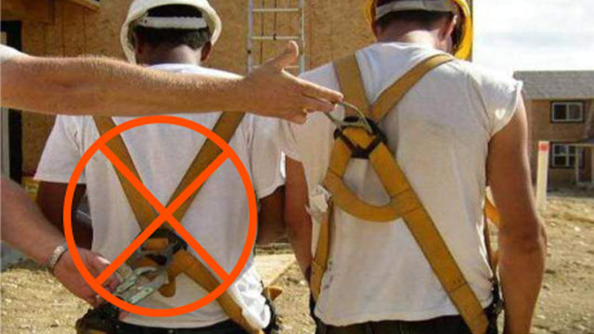
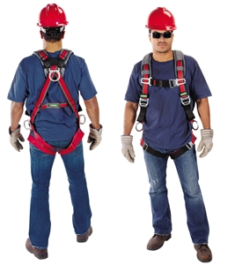
Proper Fit
Use the “Buddy System””
D-ring in center of back near shoulders
Chest strap in center of chest
Leg straps tight
Snug Fit
“All On” or “All Off”
Notes:
Explain the need for the “Buddy System”. Explain that the harnesses must have the d-ring in the center of the back near the shoulders. Explain the last bullet which means the wearer either has the harness completely on or taken off. Do not wear a harness with the leg straps unfastened.

Slide 13
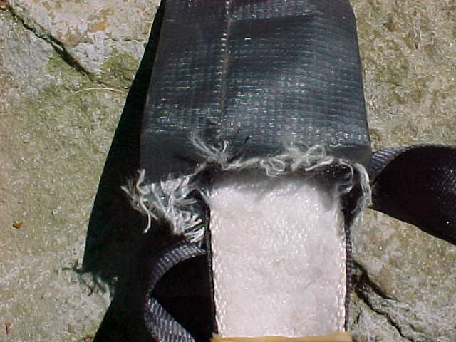
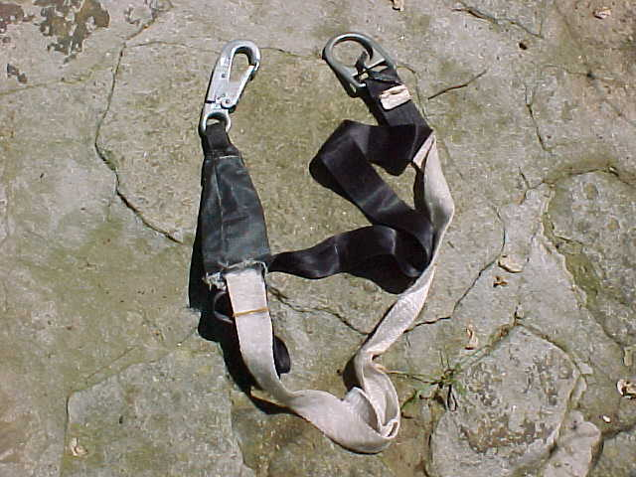
Shock Absorbing Lanyard
Shock Absorbing lanyards that are subjected to a fall must be removed from service
Even if the lanyard does not fully deploy
Notes:
Explain that if a shock absorbing lanyard starts to deploy, it must be removed from service, even if it does not fully deploy.

Slide 14
System Types
Notes:
Explain that you are going to discuss the three basic systems.

Slide 15
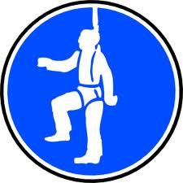
Types of Systems
Fall Protection System
Fall Arrest Systems
Positioning System
  Performance criteria is different for each
Notes:
Explain that you are going to discuss the three basic systems. Fall Protection, Fall Arrest, and Positioning Systems.

Slide 16
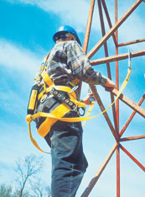
Three Systems
Fall Protection
  Prevents a fall
Fall Arrest
  Limit free fall to 6’
Positioning
  Free fall < 2 feet
Is the steel of sufficient strength to function as an anchorage and support the worker should the worker experience a fall?
Notes:
Explain that a fall prevention or fall protection system is a system, which may include a positioning system, intended to prevent a worker from falling from an elevation. Such systems may include guardrails and other barrier systems. Fall prevention systems are used in an attempt to prevent workers from falling from an elevation.
Explain that a personal fall arrest system is an assembly of equipment such as a full-body harness in conjunction with a connecting means, with or without an energy-absorbing device, and an anchorage to limit the forces a worker experiences during a fall. A fall arrest system is designed to prevent a worker, in the process of a fall, from falling more than the designed fall limit. It does not prevent a worker from falling.
Explain that work-positioning systems like a pole strap must be rigged so that an employee can free fall no more than 0.6 meters (2 feet).
Ask the group the question under the picture.

Slide 17
Fall Protection Systems
Notes:
Explain that you are going to explain in greater depth the types of systems and their differences.

Slide 18
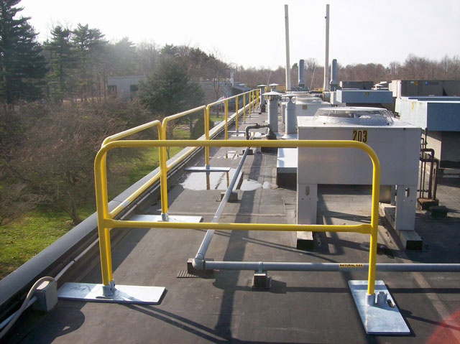
Guardrails
Top rail
  42 inches ± 3 inches
  Withstand 200 pound side force
Mid rail
  Mid-way between top rail and walking surface
  Withstand 150 pound force
Notes:
Explain that OSHA sets requirements for the strength and height requirements. The top edge height of top rails, or equivalent guardrail system members, shall be 42 inches (1.1 m) plus or minus 3 inches (8 cm) above the walking/working level. When conditions warrant, the height of the top edge may exceed the 45-inch height, provided the guardrail system meets all other criteria of this paragraph. Note: When employees are using stilts, the top edge height of the top rail, or equivalent member, shall be increased an amount equal to the height of the stilts. Midrails, screens, mesh, intermediate vertical members, or equivalent intermediate structural members shall be installed between the top edge of the guardrail system and the walking/working surface when there is no wall or parapet wall at least 21 inches (53 cm) high.

Slide 19
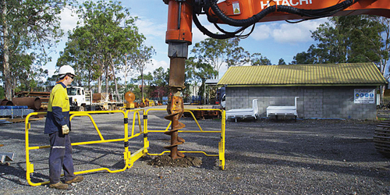
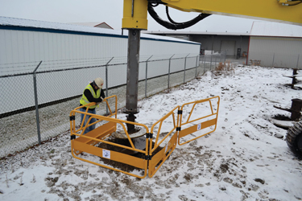
OEPS-Fall Protection
Open Excavation Protection System
Notes:
Explain that Open Excavation Protection System. OEPS™ is an industry derived safety device preventing fall related injuries and protecting staff, employers and visitors from danger and loss. OEPS™ which stands for Open Excavation Protection System, is a certified, made for industry barricade that completely secures the area around an excavation site whether excavating holes or trenches. It is an engineered safeguard that offers complete demarcation as well as a physical prevention of a fall event for staff, other workers, members of the public and animals. OEPS™ complements existing barricade protection perfectly. While excavation works take place, it operates alongside other on-site demarcation and barricading, such as demarcation exclusion zones. The OEPS™ is designed to offer ease of assembly and two-fold protection. Mesh floor panels allow over-the-excavation inspection/protection, while handrails prevent falls from the side. The system comprises of rigid panels and split floor panels that can be removed and secured away from the unit when in use, allowing access for tools for excavation. The panels are detachable and fold away. While forming a solid, rigid system, the individual components can be packed separately in a flat-pack configuration and stacked up to 6 units high. Each unit can be lifted by two adults.

Slide 20
Fall Arrest Systems
Notes:
Explain that you are going to discuss fall arrest systems.

Slide 21
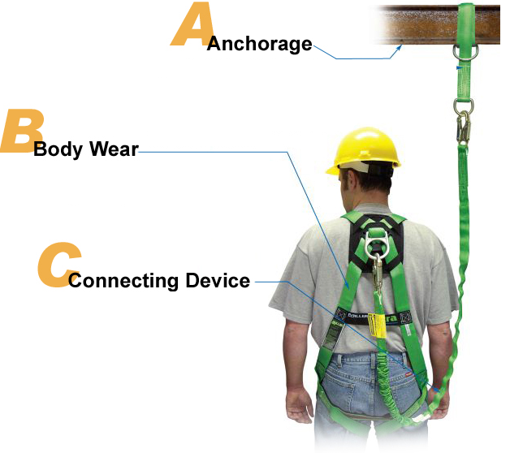
The ABC’s of Fall Arrest
Harness
Notes:
Discuss the components and the ABC’s of fall arrest.

Slide 22
Performance Criteria
Limit free fall is not more than 6’
Cannot contact with a lower level
Shock absorber brings employee to full stop within 3 ½ feet
Lanyard & harness are compatible
System must provide for prompt rescue
System based on total weight of 310 pounds (employee + tools combined weight)
Notes:
Explain that this slide lists the requirements of a personal fall arrest system. Explain that the harnesses must have the d-ring in the center of the back near the shoulders. The harness and lanyard combination must limit the arresting force to 900 lbs.

Slide 23
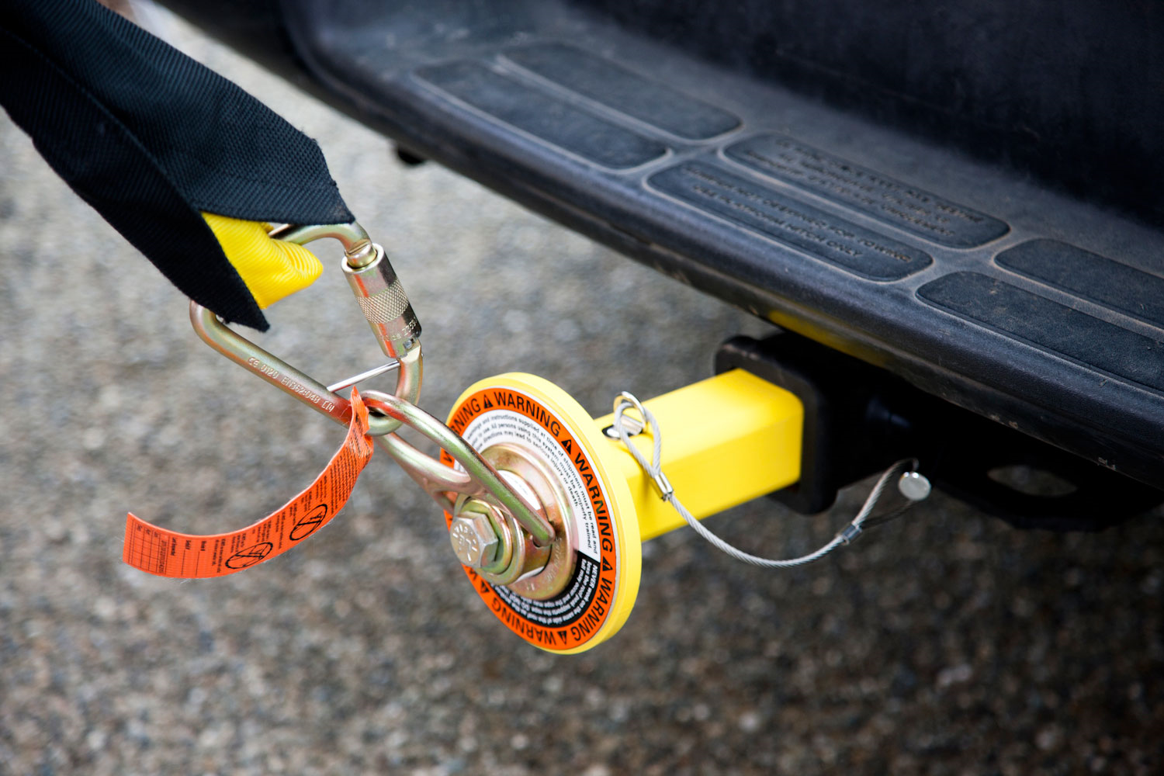
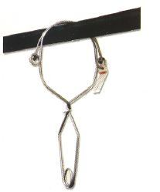
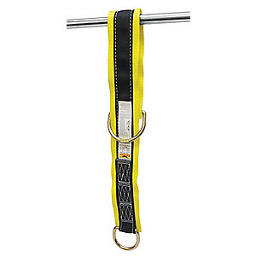
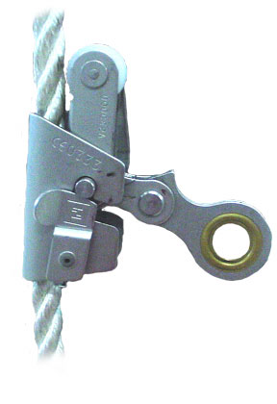
Anchorage
Strength
  Fall Arrest:
    Support at least 5,000# per employee attached
  Positioning:
    3,000# or twice impact load
Notes:
Explain that all anchorage points must be able to support at least 5,000 pounds per employee attached or twice the anticipated load that may be applied. This may be determined by a competent person. Anchorages for positioning devices shall be able to support 3,000 pounds or two times the impact load. Anchorages on our bucket trucks must be independent of the bucket. Always attach to a manufacturer supplied anchor point. This point was engineered for use in accordance with ANSI A92.2 Vehicle-Mounted Elevating and Rotating Aerial Devices. If there is no supplied anchor point, then an approved boom strap must be used.
Explain that the picture shows an anchorage system developed by Gravitec for DirectTv workers installing systems on rooftops. One aspect of the system is a truck mounted anchorage point. This device may be a possible anchorage solution for employees working near excavations.

Slide 24
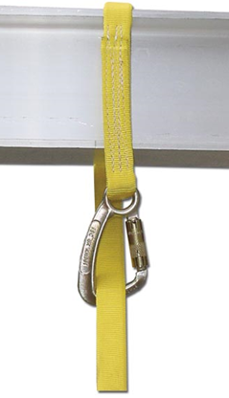
Tie Back
Only for lanyards designed to be used in a “Tie-Back” configuration
Notes:
Explain that only those lanyards that are designed to accommodate a tie back connection may be used in that configuration. Some Tie back lanyards do not allow the snap hook to connect over the webbing but to an additional D ring attached to the body of the lanyard.

Slide 25
Determine Force & Fall Distance
Notes:
Introduce the module

Slide 26
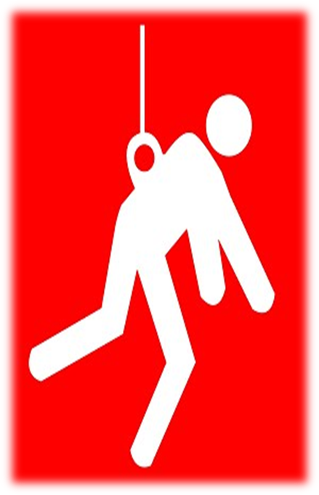
Force
Fall Distance (Feet) | Avg. Force (Pounds)
3 | 820
4 | 810
5 | 822
6 | 872
7 | 877
9 | 1,315
10 | 1,654
11.5 | 2,332
Distance of Drop | Average Force in Pounds
6 inches | 1,100
3 feet | 2,500
4 feet | 3,200
5 feet | 3,800
6 feet | 4,000
Notes:
Explain that the first table shows the force exerted when a 220 pound steel weight was dropped into a non-shock absorbing type nylon lanyard. The second table shows the results dropping the same 220 pound weight into a Miller shock absorbing lanyard.

Slide 27
Calculate Fall Distance
6’ Lanyard
5 feet of free fall
+
Anchorage at foot level
5’ from dorsal “D” ring to the anchorage point
6 feet of Lanyard
+
Free Fall Distance = 11 feet before lanyard starts to deploy!
3 1/2 feet (Pouch)
=
14 ½ feet to the “D” Ring
27
Notes:
62
62
62
62
62
62
62
Ask the group how far this person would fall then explain all the factors. Also explain that OSHA limits the maximum allowable free fall distance to 6 feet. To ensure an employee does not strike a lower level – 12.5 to 19.5 feet of clearance distance is typically needed. For power transmission and distribution workers, OSHA does not consider trees, conductor, the tower leg, cross bracing, or lattice work to be a lower level. This is critical when considering fall arrest and fall positioning equipment

Slide 28
Life Lines
Notes:
Explain the the following section will discuss both horizontal and vertical lifelines.

Slide 29
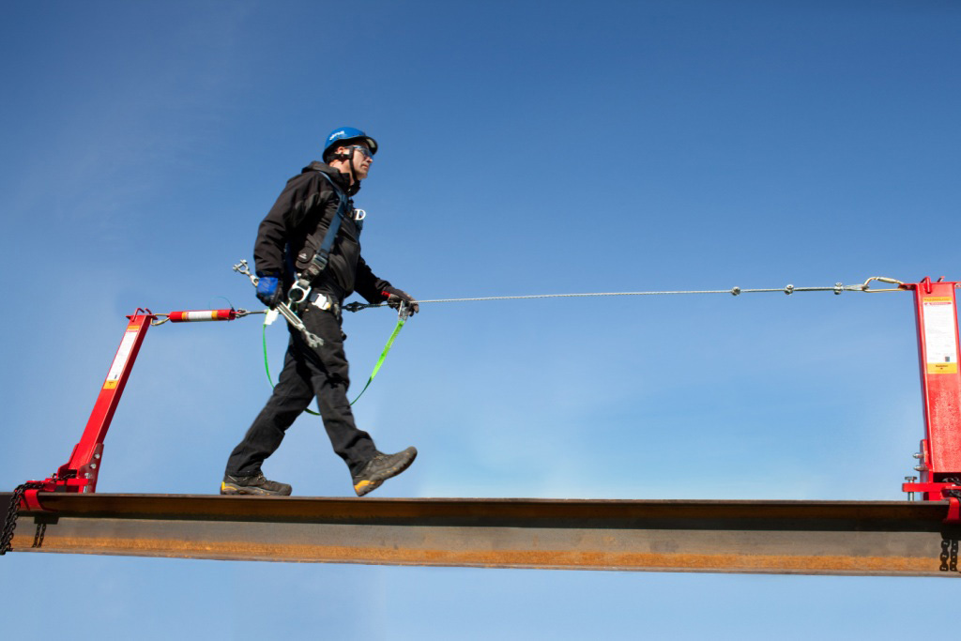
Horizontal Lifeline
Minimum safety factor of 2
Protected from being cut or abraded
Designed, installed, and used under the supervision of a qualified person
Notes:
Explain that in the context to this standard, a Qualified person means one who, by possession of a recognized degree, certificate, or professional standing, or who by extensive knowledge, training, and experience, has successfully demonstrated his ability to solve or resolve problems relating to the subject matter, the work, or the project. Discuss that only one person per lifeline or the lifeline must be rated for the number of persons attached. Number of Persons X 5,000 lbs = rating

Slide 30
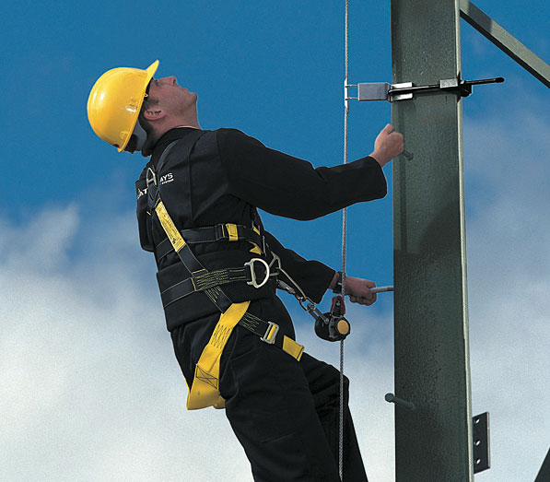
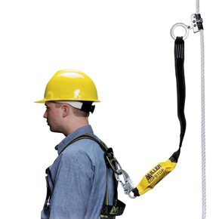
Vertical Lifeline
Minimum breaking strength of 5,000#
Designed, installed, and used under the supervision of a qualified person
Only one worker per lifeline
Vertical Lifeline
Notes:
Lanyards and vertical lifelines shall have a minimum breaking strength of 5,000 pounds (22.2 kN). Explain that only one person at a time (except elevator workers) is allowed to be attached to a vertical lifeline.

Slide 31
Positioning Systems
Notes:
Introduce the module

Slide 32
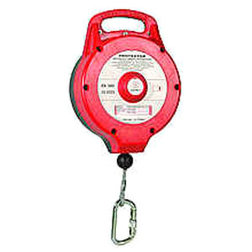
Self Retracting Lifeline
Limits free-fall to Two (2) feet
  Minimum breaking strength of 3,000 pounds
Notes:
When using a self-retracting lifeline, it must not allow any more than a 2 foot free fall. The minimum breaking strength of a self-retracting lifeline is 3,000 pounds.

Slide 33
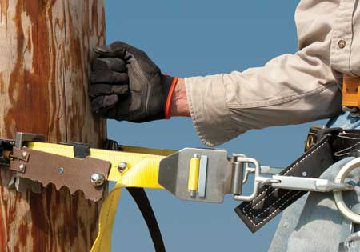
Wooden Pole
Limits free-fall to Two (2) feet
Minimum breaking strength of 3,000#.
Notes:
Wooden pole positioning systems are designed to provide line personnel protection from falling while working from wood poles from the ground, to the elevated work position, and back to the ground. These systems require the user to hitchhike up and down the pole utilizing the cross over strap and the paddle tensioner. If the user starts to fall, the strap squeezes the pole, securing the user and preventing a fall. While climbing over obstructions, the user would secure a second lanyard prior to removing the primary strap. These systems can accommodate various size poles.

Slide 34
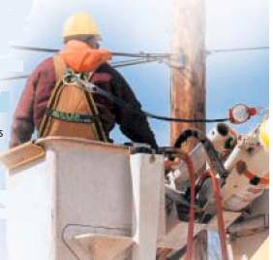
Aerial Lifts
Each employee working from an aerial lift shall use:
  A fall restraint system or
  A personal fall arrest system
Notes:
Explain that each employee working from an aerial lift shall use a fall restraint system or a personal fall arrest system.

Slide 35
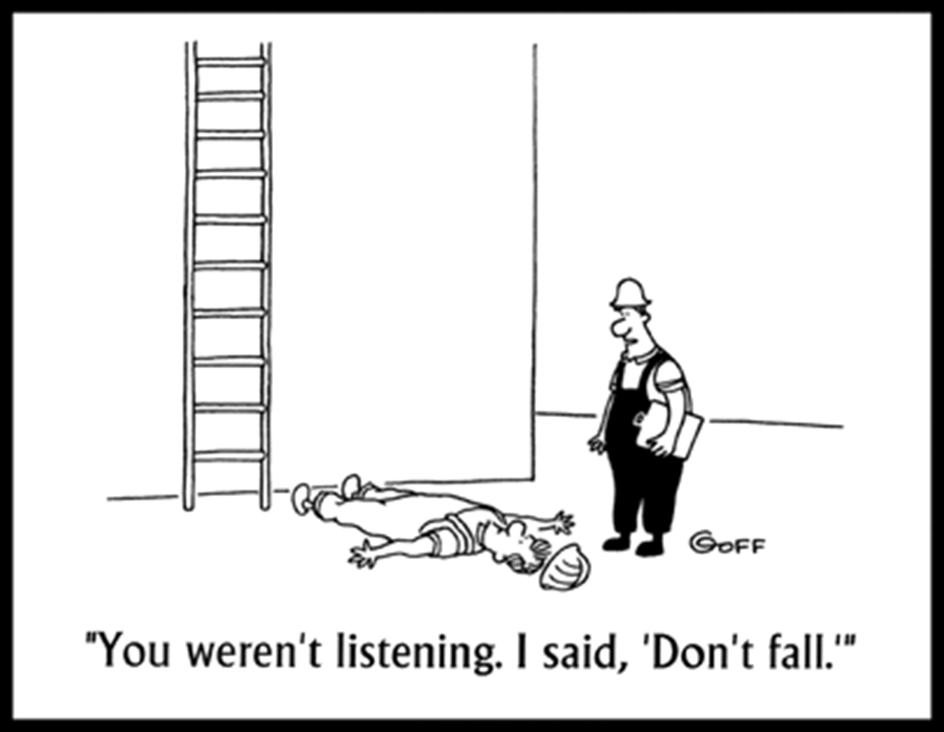
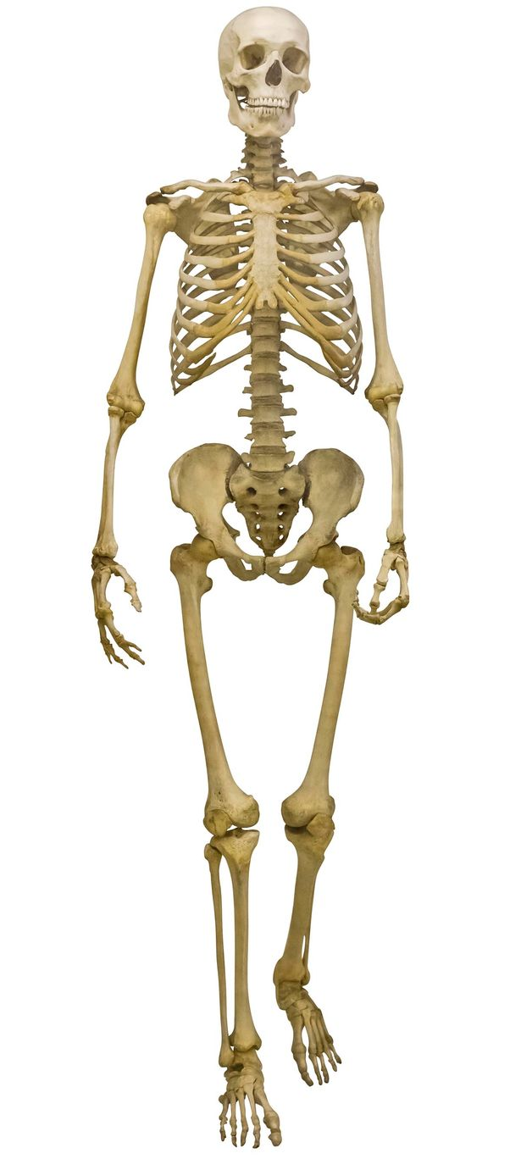
Why Fall Protection?
There are at least 206 very good reasons to protect yourself from a fall
Remember,
Gravity is the Law!!
Notes:
There are 206 bones in the human body. So there are 206 good reasons that you might not want to be involved in a fall.

