Slide 1
Slips, Trips, and Falls
From Ground Level
Session Two
Notes:
Explain that the following section will discuss slip, trip, and fall events that occur from ground level or same elevation.

Slide 2
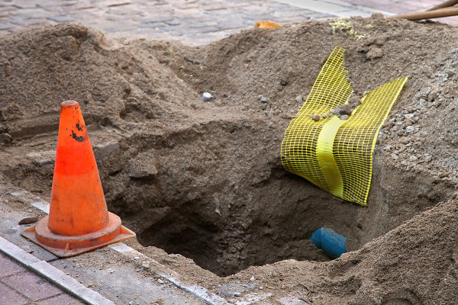
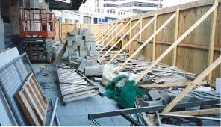
Common Causes
  Possible Deficiencies
  Housekeeping
  Unguarded holes
  Barriers
  Awareness
  Loss of Focus
Notes:
Explain the typical job sites hazards and certain common causes of slip, trip, and fall events. Engage the group by asking if they have seen or experienced any of these instances at their worksites?

Slide 3
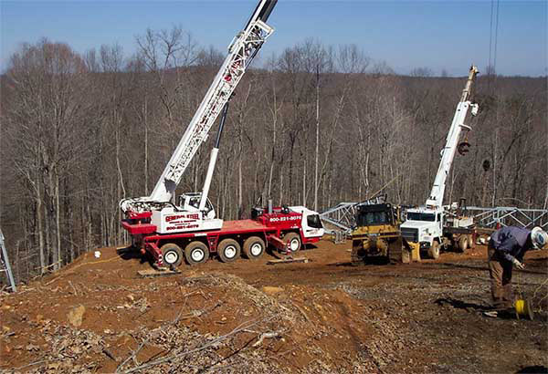
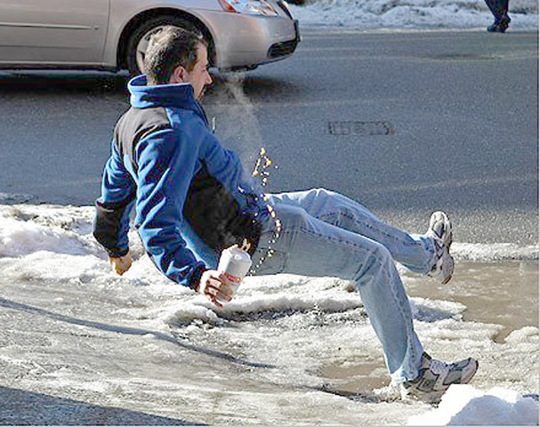
Common Causes
Environmental Issues
  Ruts
  Mud
  Rain
  Ice
  Snow
  Uneven/rough terrain
Notes:
Explain how weather and terrain need to be identified and the hazards associated with them must be controlled to the best of our abilities prior to and while working.

Slide 4
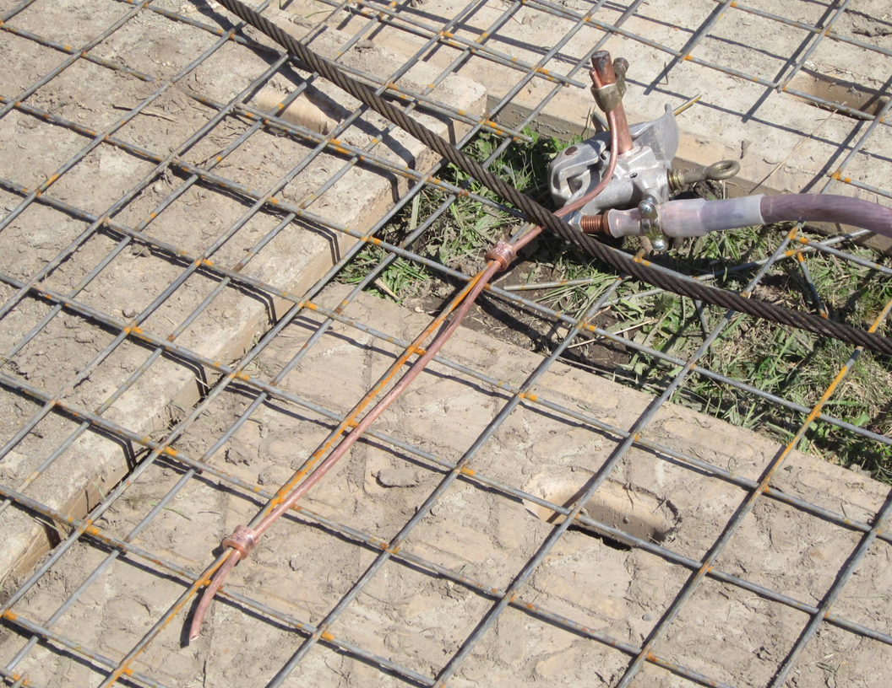
Hazard?
Possible Solution(s)?
Notes:
Use this as an involvement activity. Ask the group if they see a potential hazard in this image. Ask them to identify the hazard and suggest a corrective solution. The desired answers here are that there is a possible trip hazard as well as a possible impalement hazard. The best solution is to move this ground rod to a non-travel location where people will not normally be walking. If the hazard absolutely cannot be removed then try to lower the exposure. Maybe drive the rod a bit deeper into the ground.

Slide 5
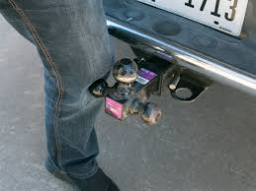
Hazard?
Possible Solution(s)?
Notes:
Use this as an involvement activity. Explain how a receiver hitch can cause trips and falls, including bruising. Explain the need to identify with barriers or eliminate by vehicle placement or removing them when not in use. Ask the group what could be some possible solutions to this hazard? This is a good slide to foster some discussion.

Slide 6
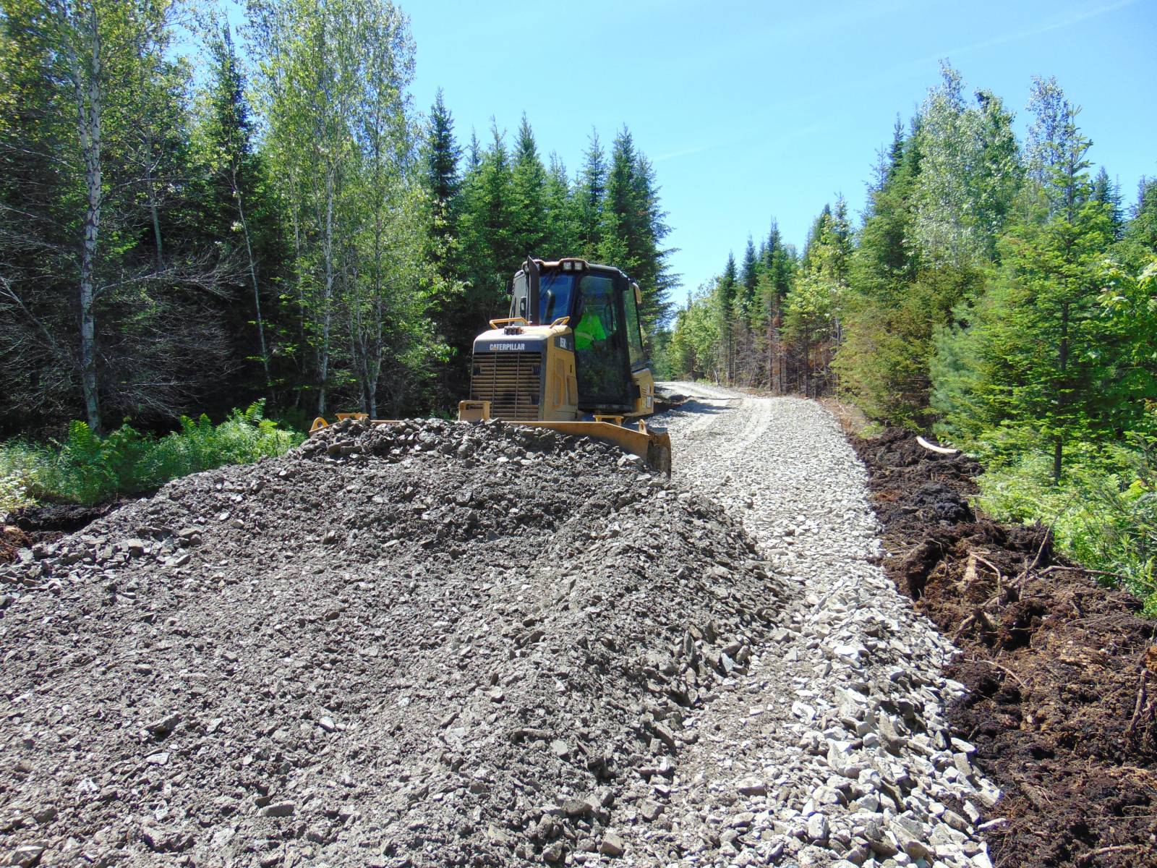
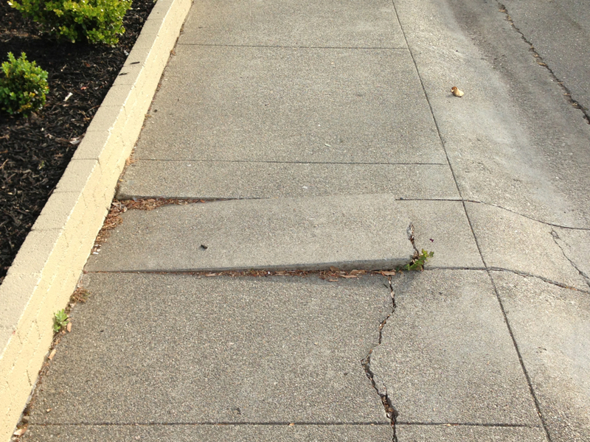
Common Causes
Uneven surfaces
Curbs
Cracks
Damaged surfaces
Loose gravel or debris
Notes:
Explain the need to identify hazards and maintain situational awareness when walking. State that irregular walking surfaces pose a risk. Identify these issues in the pre-task analysis.

Slide 7
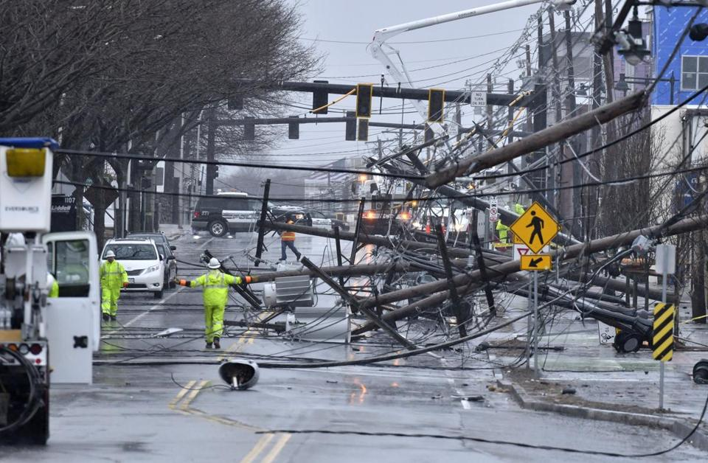
Slip, Trip, & Fall Environment!
Possible Solution(s)?
Notes:
Use this as an involvement activity. Ask the group to look at this picture and state some of the obvious hazards. The facilitator is looking for items such as electrical hazards, trip hazards, slick surfaces from spilled oil, puncture hazards, back feed, and step potential issues. Then explain how conditions are unpredictable and ever changing on storms. Explain that we need to do our best to address all STF hazards in our work areas. After a short discussion, ask the attendees to list some methods for controlling these obvious hazards.

Slide 8
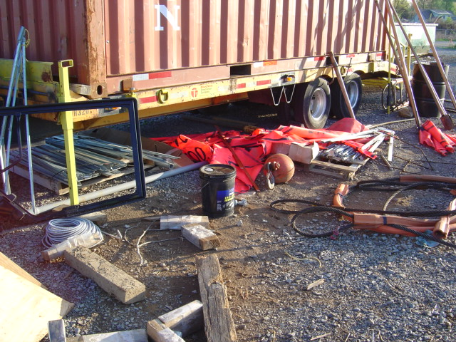
Common Causes
Housekeeping
Hoses
Cables
Conductor
Extension cords
Rigging
Hardware
Poor housekeeping is a precursor to an injury
Notes:
Explain that housekeeping or lack thereof can be a contributing factor to an injury. Poor housekeeping is a precursor to an injury. Rarely is there a time when housekeeping is deficient and productivity, quality, and/or safety is good. Poor housekeeping equals poor performance. Time is wasted, materials and tools are damaged or lost, workers are frustrated and may be injured. There is no plus-side to poor housekeeping.

Slide 9
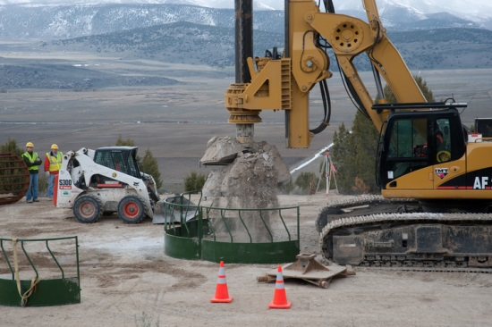
5-10-15 Method
Recognize
Every 5 minutes
Take 10 seconds
Look 15’ around you
Have a plan
Consider your next steps
Escape route
Evaluate
Control
Notes:
Explain the 5, 10, 15, process. Tell the attendees that they need to be purposeful in their thinking and plan their next steps. Explain the need to not only have a plan, but they need to have an escape route if something goes wrong.

Slide 10
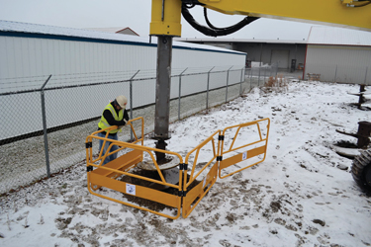
O.E.P.S.
Open Excavation Protection System
Protection from falling into open excavations such as pole and/or foundation holes
Notes:
Explain that workers must be protected from falling into an excavation or drilled hole. The illustration shows an open excavation protection system. This system is a guardrail system that will keep workers from falling into a drilled hole. However it is important to mention that there are times a worker may need to enter this workspace. There must be a system in place to keep the worker from falling into the hole and in the worst case, retrieve the worker should the edge of the excavation fail and the worker slips into the hole.

Slide 11
Key Points-Session Two
Falls from ground elevation can be caused by poor housekeeping.
  True
  False
Open excavations should be guarded to prevent fall hazards.
  True
  False
Uneven and or damaged surfaces may cause falls and result in an injury.
  True
  False
The meaning of the 5-10-15 rule is:
  Every 5 steps, take a 10 to 15 minute smoke break
  Every 5 days, take 10 minutes to do 15 push-ups
  Every 5 minutes, take 10 seconds to look 15 feet around you
  Every 5 minutes, take 10 seconds to snap 15 selfies and post them on Facebook.
Notes:
Falls from ground elevation can be caused by poor housekeeping.
True
False
Open excavations should be guarded to prevent fall hazards.
True
False
Uneven and or damaged surfaces may cause falls and result in an injury.
True
False
The meaning of the 5-10-15 rule is:
Every 5 steps, take a 10 to 15 minute smoke break
Every 5 days, take 10 minutes to do 15 push-ups
Every 5 minutes, take 10 seconds to look 15 feet around you
Every 5 minutes, take 10 seconds to snap 15 selfies and post them on Facebook.

