Slide 1


WORK ZONE
PROTECTION
OSHA ELECTRICAL TRANSMISSION & DISTRIBUTION PARTNERSHIP
2nd Quarter 2026
Notes:
Introduce the module. Explain that the intent of this presentation is to provide a continuing education training topic related to certain aspects from the either the ET&D 10-Hour OSHA training class, the OSHA Partnership Best Practices, and/or incident trending analysis.

Slide 2

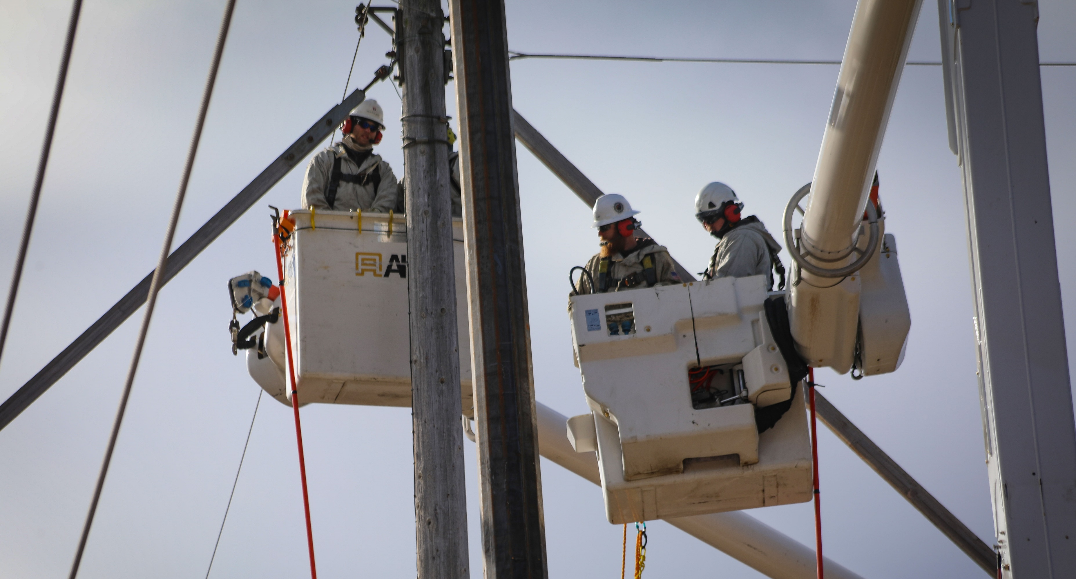

OBJECTIVES
Upon completion of this continuing education module, you should be able to:
  Describe the hazards of working in proximity to traffic
  Define a work zone
  Discuss the importance of traffic control
  Explain requirements for certain traffic control devices
  Explain requirements for flagger operations
OSHA ELECTRICAL TRANSMISSION & DISTRIBUTION PARTNERSHIP
Notes:
Thank the attendees for their attention and explain the objectives of this course and the duration. Explain that this is second quarter 2026 topic.

Slide 3


If you are unsure of the requirements associated with Work Zone Protection, or if Work Zone Protection fails or becomes unsafe, YOU have the right and the responsibility to STOP WORK
Q2 2026 – Work Zone Protection
OSHA ELECTRICAL TRANSMISSION & DISTRIBUTION PARTNERSHIP
3
Notes:
Explain that workers have the right, the responsibility and the authority to STOP WORK. If they are unsure of the possible hazards and controls, or if the controls fail to protect. They must STOP WORK.

Slide 4
One of the most dangerous work environment in the United States is the public highway system
Hazards caused by distractions such as cell phones and work performed in traffic areas makes it necessary to put in place the proper measures to control the risks
Q2 2026 – Work Zone Protection
OSHA ELECTRICAL TRANSMISSION & DISTRIBUTION PARTNERSHIP
4
Notes:
Explain that work zone safety is critical for protection of both workers and the public. Because the public highway system can be a very hazardous place to work, it is essential that our workers have a basic understanding of the hazards involved and understand certain measures used to help minimize the risks.

Slide 5

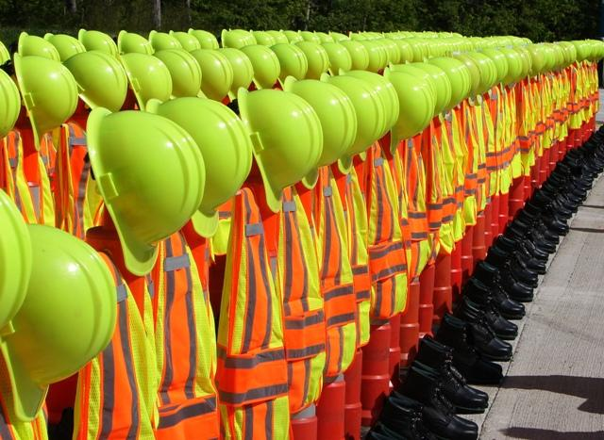
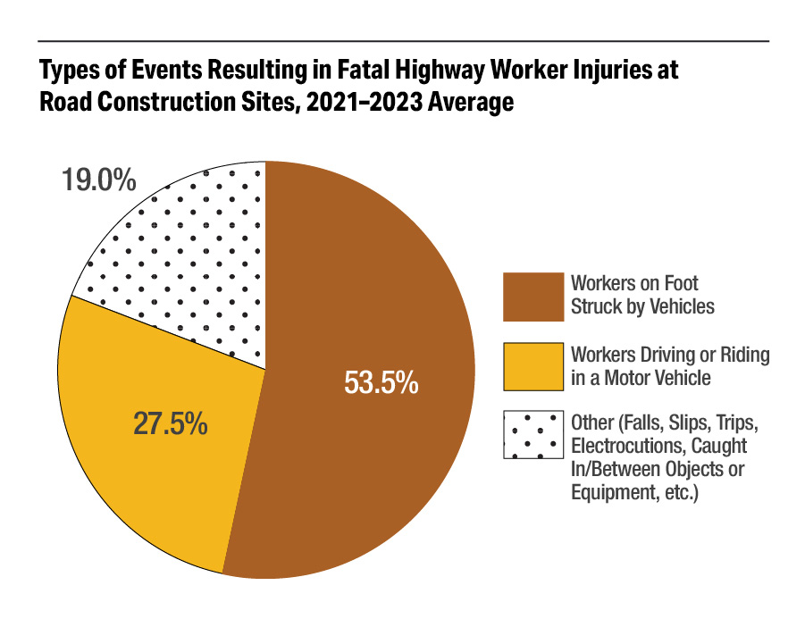
INDUSTRY FACTS
Q2 2026 – Work Zone Protection
OSHA ELECTRICAL TRANSMISSION & DISTRIBUTION PARTNERSHIP
Notes:
Data from 2021 to 2023 indicate that more than 80 percent of all worker fatalities at road construction sites are the result of a) motor vehicle crashes where the worker is the driver or a passenger (28 percent), or b) a worker on foot who is struck by a motor vehicle (54 percent). Other types of events, such as falls/slips/trips, struck by objects or equipment, caught in/between objects or equipment, and electrocutions were responsible for the remaining 19 percent of highway worker fatalities at road construction sites. (Source: BLS CFOI)

Slide 6
WORKZONE DEFINED
The Federal Highway Administration defines a work zone as:
An area of a traffic-way with highway construction, maintenance, or utility-work activities
A work zone is typically marked by signs, channeling devices, barriers, pavement markings, and/or work vehicles
Q2 2026 – Work Zone Protection
OSHA ELECTRICAL TRANSMISSION & DISTRIBUTION PARTNERSHIP
Notes:
Explain that it may be surprising to hear that there are currently no nationally recognized definitions of work zones. Almost every state has its own definition. Work planners such as managers, supervisors, foremen, and leads, should be aware of the safety impact of work zones to understand the full impact of working on or near a roadway. The Federal Highway Administration (FHWA) is currently involved in an effort to develop a standardized definition of work zone. Ultimately, this effort will allow researchers the opportunity to assess the current state of work-zone safety and to recommend possible countermeasures to eliminate or mitigate safety problems.

Slide 7
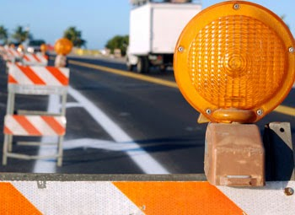
TRAFFIC CONTROL PLAN
Part of job planning
Should be prepared by persons which are:
    Knowledgeable about the principles of temporary traffic control
    Understand the work activities to be performed
Q2 2026 – Work Zone Protection
OSHA ELECTRICAL TRANSMISSION & DISTRIBUTION PARTNERSHIP
7
Notes:
Explain that Traffic Control Plans (TCP's) play a vital role in providing continuity of safe and efficient traffic flow. To a certain extent, interruptions in normal flow are necessary for temporary traffic control operations. A traffic control plan, in detail appropriate to the complexity of the work project or incident, must be prepared and understood by all responsible parties before work starts. Any changes in the plan must be approved by a competent person trained in safe traffic control practices.

Slide 8

FACTORS
These factors can affect worker safety:
  Changing conditions
  Moving equipment
  Vehicles in the activity area
  Workers on foot
  Workers not visible
  Distracted/impaired drivers
  Short duration projects
  Barriers possibly not feasible
Q2 2026 – Work Zone Protection
OSHA ELECTRICAL TRANSMISSION & DISTRIBUTION PARTNERSHIP
8
Notes:
Explain that because of the type, location and duration of work, and roadway/traffic characteristics, work zones can be very diverse. Applicable standards and procedures may vary depending on several factors.

Slide 9
KEY POINTS– SESSION ONE
1. Hazards caused by distractions (and other issues) make it necessary to put in place the proper measures to control the risks encountered in work zones.
  True
  False
According to the Bureau of Labor Statistics (BLS), approximately 54% of the workers killed in construction zones from 2021 to 2023 were “Workers of Foot Struck by Vehicles”?
  True
  b. False
The public highway system can be one of the most dangerous work environments in the United States.
  True
  False
Q2 2026 – Work Zone Protection
OSHA ELECTRICAL TRANSMISSION & DISTRIBUTION PARTNERSHIP
9
Notes:
The presenter should have touched on the following items when Explaining session one:
Hazards caused by distractions (and other issues) make it necessary to put in place the proper measures to control the risks encountered in work zones.
a. True
b. False
According to the Bureau of Labor Statistics (BLS), approximately 54% of the workers killed in construction zones from 2021 to 2023 were “Workers of Foot Struck by Vehicles”?
a. True
b. False
The public highway system can be one of the most dangerous work environments in the United States.
a. True
b. False

Slide 10
TRAFFIC CONTROL
Q2 2026 – Work Zone Protection
OSHA ELECTRICAL TRANSMISSION & DISTRIBUTION PARTNERSHIP
10
Notes:
Explain that the following section will discuss traffic control. The information in this section is based on the Manual for Uniform Traffic Control Devices known as the MUTCD. The Manual is a document issued by the Federal Highway Administration (FHWA) of the United States Department of Transportation (USDOT) to specify the standards by which traffic signs, road surface markings, and signals are designed, installed, and used. The MUTCD is generally considered the minimum requirement for traffic control and devices.

Slide 11
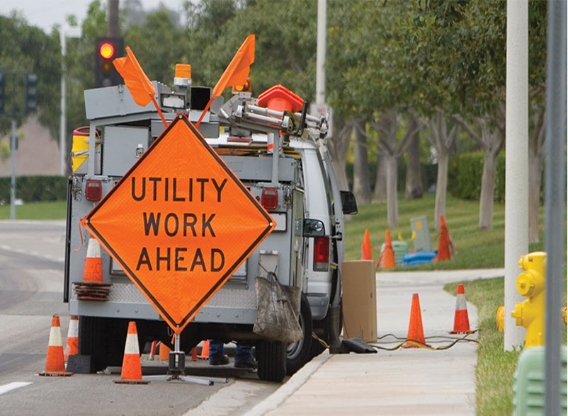

THE PURPOSE
Warn
Inform
Guide
Regulate
Q2 2026 – Work Zone Protection
OSHA ELECTRICAL TRANSMISSION & DISTRIBUTION PARTNERSHIP
11
Notes:
Explain that the four main purposes of traffic control is to warn the traveling public of a potential work zone ahead, to inform what type of work zone they may encounter, to guide them safely through the work zone, and lastly to regulate the traffic so worker and public exposure is mitigated.

Slide 12
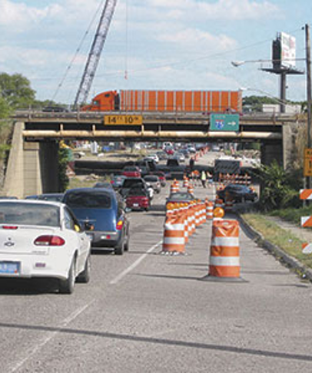
EFFECTIVENESS
  There are many factors that may hinder effectiveness:
    Hills
    Curves
    Intersections
    Shade
    Color Contrast
    Driveways
Q2 2026 – Work Zone Protection
OSHA ELECTRICAL TRANSMISSION & DISTRIBUTION PARTNERSHIP
12
Notes:
Explain that there are numerous factors that may influence the effectiveness of traffic control. Hills, curves, intersections, shade, color contrast, and driveways just to name a few. Add to that, distractions caused by driver behavior, other operations in the area, and possible bad weather and there is a recipe for disaster.

Slide 13
SEND A CLEAR MESSAGE
Q2 2026 – Work Zone Protection
OSHA ELECTRICAL TRANSMISSION & DISTRIBUTION PARTNERSHIP
13
Notes:
Explain that damaged, soiled, or illegible signs will not provide the necessary protection. Also, use the correct sign for the application. The sign shown in the picture indicates that there may be a flagger ahead. However, there was no flagger or need to stop. A “Utility Work Ahead” sign would be more appropriate. Signs used in temporary traffic control zones are moved frequently, loaded and unloaded from trucks, and in general receive much harsher treatment than permanent signs. For this reason, particular attention must be given to maintaining signs properly for cleanliness, visibility, and correct positioning.

Slide 14
WARNING SIGN PLACEMENT
Road Type | Distance Between Signs
 | A | B | C
Urban Low Speed | 100’ | 100’ | 100’
Urban High Speeds | 350’ | 350’ | 350’
Rural | 500’ | 500’ | 500’
Expressway-Freeway | 1000’ | 1600’ | 2640’
Certain work zones may require the use of only 1 advance warning sign
Other zones may require the use of multiple advance warning signs
Q2 2026 – Work Zone Protection
OSHA ELECTRICAL TRANSMISSION & DISTRIBUTION PARTNERSHIP
14
Notes:
Explain that this chart is from the MUTCD. On urban streets, the effective placement of the first warning sign in feet should range from 4 to 8 times the speed limit in mph, with the high end of the range being used when speeds are relatively high. When a single advance warning sign is used (in cases such as low-speed residential streets), the advance warning area can be as short as 100 feet. When two or more advance warning signs are used on higher-speed streets, such as major arterials, the advance warning area should extend a greater distance. The distances contained in Table 6C-1 are approximate, are intended for guidance purposes only, and should be applied with engineering judgment. These distances should be adjusted for field conditions, if necessary, by increasing or decreasing the recommended distances.

Slide 15


TYPICAL PLACEMENT
Distance “A” is based on speed & work location
Work Zone
A
Q2 2026 – Work Zone Protection
OSHA ELECTRICAL TRANSMISSION & DISTRIBUTION PARTNERSHIP
15
Notes:
Explain that depending on traffic speed and other work zone requirements the spacing between signs and the work zone may vary. The table shown on the previous slide is from the MUTCD.

Slide 16

WARNING SIGN PLACEMENT
Sign “C” is first sign the approaching motorist will encounter
Work Zone
C
B
A
Q2 2026 – Work Zone Protection
OSHA ELECTRICAL TRANSMISSION & DISTRIBUTION PARTNERSHIP
16
Notes:
Explain that this slide shows the order of the signs from a driver’s point of view. The driver will encounter sign “C” first as he or she approaches the work zone.

Slide 17
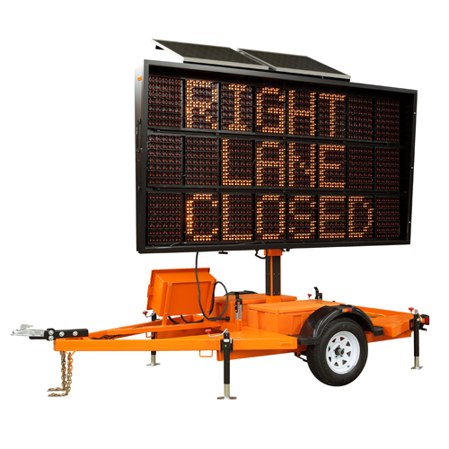
PORTABLE CHANGEABLE MESSAGE SIGNS
Visible up to ½ mile away
Visible from all lanes
Read entire message twice at the posted speed
Adjust under low-light conditions
Q2 2026 – Work Zone Protection
OSHA ELECTRICAL TRANSMISSION & DISTRIBUTION PARTNERSHIP
17
Notes:
Explain that Portable Changeable Message Signs (PCMS) are traffic control devices with the flexibility to display a variety of messages to fit the needs of road and street authorities. Each message consists of one or more displays. Portable Changeable Message signs are used most frequently on high density, urban freeways, but have applications on all types of highways where highway alignment, traffic routing problems or other pertinent conditions require advance warning and information. The signs should be visible from 1/2 mile under ideal day and night conditions. Each sign message should be legible from all lanes, from the sign up to a minimum of 650 feet. In the field, the PCMS should be sited and aligned to optimize driver performance. The message panel should have adjustable flash rates, so that the entire message can be read at least twice at the posted speed, the off-peak 85th percentile speed prior to work starting, or the anticipated operating speed. Under low light level conditions, the sign shall automatically adjust its light source so as to meet the legibility requirements and not impair the drivers, vision.

Slide 18
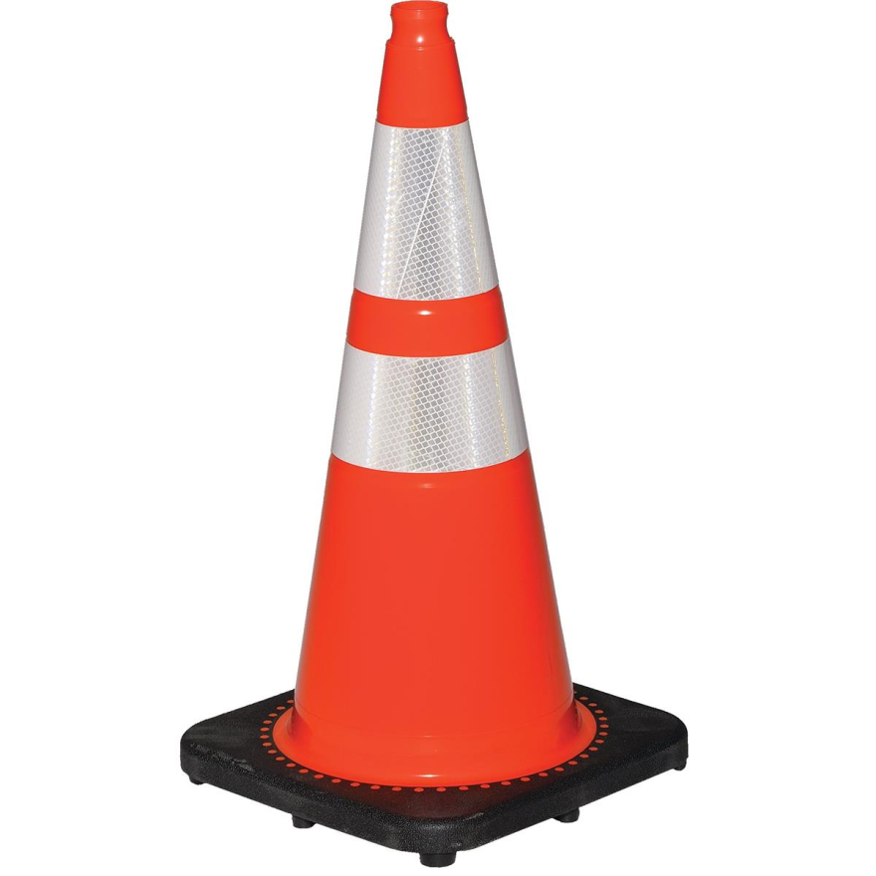
CONES
Not less than 18” in height
Must be at least 28” to 36” for freeway
When retro-reflective material is used:
Must have a white band 3” from top & 6” wide
Then a 4” band 2” below the 6” band
Q2 2026 – Work Zone Protection
OSHA ELECTRICAL TRANSMISSION & DISTRIBUTION PARTNERSHIP
18
Notes:
Explain that this requirement is also from the MUTCD. 36” is recommended.

Slide 19
ADVANCE WARNING SIGNS
SHORT DURATION
48” For High Speed
36” For moderate traffic loads and speeds
24” For rural low speed
Q2 2026 – Work Zone Protection
OSHA ELECTRICAL TRANSMISSION & DISTRIBUTION PARTNERSHIP
19
Notes:
Explain that where any part of the roadway is obstructed or closed, advance-warning signs are required to alert traffic well in advance of these obstructions or restrictions. These signs may be used singly or in combination. Because of their importance, they shall have a standard size of 48 inches square and shall be the standard diamond shape for warning signs. Signs larger than 48 inches square may be used for additional emphasis of the temporary traffic control zone. Where speeds and volumes are moderately low, a minimum size of 36 inches square may be used for advance warning signs, if they have a minimum letter size of 5 inches. On secondary roads or city streets where speeds are very low, signs smaller than the standard size, but not less than 24 inches square, may be used for warning signs having short word messages or clearly understood symbols. Where distances are not shown on warning signs as part of the message, a separate panel with the distance legend may be mounted immediately below the sign on the same support.

Slide 20


ADVANCE WARNING SIGNS
Should be mounted on the right side of the road
    Should be placed on both sides of divided highways
Q2 2026 – Work Zone Protection
OSHA ELECTRICAL TRANSMISSION & DISTRIBUTION PARTNERSHIP
20
Notes:
*Signs shown are for illustration purposes only and not intended to indicate what sign to use.
Explain that on divided highways, the MUTCD requires that warning signs be placed so that both travel lanes see the signs.

Slide 21
MERGING TAPER FORMULA
L = Taper in length of feet
W = Width of offset in feet
S = Speed*
*Note: May not be posted speed!
L=W(S)² 40 MPH or Less
60
L=W(S) 45 MPH or Greater
Taper Length
Offset
Work Zone
Q2 2026 – Work Zone Protection
OSHA ELECTRICAL TRANSMISSION & DISTRIBUTION PARTNERSHIP
21
Notes:
Explain that when redirection of the driver’s path is required, traffic is channelized from the normal path to a new path. The traffic control should try to inhibit the driver’s speed as little as possible. In addition, traffic movement should be inhibited as little as possible. Frequent and abrupt changes in geometries should be avoided. Roadway occupancy and work completion should be minimized to reduce exposure.

Slide 22
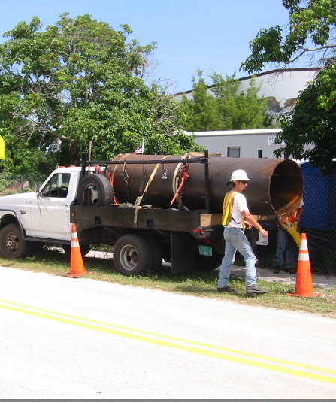
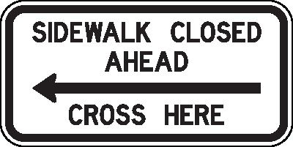
PEDESTRIANS
A wide range of pedestrians might be affected by our work zones
Pedestrians need a clearly delineated and usable travel path
Q2 2026 – Work Zone Protection
OSHA ELECTRICAL TRANSMISSION & DISTRIBUTION PARTNERSHIP
22
Notes:
Explain that if our work zone activity affects pedestrian walkways, then we must provide them safe access through the work zone or route them to a safe area. A wide range of pedestrians might be affected by traffic temporary work zones, including the young, elderly, and people with disabilities such as hearing, visual, or mobility. These pedestrians need a clearly delineated and usable travel path.
The following three items should be considered when planning for pedestrians in work zones:
Pedestrians should not be led into conflicts with vehicles, equipment, and operations.
Pedestrians should not be led into conflicts with vehicles moving through or around the worksite.
Pedestrians should be provided with a convenient and accessible path that replicates as nearly as practical the most desirable characteristics of the existing sidewalk(s) or footpath(s).

Slide 23
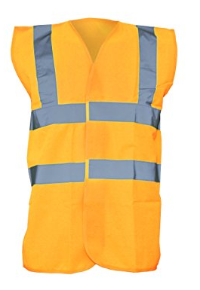
RETRO-REFLECTIVE CLOTHING
Drivers need to be able to see the worker
  Many states have different requirements as to the color of vest and hard hats
  Before performing work along any roadway consult your Supervisor or Safety Representative for clarification
Q2 2026 – Work Zone Protection
OSHA ELECTRICAL TRANSMISSION & DISTRIBUTION PARTNERSHIP
23
Notes:
Explain that retro-reflective clothing will shine light back toward the source. States have different requirements as to the color of vest and hard hats required.

Slide 24
KEY POINTS – SESSION TWO
There are many factors that can hinder the effectiveness of traffic control.
  True
  False
For high-speed roadways, warning signs must be a minimum size of _______ inches.
  24
  36
  48
Road cones must be no shorter than _______ inches.
  16
  18
  24
Q2 2026 – Work Zone Protection
OSHA ELECTRICAL TRANSMISSION & DISTRIBUTION PARTNERSHIP
24
Notes:
The presenter should have touched on the following items when explaining session two:
There are many factors that can hinder the effectiveness of traffic control
a. True
b. False
2. For high-speed roadways, warning signs must be a minimum size of _______ inches.
a. 24
b. 36
c. 48
3. Road cones must be no shorter than _______ inches.
a. 16
b. 18
c. 24

Slide 25
FLAGGING
Q2 2026 – Work Zone Protection
OSHA ELECTRICAL TRANSMISSION & DISTRIBUTION PARTNERSHIP
25
Notes:
Explain that the following section will discuss traffic control. The information in this section is based on the Manual for Uniform Traffic Control Devices known as the MUTCD. The Manual is a document issued by the Federal Highway Administration (FHWA) of the United States Department of Transportation (USDOT) to specify the standards by which traffic signs, road surface markings, and signals are designed, installed, and used. The MUTCD is generally considered the minimum requirement for traffic control and devices.

Slide 26

FLAGGING OPERATIONS
Each flagger should be trained
  Techniques necessary to safely recognize the hazards
  Have certain abilities
Q2 2026 – Work Zone Protection
OSHA ELECTRICAL TRANSMISSION & DISTRIBUTION PARTNERSHIP
26
Notes:
Explain that each flagger should be trained in the techniques necessary to recognize the hazards associated with performing flagger operations. Flaggers should only use “Stop/ Slow” paddles to flag traffic and flags should only be used in emergency situations. Because flaggers are responsible for public safety and make the greatest number of contacts with the public of all highway workers, they should be trained in safe traffic control practices and public contact techniques.
Flaggers should be able to satisfactorily demonstrate the following abilities:
Ability to receive and communicate specific instructions clearly, firmly, and courteously
Ability to move and maneuver quickly in order to avoid danger from errant vehicles
Ability to control signaling devices (such as paddles and flags) in order to provide clear and positive guidance to drivers approaching a TTC zone in frequently changing situations
Ability to understand and apply safe traffic control practices, sometimes in stressful or emergency situations
Ability to recognize dangerous traffic situations and warn workers in sufficient time to avoid injury

Slide 27
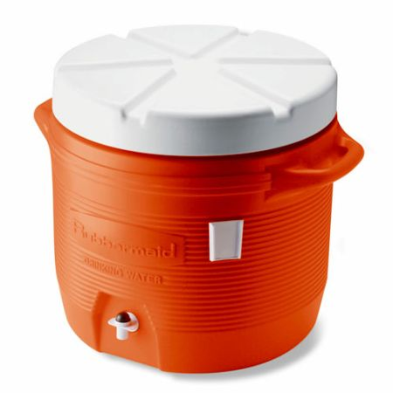
FLAGGER OPERATIONS
Wear reflective vest
Use Stop/Slow paddles
Be physically fit
Be courteous and conscientious
Provided drinking water
Q2 2026 – Work Zone Protection
OSHA ELECTRICAL TRANSMISSION & DISTRIBUTION PARTNERSHIP
27
Notes:
Explain that flaggers should always wear retro reflective vest. For daytime and nighttime activity, flaggers shall wear high-visibility safety apparel that meets the Performance Class 2 or 3 requirements of the ANSI/ISEA 107–2004 publication entitled "American National Standard for High-Visibility Apparel and Headwear" and labeled as meeting the ANSI 107-2004 standard performance for Class 2 or 3 risk exposure. The apparel background (outer) material color shall be fluorescent orange-red, fluorescent yellow-green, or a combination of the two as defined in the ANSI standard. The retroreflective material shall be orange, yellow, white, silver, yellow-green, or a fluorescent version of these colors, and shall be visible at a minimum distance of 1,000 feet. The retroreflective safety apparel shall be designed to identify the wearer as a person.
For nighttime activity, high-visibility safety apparel that meets the Performance Class 3 requirements of the ANSI/ISEA 107–2004 publication entitled "American National Standard for High-Visibility Apparel and Headwear" and labeled as meeting the ANSI 107-2004 standard performance for Class 3 risk exposure should be considered for flagger wear.
Flaggers must be physically fit to perform the necessary duties and flaggers must be courteous and conscientious. Also, explain that flag persons must be provided with clean drinking water at their flagging station (water cooler) when the flag person is to be at the flagger station for a period exceeding 30 minutes.

Slide 28
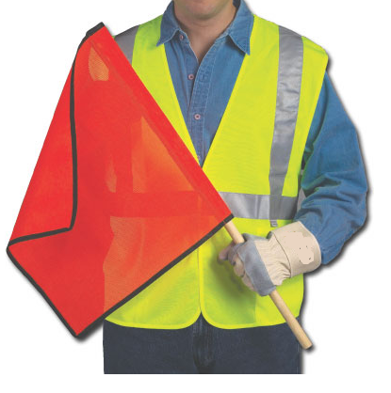
REQUIREMENTS
Signaling directions by flag persons
  Must conform to the MUTCD or State requirements
  Flags are used to direct traffic only during an emergency
Q2 2026 – Work Zone Protection
OSHA ELECTRICAL TRANSMISSION & DISTRIBUTION PARTNERSHIP
28
Notes:
Explain that signaling directions by flag persons must conform to the directions described in Chapter 6E, “Flagger Control”, of the Manual on Uniform Traffic Control Devices (MUTCD) or state requirements. One must ensure that flags are used to direct traffic only during an emergency. Also, explain that flag persons must use a legible, 18-inch STOP/SLOW paddle mounted on a 7-ft PVC pole for hand signaling. Red lights may be used in periods of darkness and a flagger’s station must be illuminated to the point that the flag person is visible to oncoming traffic when the flagger is working in darkness. Ensure that flagger stations are set up far enough ahead of the workspace, so that approaching traffic has sufficient distance to stop before entering the work zone. Always position flag persons on the shoulder of the road and adjacent to the traffic being controlled or place them in a barricaded area.

Slide 29
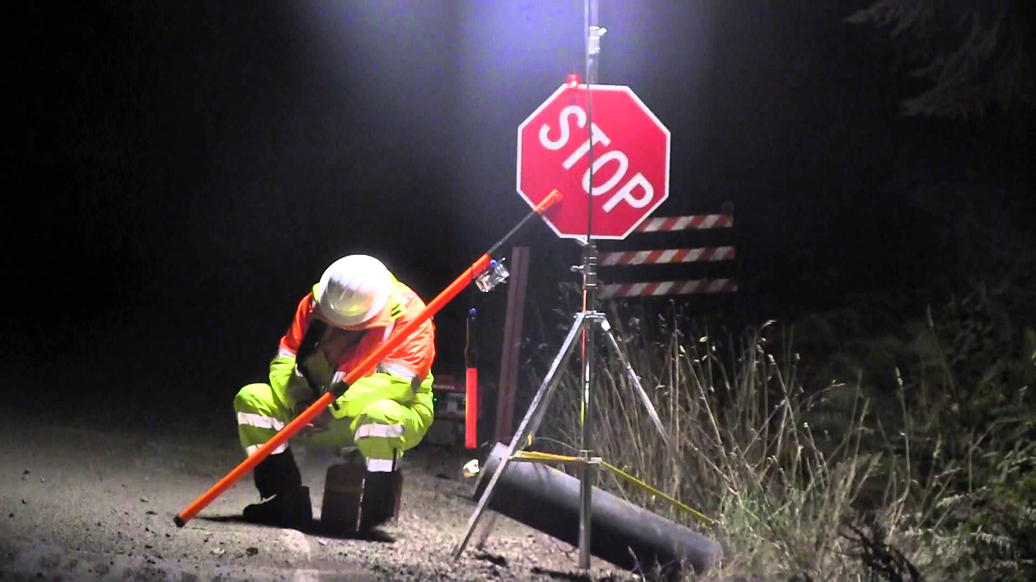
GIVE THEM
A BREAK
Q2 2026 – Work Zone Protection
OSHA ELECTRICAL TRANSMISSION & DISTRIBUTION PARTNERSHIP
29
Notes:
Instruct flaggers to stand in an open area, not under trees, in curves, over the crest of the hill or directly behind parked vehicles to enhance their visibility to oncoming motorists. Ensure that flag persons do not leave their flagging stations unless relieved by another trained flag person or in the event of an emergency. Also, explain that flag persons with a horn, whistle, or other sounding device are stationed far enough ahead of the workforce to warn workers of approaching dangers, such as out-of-control vehicles. Importantly, give the flag person a break. Relive them occasionally.

Slide 30
REQUIREMENTS
Except in an emergency, only trained workers may perform flagging operations.
  True
  False
Flags may only be used to direct traffic in an emergency situation.
  True
  False
Flaggers should stand alone and not allow people or other workers to gather around their flagger station.
  True
  False
Flaggers must be trained in techniques necessary to recognize hazards associated with performing flagger operations.
  True
  False
Q2 2026 – Work Zone Protection
OSHA ELECTRICAL TRANSMISSION & DISTRIBUTION PARTNERSHIP
30
Notes:
The presenter should have touched on the following items when explaining session two:
Except in an emergency, only trained workers may perform flagging operations.
True
False
Flags may only be used to direct traffic in an emergency situation.
True
False
Flaggers should stand alone and not allow people or other workers to gather around their flagger station.
True
False
Flaggers must be trained in techniques necessary to recognize hazards associated with performing flagger operations.
True
False

Slide 31

Thank You!
Notes:
Ask for questions. Once complete thank the attendees and close the session.

